Slide 1


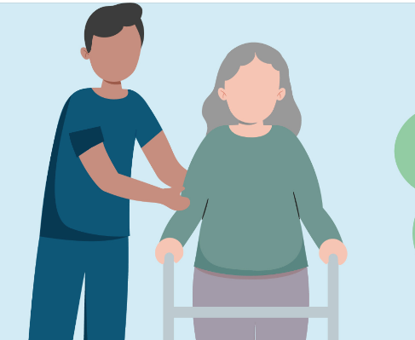
Haiku of Aged Care:
IDC
Management
IPC
Perspectives
Emma Dowler, NPc
Dr Liza Lau, Uro-Geriatrician

Slide 2

  ACIPC acknowledges Aboriginal and Torres Strait Island people as the traditional owners of country throughout Australia and ngā iwi Māori as the people of the land of Aotearoa and respects their continuing connection to culture, land, waterways, community, and family.

Slide 3

Learning Objectives
Identify appropriate use of IDC
Apply IPC principles to everyday catheter care
Improve troubleshooting and decision-making in residential home care
Notes:
LIZA: Why this matters:
High prevalence of IDC use in aged care
Catheter-associated UTI (CAUTI) = one of the most common healthcare-associated infections

Slide 4
When is an IDC appropriate?
Indications | Alternatives
Acute or chronic urinary retention, hypotonic/atonic or acontractile bladder Measuring and monitoring urine output Pre- and post- surgery Bladder outlet obstruction Management of incontinence (e.g in the presence of open sacral wounds or with some palliative care patients) | Toileting regimes Condom drainage Pure-wick Continence pads Intermittent self catheterisation Suprapubic catheterisation

Slide 5
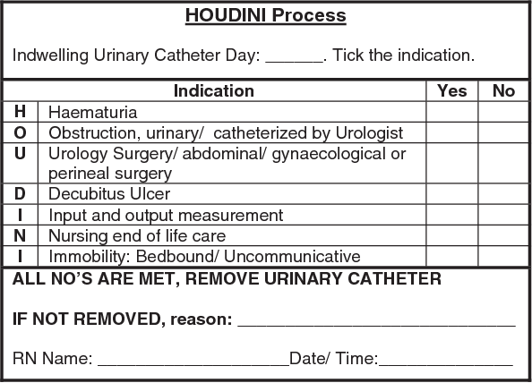
HOUDINI: Every catheter has a reason
Adams D, Bucior H, Day G, Rimmer J-A. HOUDINI: make that urinary catheter disappear – nurse-led protocol. Journal of Infection Prevention. 2012;13(2):44-46. doi:10.1177/1757177412436818

Slide 6
Catheter associated issues
Adams D, Bucior H, Day G, Rimmer J-A. HOUDINI: make that urinary catheter disappear – nurse-led protocol. Journal of Infection Prevention. 2012;13(2):44-46. doi:10.1177/1757177412436818

Slide 7
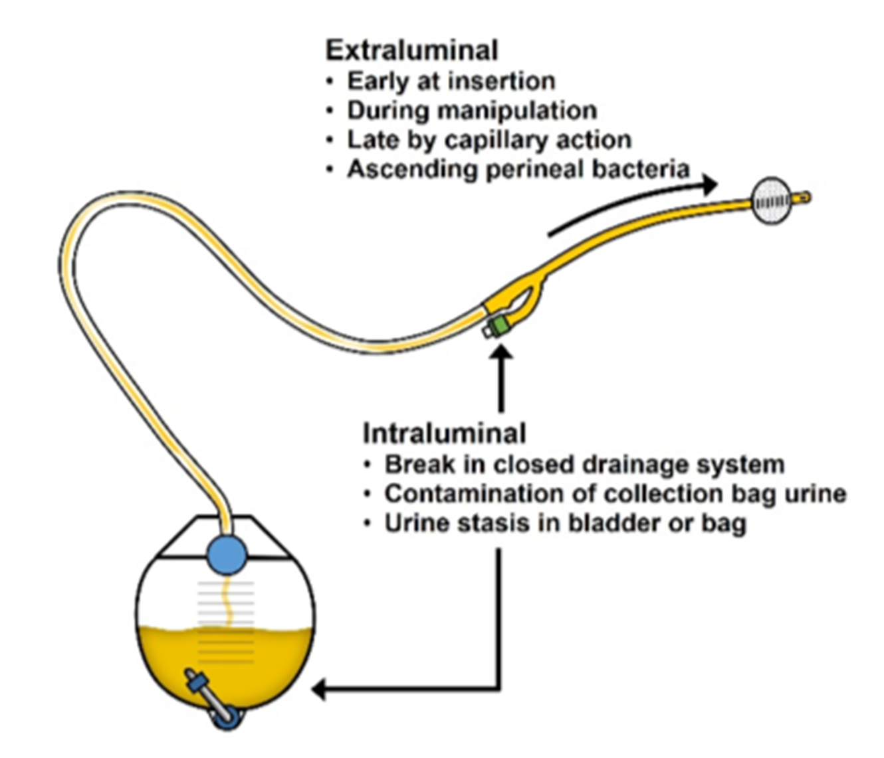
CAUTI risk 3 - 7% per day
70% of CAUTIs
30% of CAUTIs

Slide 8
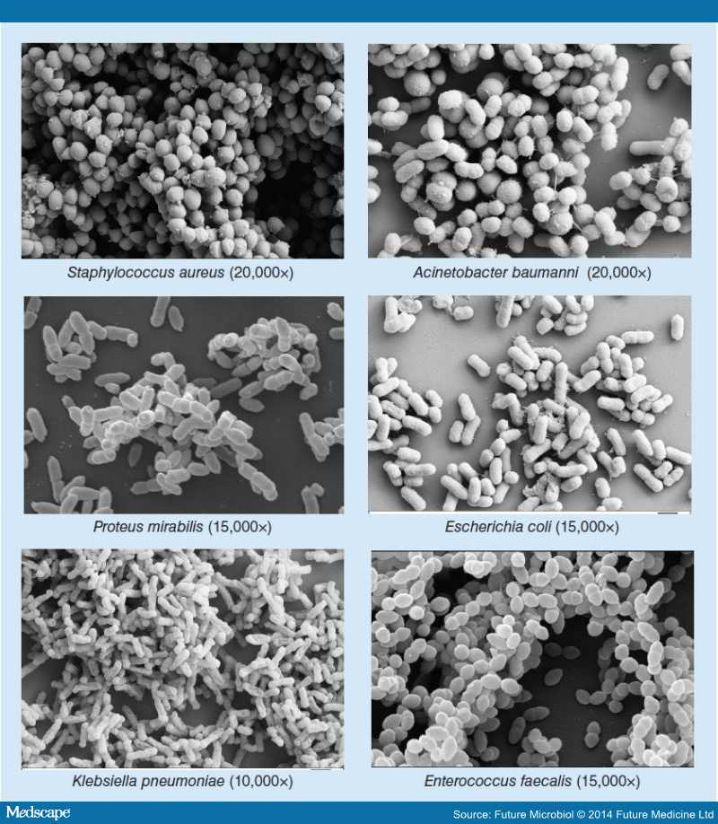
Bacteruria

Slide 9

Golden Rules
Hand Hygiene
Aseptic Technique
Closed System
Bag below bladder
Unobstructed flow

Slide 10
Catheter Insertion Checklist
Catheter pack
Cleansing: one sachet 0.9% sodium chloride
Lubricant: 2% Lidocaine gel in a syringe applicator
Water: Sterile water ampoule 10mL
Syringe 10mL
Sterile drainage: leg bag / catheter valve.
Pad / towel for bed protection.
Specimen jar if CSU required.
Sterile gloves (double gloving is optional)
Plastic gown
Waste bin
2 x catheters (keep a spare)
Good lighting.
Anchoring device, i.e.: cathstrap, flexitrak
Hand sanitizer
Do NOT use N/Saline for balloon!

Slide 11
Catheter Material Type & Dwell Time
Catheter dwell time = optimal time frame for which the catheter remains patent without complications.
For most patients this is about 6 weeks (CONSA, 2021)
Catheter should not be left in longer than manufacturers recommendation (CONSA, 2021)
CATHETER MATERIAL | DWELL TIME
100% Silicone Latex Hydrogel coated latex | Long term – 6 weeks, maximum 12 weeks
Silicone coated latex Silicone coated elastomer | Short term – up to 7 days

Slide 12
Additional Catheter Changes
Change when there is infection or obstruction
Adjust schedule in anticipations of obstruction
Recurrent blockages may require medical workup

Slide 13
Catheter Size Selection
Rule of thumb: The smallest diameter that provides adequate drainage
Parameter | Recommendations
Size | Females: 12 FG (white), 14 FG (green) Males: 16 FG (orange), 18 FG (red) Haematuria: 22 FG (purple), 24FG (blue) SPC: 16 FG and above
Length | 40-43 cm (Female length 26cms if preferred)
Balloon size | 10mLs – check manufacturer’s instructions
Channels | 2 way – routine drainage 3 way – bladder irrigation

Slide 14
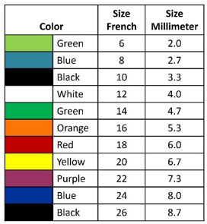
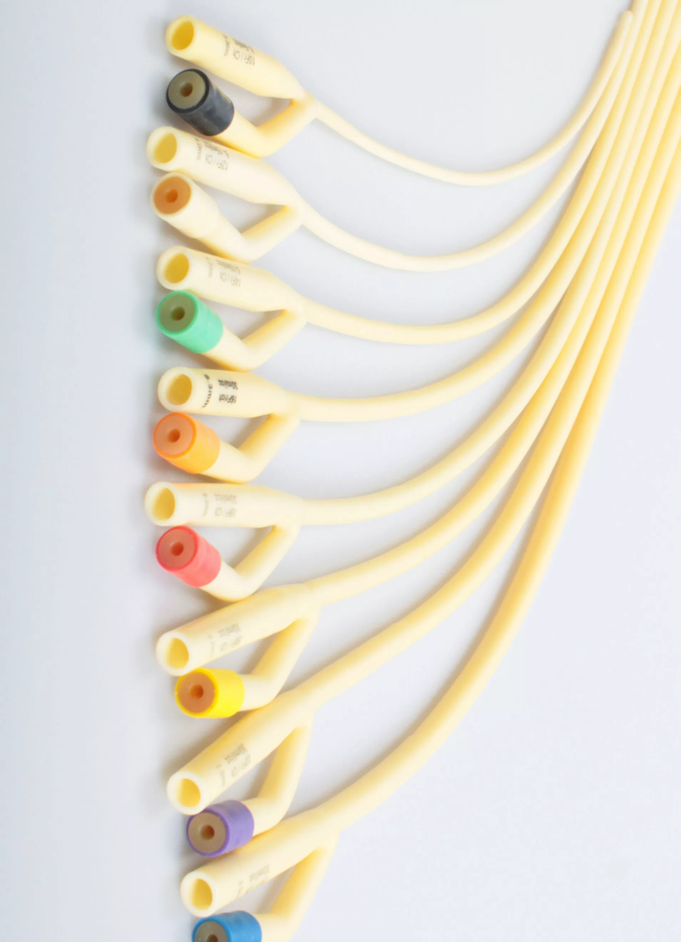
Sizes – how do you choose?

Slide 15

Meatal Cleansing

Slide 16
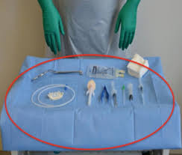
Sterile Aseptic non-touch technique

Slide 17

Documentation
Indication
Date of insertion
Size and material
Volume of balloon fill
Urine volume drained out
Type of bag used
Fixation device
Date for next change
And ORDER SUPPLIES!!

Slide 18
Day to Day IDC Care in Aged Care
Hygiene & Routine Care | Bag Management | Positioning
• Daily cleaning of meatal area • No routine antiseptics • Secure catheter to prevent traction • SPC rotation | • Leg bag • Piggybacking the night bag • Wash and dry night bag daily • Avoid disconnection unless necessary • Empty: • Using clean technique • Avoid contact with outlet tap • Replace bags: • Typically weekly (or per local protocol) | • Bag always below bladder level • Avoid floor contact • Prevent kinking or loops

Slide 19

Trouble Shooting Common Problems

Slide 20
Blocked Catheter
First Check – kinks, bag position
Look for the reason – urine colour, sediment, blood clots, signs of infection?
Fluid intake ​​- how much has the resident had to drink?
Size of catheter – is it right or is it too small?
Type of catheter ​- consider a silicone catheter with bigger internal lumen
Frequency of changes​​

Slide 21
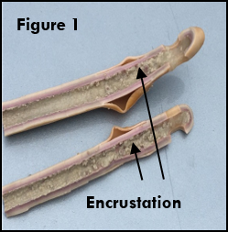
Catheter encrustation
Ideal Urine pH 5 – 6
Bacteria producing urease enzymes
Eg. Proteus, Morganella, Klebsiella, Staph aureus, Providentia
Urease splits urea into ammonia
More alkaline pH > 7.5 +
Precipitate salt crystals (Mg / Ca)
Damage urothelium -> more infection

Slide 22
Bypassing / Leaking
Cause of bypassing – blockage, drainage issue, other
Pattern of bypassing​​
Rule out infection​​
Optimise drainage
Constipation​​
Review medications
Consider treating bladder spasms (detrusor overactivity)

Slide 23
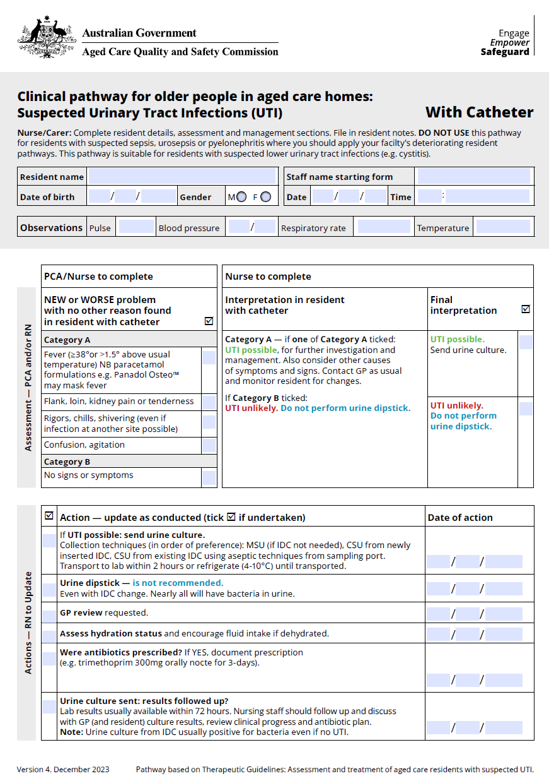

Clinical pathway for older people in aged care homes:
Suspected UTI with Catheter
https://www.agedcarequality.gov.au/resource-library/clinical-pathways-suspected-utis-forms

Slide 24
Recognising Infection: CAUTI
Fever > 38 or >1.5 above usual temp
Flank, loin, kidney pain or tenderness
Rigors, chills, shivering
Bypassing or bladder spasms
Delirium, confusion, agitation
?Haematuria
?Blocked catheter

Slide 25

Case Study

Slide 26

Emerging Catheter technologies
Double balloons to cushion drain holes (Duette)
MiniSPC Button (needs monthly exchange)
Micro-hole Zone Technology (Luja)
Balloon auto deflation when pulled (Egress)
InFlow (Vesiflo) pump, empties by remote control
UroShield ultrasound waves prevent biofilm and blockages
https://www.urotoday.com/conference-highlights/aua-2026/aua-2026-lower-urinary-tract-conditions/169101-aua-2026-state-of-the-art-lecture-new-developments-in-urinary-catheters.html

Slide 27

Take Home Messages
• Avoid unnecessary catheterisation
• Maintain a closed system
• Position and hygiene matter
• Troubleshoot systematically before escalating
• Treat the patient—not just the urine

Slide 28
Take Home Messages
• Avoid unnecessary catheterisation
• Maintain a closed system
• Position and hygiene matter
• Troubleshoot systematically before escalating
• Treat the patient—not just the urine
Notes:
Liza

