Slide 1

Reusable Sterile Gowns and Drapes
Barriers, solutions, and a sustainable future
November 2025
Identifier first line
Second line
Dr Ben Dunne
Thoracic Surgeon RMH/PMCC, Clinical Sustainability Lead
Senior Fellow, Climate, Health and Sustainability, Uni Melb
Chair Environmentally Sustainable Surgery Network, Uni Melb
Chair, RACS Environmentally Sustainable Surgical Practice Working Party
Ben.Dunne@unimelb.edu.au
Notes:
Good afternoon everyone
I am Ben
Introduce using titles

Slide 2
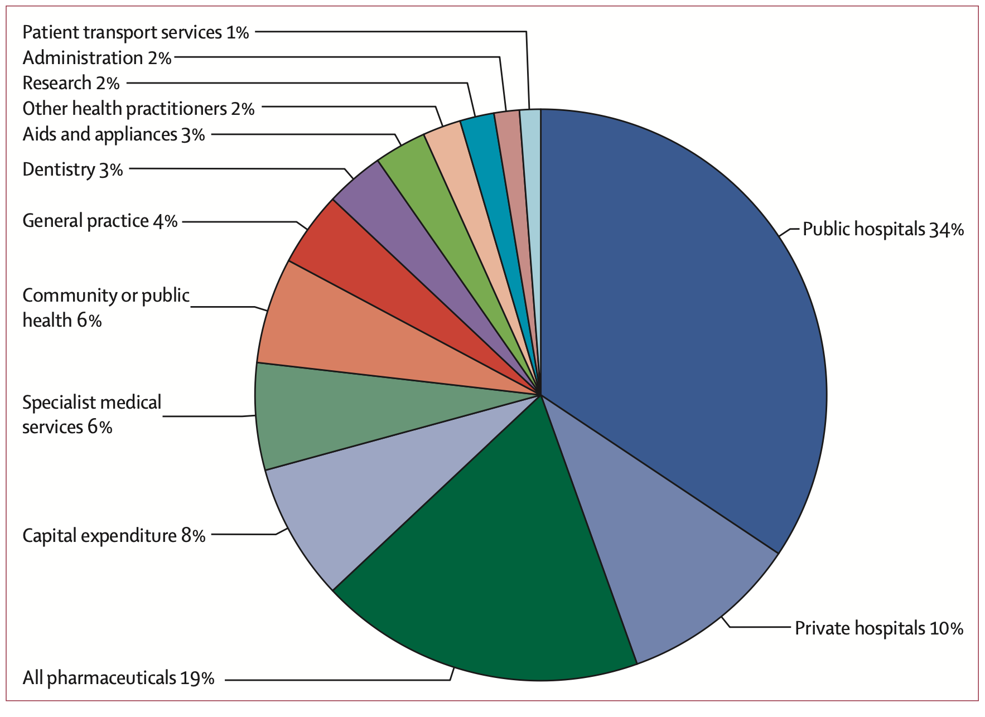
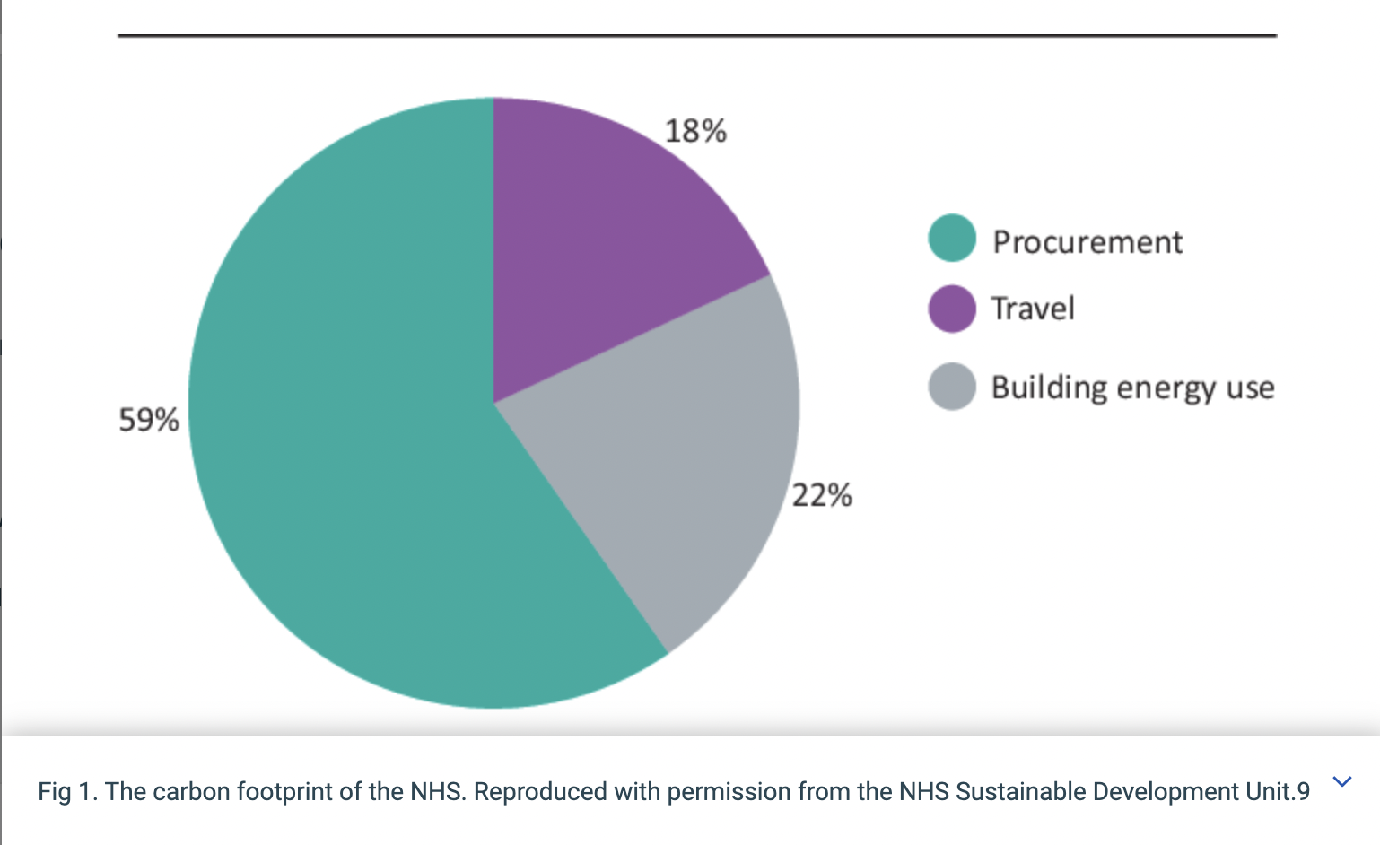
Healthcare carbon footprint
Malik A., Lenzen M., McAlister S., McGain F. The carbon footprint of Australian health care Lancet Planetary Health 2;1;27-35
National Health Service ‘Delivering a Nero Zero National Health Service’ 12 Feb 2023 https://www.england.nhs.uk/greenernhs/wp-content/uploads/sites/51/2020/10/delivering-a-net-zero-national-health-service.pdf
Notes:
Im sure most of you have seen these two images previously
The first demonstrates that 45% of Australia’s healthcare carbon footprint comes from hospitals
Framed a different way, based on NHS data, about 60% of healthcare’s carbon footprint is from procurement – meaning all the stuff we use to deliver care to our patients
SO the stuff we use in hospitals is an obvious target for us to tackle

Slide 3
Why focus on surgical waste?
Surgery is carbon intense!
Approx 30% of hospital waste is generated in theatres/procedural areas and theatres are very energy intense [1]
Carbon footprint of procedure
70% is due to disposable equipment, gowns, drapes [2]
Move away from reusables
Not evidence based
No strong infection control evidence
Industry driven
Short term cost shifting and convenience for healthcare organisations
Kerstin Wyssusek, Maggie Keys and André van Zundert. Operating room greening initiatives – the old, the new, and the way forward: A narrative review. Waste Management & Research 2019, Vol. 37(1) 3–19
Chantelle Rizan, Robert Lillywhite, Malcom Reed and Mahmood F Bhutta. The carbon footprint of products used in five common surgical operations: identifying contributing products and processes. Journal of the Royal Society of Medicine; 0(0) 1–15 DOI: 10.1177/01410768231166135
Notes:
So why surgical waste in particular
Surgery is very carbon intense
We are responsible for a large proportion of a hospitals’ waste and use a significant amount of energy
The bulk of the carbon footprint from an operation is from the disposable equipment gowns and drapes we use
And the move away from reusable versions of these items has not been based on strong infection prevention evidence, it has been industry driven along with short term cost shifting and convenience for healthcare organisations.

Slide 4

Sterile Surgical Gowns and Drapes
Notes:
This is a more visually striking depiction of the single use waste from surgery
This dutch artist used all the single use equipment from her breast cancer procedures to create an art installment and it really conveys the scale of waste generation with procedures

Slide 5
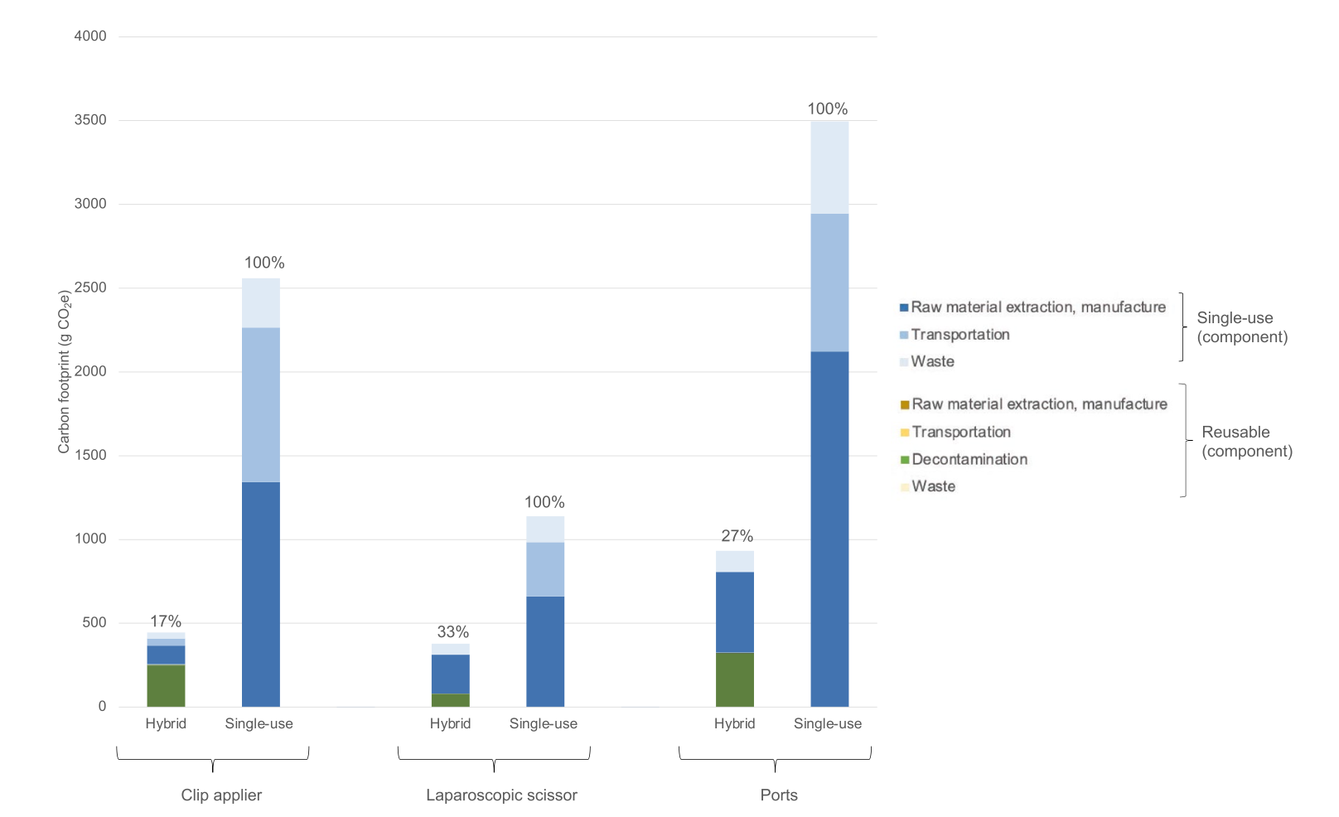
Reuse to reduce
Even if you recycle your single use instrument it is not enough ²
Carbon footprint of production vs disposal of single use instruments:
Carpal tunnel – 67% vs 11%
Inguinal hernia – 49% vs 9%
Knee arthroplasty – 69% vs 6%
Lap chole – 44% vs 6%
Tonsillectomy – 43% vs 11%
Cost of reusable instruments 46% (GBP £131 vs £282 per case)
eCO2 footprint of reusable instruments 24% (1.75kg vs 7.19kg) ¹
1] C Rizan, M Bhutta. Environmental impact and life cycle financial cost of hybrid (reusable/ single‐use) instruments versus single‐use equivalents in laparoscopic cholecystectomy. https://doi.org/10.1007/s00464-021-08728-z
2] The carbon footprint of products used in five common surgical operations: identifying contributing products and processes Chantelle Rizan1 , Robert Lillywhite2, Malcom Reed1 and Mahmood F Bhutta1,3 Journal of the Royal Society of Medicine; 0(0) 1–15 DOI: 10.1177/01410768231166135
Notes:
Looking first at instruments
This is data to show that it is not only possible to to reduce your environmental impact with reusable instruments but it actually saves money at the same time
This shows the emissions associated with 3 instruments used for lap chole
Emissions are reduced by 75%
Cost is reduced by over 50%
Why not??????
Environmental impact and life cycle financial cost of hybrid (reusable/ single‐use) instruments versus single‐use equivalents in laparoscopic cholecystectomy.
Chantelle Rizan, Mahmood Bhutta
https://doi.org/10.1007/s00464-021-08728-z

Slide 6
Barriers to Reusable Sterile Surgical Gowns
Not safe from infection prevention perspective
They don’t provide adequate staff protection
Do not comply with ACORN standards
Staff do not like them
No environmental advantage
Lack of availability
Too expensive
Logistical challenges
Existing linen contracts/agreements
Notes:
Of course gowns and drapes are a very visual example of disposable items in surgery as they form a lot of the bulk of surgical waste
But when I first started looking into how we could start to move away from single use to reusable gowns and drapes I was surprised at the number of barriers that were put up to block this change
List barriers
But I was pretty determined that I could find evidence and solutions to most if not all of these barriers

Slide 7
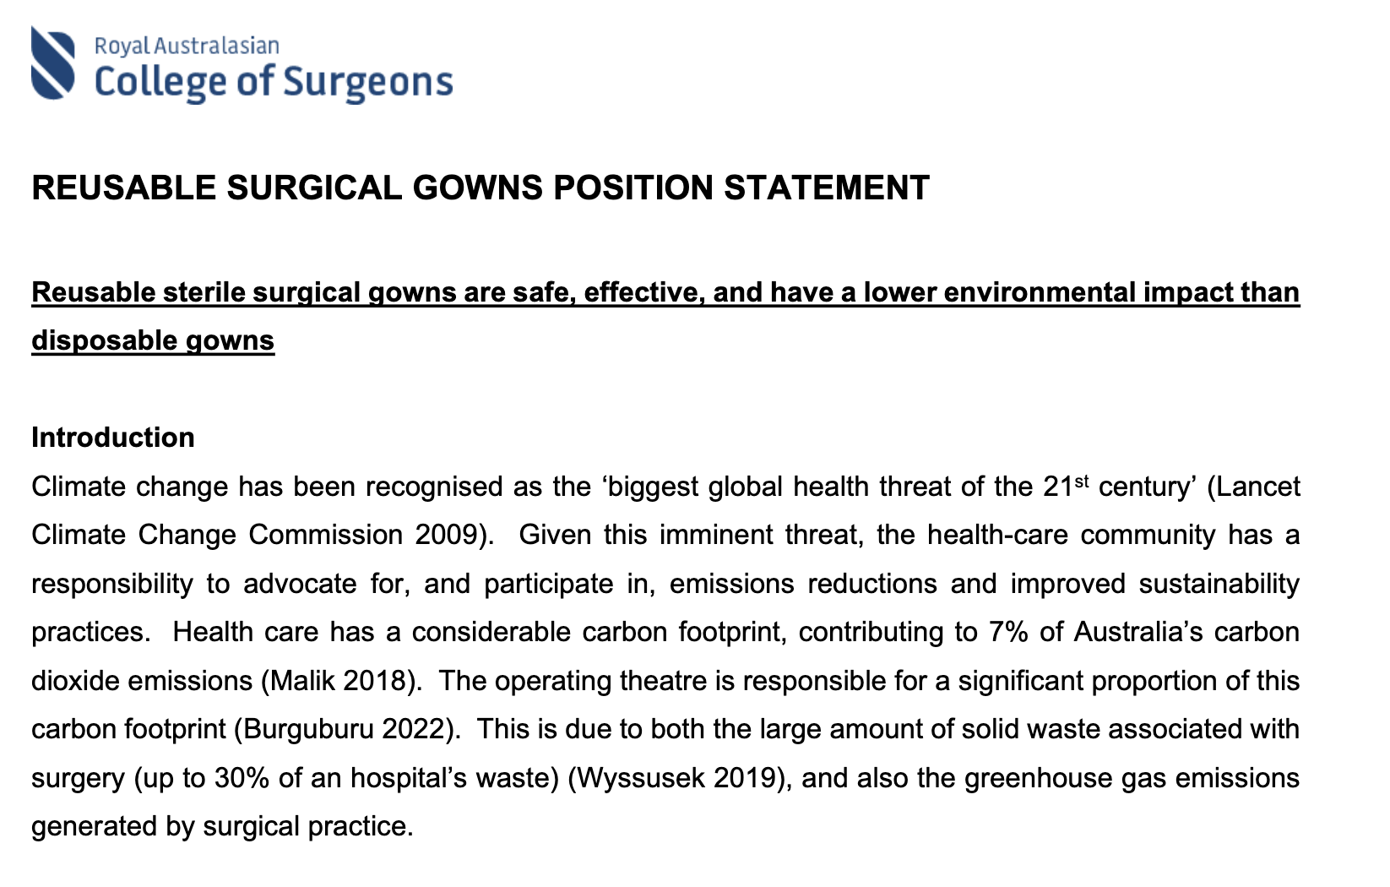




Position Statement on Reusable Sterile Surgical Gowns
Notes:
So we started with a plan to collate the available evidence and bring the peak bodies responsible for some of these decisions together to endorse an evidence based position
RACS, ACORN and ACIPC

Slide 8

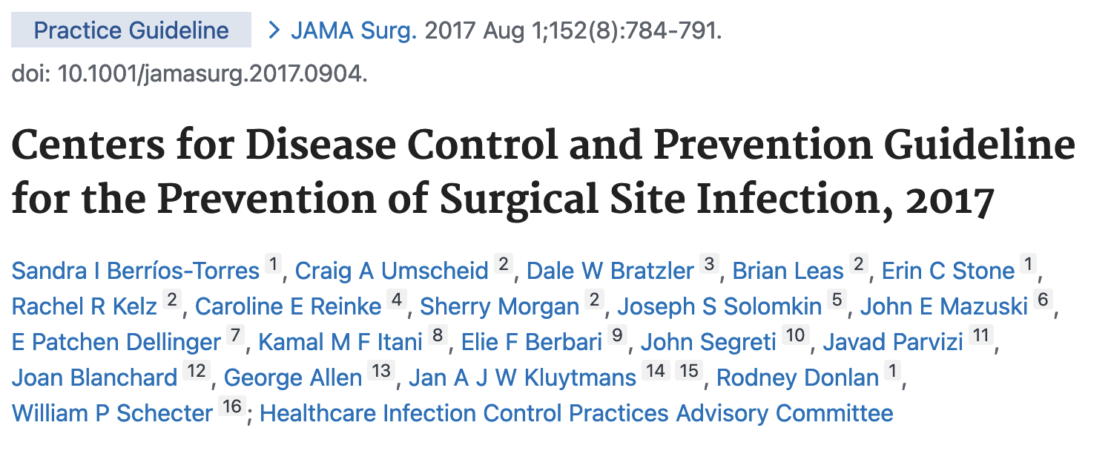
Are they safe for our patients?
Global guidelines for the prevention of surgical site infection, second edition. Geneva: World Health Organization; 2018. Licence: CC BY-NC-SA 3.0 IGO
Berríos-Torres, S. I., Umscheid, C. A., Bratzler, D. W., Leas, B., Stone, E. C., Kelz, R. R., ... & Healthcare Infection Control Practices Advisory Committee. (2017). Centers for disease control and prevention guideline for the prevention of surgical site infection, 2017. JAMA surgery, 152(8), 784-791.
Notes:
We started with the most important question
Are they safe for our patients – can they effectively prevent SSIs in surgical patients
Thankfully, most of this work had already been done for us with 2 systematic reviews and meta-analyses – from well respected bodies the WHO and the CDC in the US – both stating that reusable gowns and drapes were equally effective as single use versions.
So we were off to a good start

Slide 9
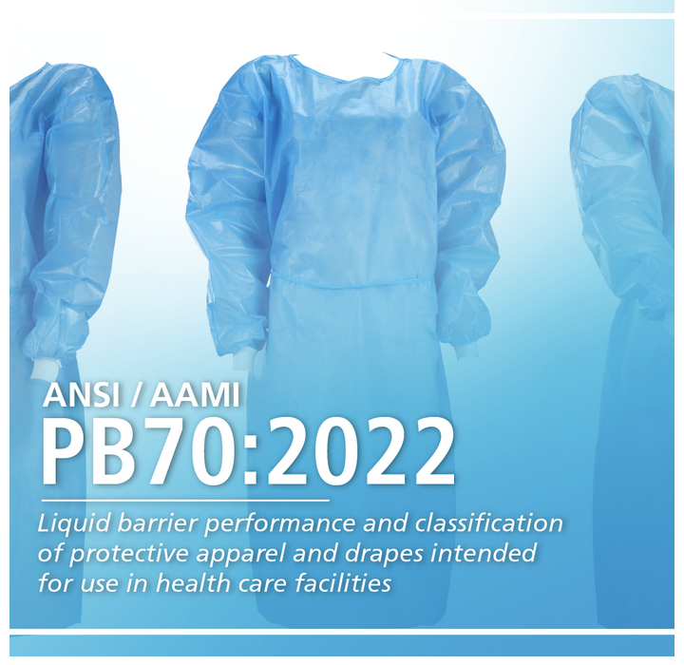
Are they safe for our staff?
The 4 AAMI levels and suggested appropriateness of each
- Level 1 – minimal fluid barrier protection – not suitable for surgical procedures
- Level 2 – low fluid barrier protection – suitable for procedures with low risk of liquid exposure
- Level 3 – medium fluid barrier protection – suitable for most procedures
- Level 4 – high fluid barrier protection – suitable for procedures with high volume liquid exposure
https://www.aami.org/standards/featured-standards/ansi-aami-pb70-2022
Notes:
But that did not necessarily addrwss staff concerns
Thankfully again, there are clear standards set out for the barrier protection for any procedural gown so any gown must be able to demonsxtrate that iscan meet these barrier standards – level 1 being minimally effective for fluid protection, level 4 being the highest, in reality operating theatres usually only stock levels 2 and 3
Any gown on the market must be clearly labelled as to what level it is performing at

Slide 10

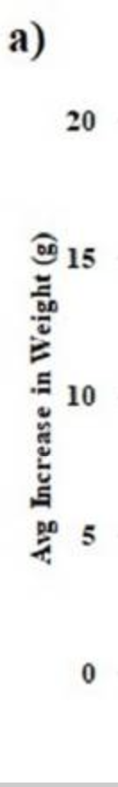
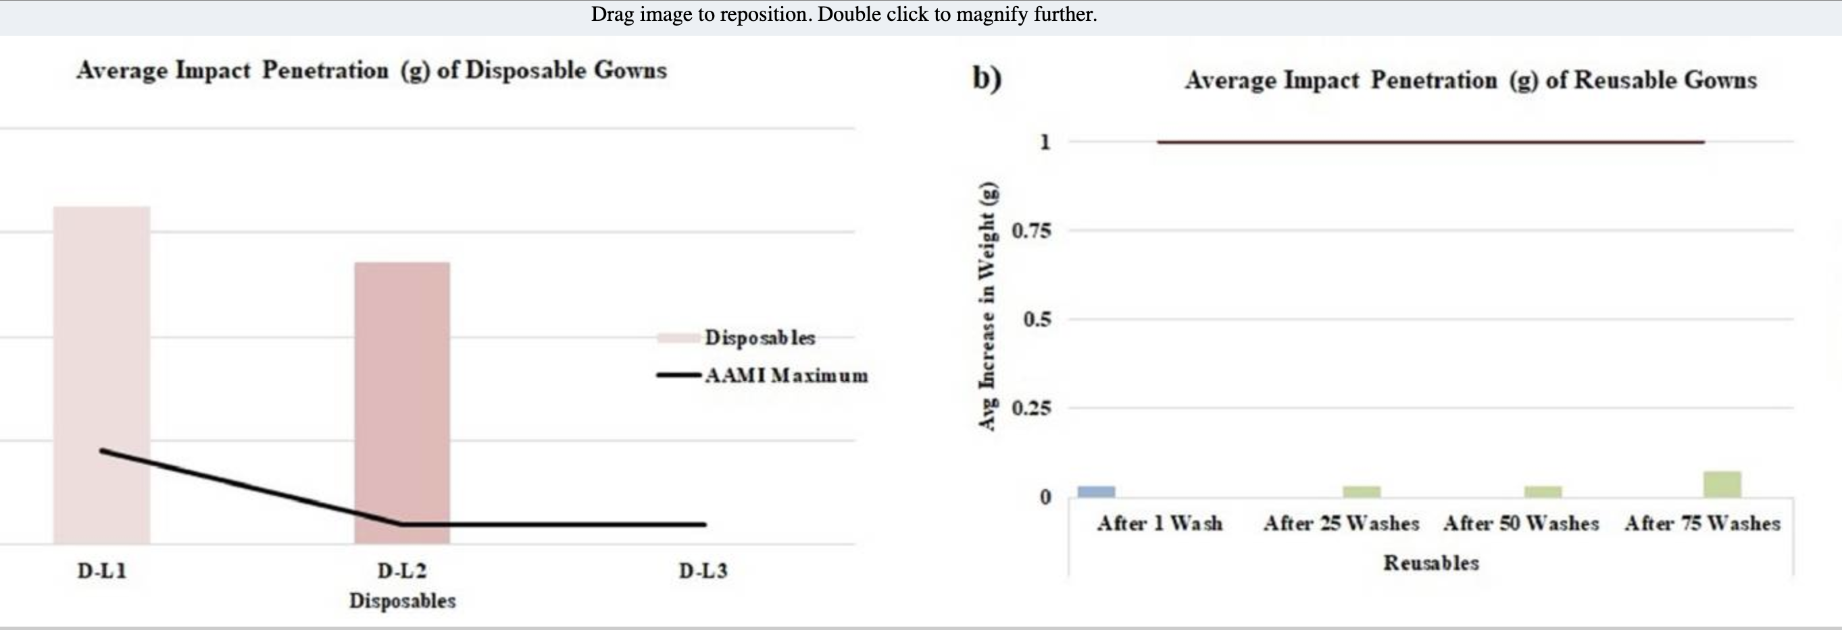
Are they safe for our staff?
McQuerry M, Easter E, Cao A. Disposable versus reusable medical gowns: A performance comparison. Am J Infect Control 2021; 49(5): 563–70. doi:10.1016/j.ajic.2020.10.013
Notes:
And again we were pleased to find that someone else had done the hard work here and compared a ranfge of single use vs disposable gowns in the US
Certainly for level 1 and 2 the disposable gowns were not performing at the minimum acceptable standard, although the level 3 gowns were.
The reusable gowns passed the tests clearly at all 3 levels.
So – they are safe for staff

Slide 11
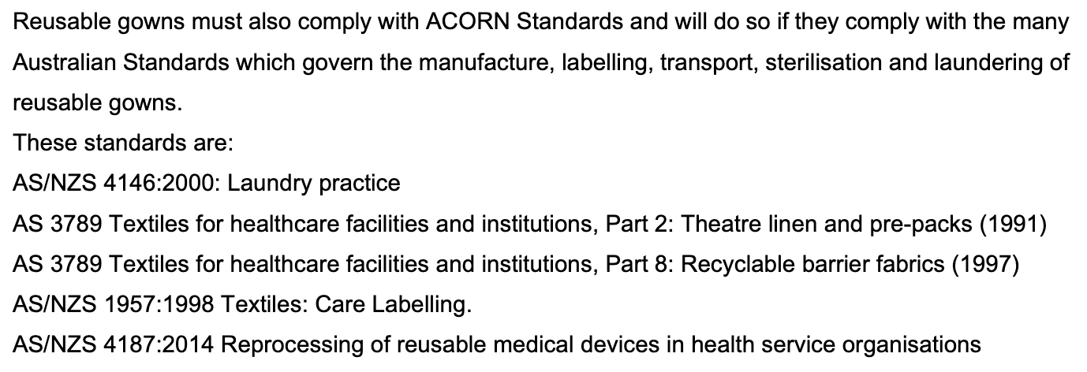
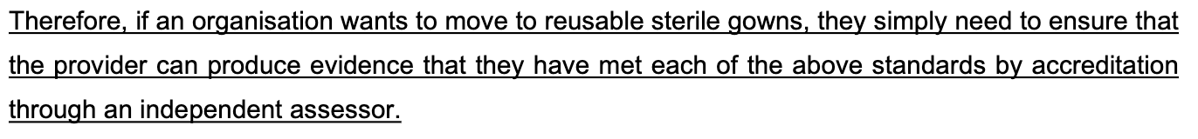
Do they meet the required standards?
Notes:
But there are of course important standards that need to be met for any medical product or device – which gowns and drapes are considered.
However, these are clearly defined, and any provider of reusable textiles must be able to produce evidence that they meet the required standards and have been independently assessed
SO again, this burden falls on the suppliers so any health organization just needs to ensure this is p[rovided to them if they want to make the change.

Slide 12
Surgeons realise this is a problem
Surgeons are willing to change
Surgeons are looking for guidelines and evidence
Notes:
But what if staff don’t want to change…. Surgeons are a fairly conservative bunch
However, we did survey all the RACS fellows and trainees in 2021 and, at least for those who responded, over 80% were keen to move to reusable gowns and drapes, if they are provided with some assurance/guidance that it can be done safely
As a profession, we realise this is an urgent problem and we are willing to make changes to our practice if we are provided with guidance

Slide 13
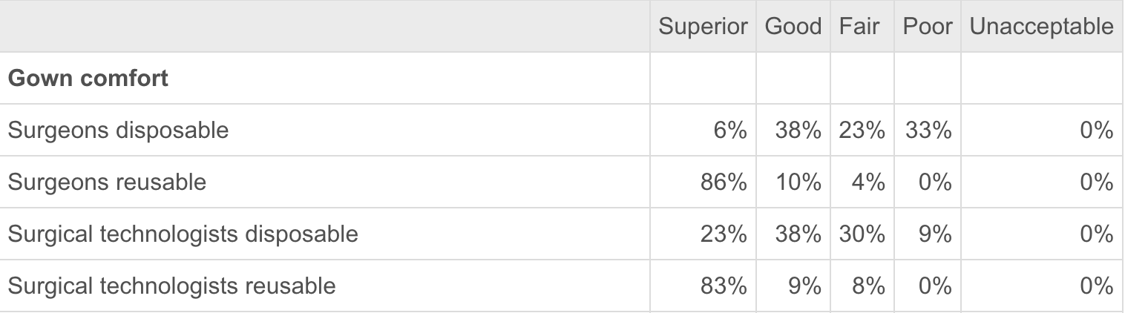
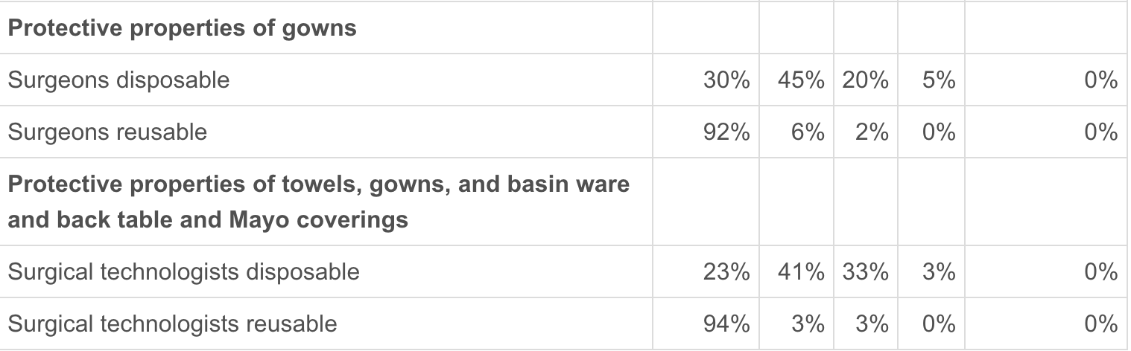
Do staff really prefer disposable gowns?
Conrardy J, Hillanbrand M, Myers S, Nussbaum GF. Reducing Medical Waste. AORN J. 2010;91(6):711-721. doi:10.1016/j.aorn.2009.12.029
Notes:
But if they try it they wont like it….
Well that is not borne out by the data either
We can see here that over 80% of staff in this study preferred reusable gowns and drpaes and thought they were more protective

Slide 14
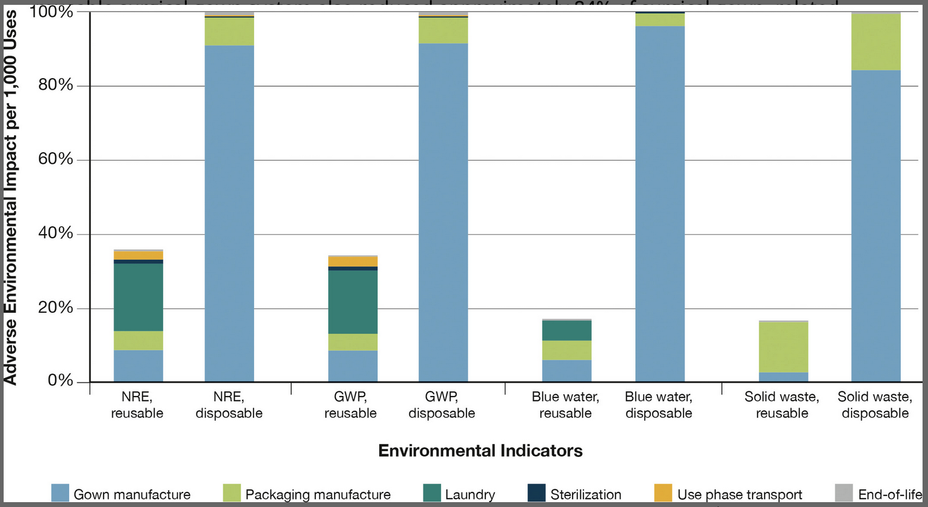
What is the environmental advantage?
Vozzola E, Overcash M, Griffing E. An Environmental Analysis of Reusable and Disposable Surgical Gowns. AORN J. 2020;111(3):315-325. doi:10.1002/aorn.12885
Notes:
Is there really an environmental advantage when we factor in transporting them to the laundry, sterilizing them and using all the water and cleaning chemicals – well, unreservedly the answer is yes
On every metric from resource utilization, to global warming potential, to water use and waste generation reusable gowns outperform single use versions by a long way

Slide 15

Initial Position Statement
Early engagement with ACORN and ACIPC
Initial position statement drafted by RACS
Peer reviewed at RACS Environmental Sustainability in Surgical Practice Working Party
Circulated to ACORN and ACIPC for input
Endorsed by all 3 organisations following revisions
Notes:
And so we brought all this information together into our position statement
The key to successfully bringing the 3 organisations together were early engagement, a robust approach to data collection and evaluation, and openness to revisions
Follow the QR code on screen to go to the actual document if you like

Slide 16


Broader Endorsement
Notes:
We’ve been delighted with the response from many other colleges and societies as we have sought broader endorsement of the position statement
As you can see we are now up to 11 further organisations that have endorsed the statement which really helps bring clinicians on board if they know they have the support of their craft group

Slide 17
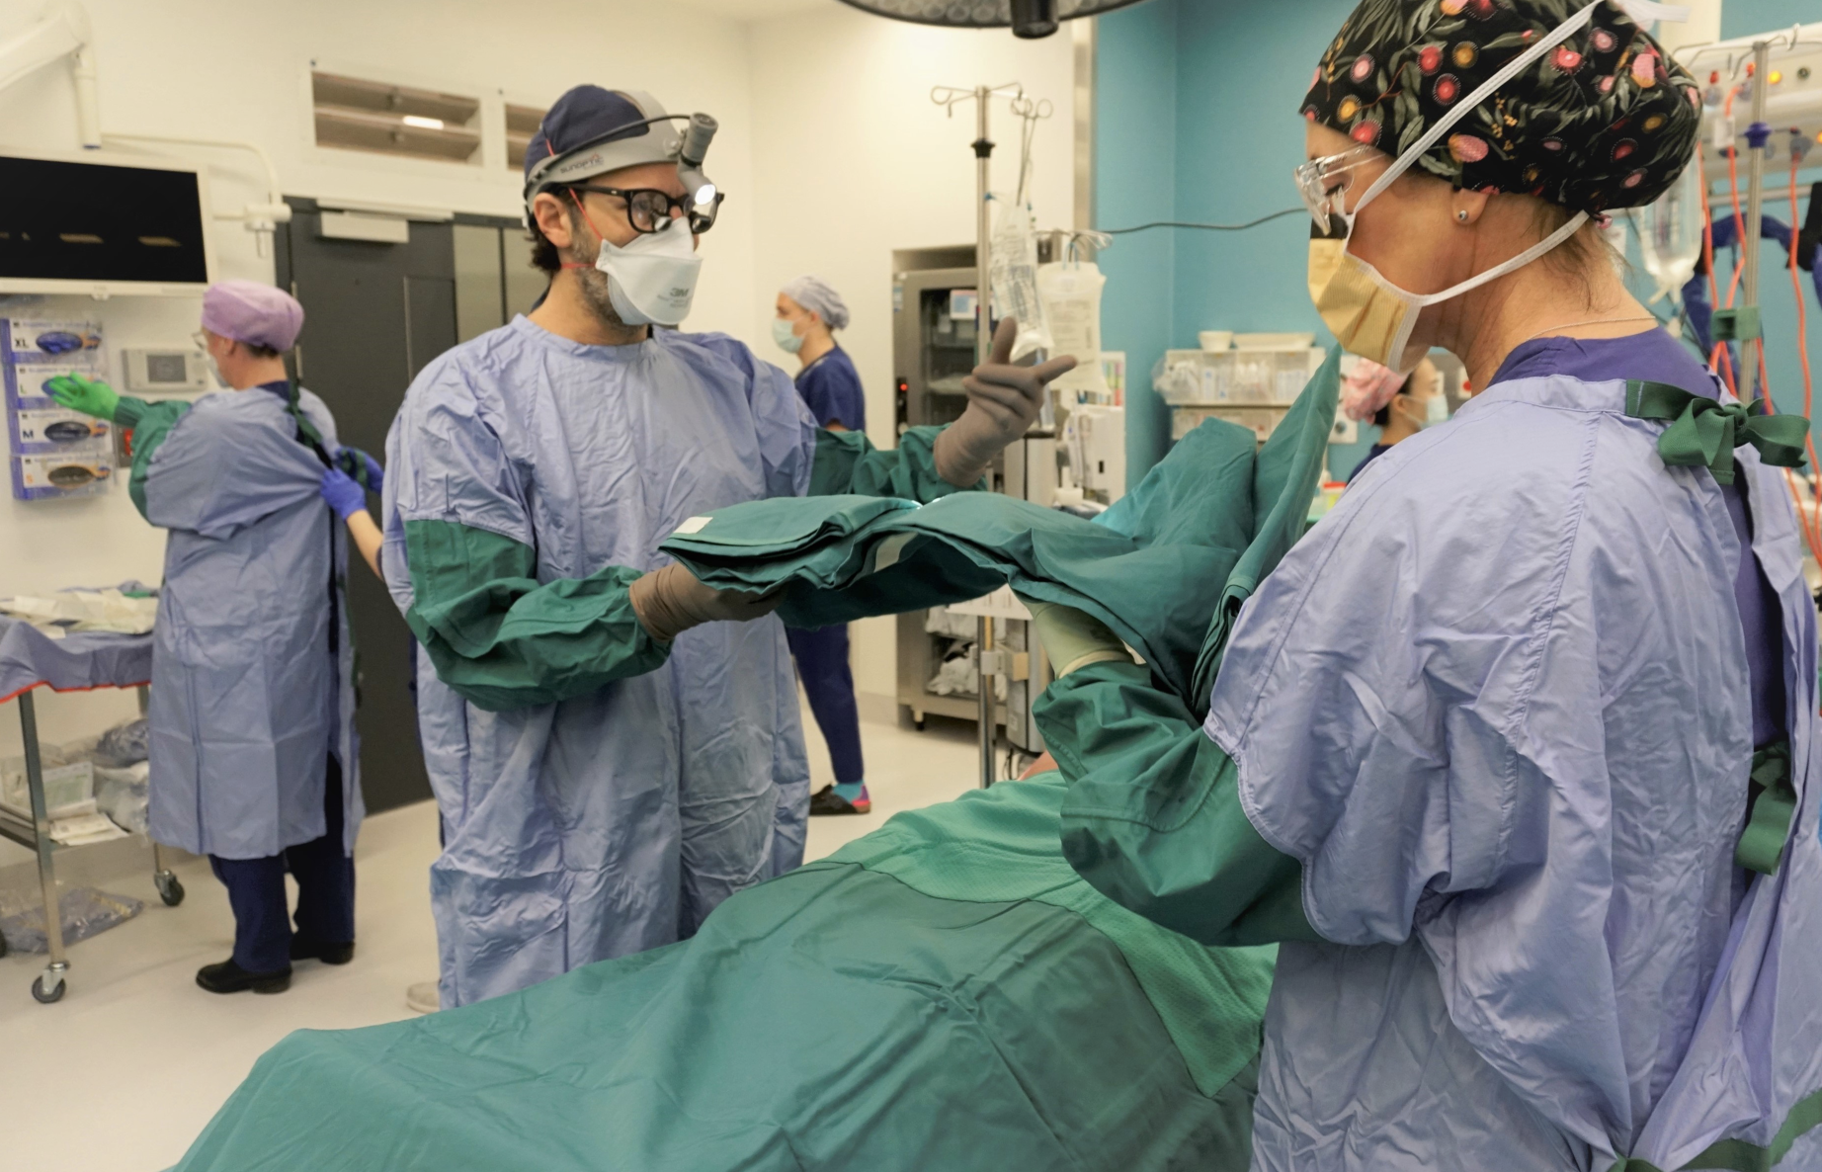
Has this achieved anything?
Raised awareness among surgeons – significant interest at RACS ASC and via ANZCA Webinar
Opened door for pilots of reusable gowns and drapes at
PMCC
RMH
Belmont Hospital (HNE)
Featured in National Health and Climate Strategy
Notes:
But has this achieved anything really or is it just another piece of paper on a college website
It has cerrtaiunly helped raise awareness in the possibility o fmaking these changes among surgeons and also among anaesthetists as we have had session on this topic at RACS and ANZCA events in the last year
It helped get 3 pilots underway in PMCC and Belmont Hospital theatres as well as a smaller pilot in cath lab at RMH.
It even got the concept of moving back to reusable surgical textiles mentioned in the National Healht and Climate Stratgey – with this phot of Hayden Snow from Peter Mac in the middle of their pilot.
I would like to congratulate Hayden and the PMCC team as I saw yesterday that they have been listed as a finalist in the Vic Public Healthcare Awards in the sustainability category for this project.

Slide 18
Gathering local data
B
A
A – How satisfied are you with reusable drapes?
B – Would you support the ongoing use of reusable drapes?
C – Effectiveness compared to disposable drapes?
D- Ease of application and removal compared to a disposable drape?
C
D
Notes:
And here are some early results from that pilot, as local data is always more powerful when you are looking to make change.
This showed pretty conclusively that reusable gowns and drapes were either better or equivalent to their disposable cunterparts and I look forward to seeing this in publication soon.

Slide 19

Remaining barriers
Cost
Cost neutral compared than cost of single use gowns
Some of the cost is offset when you remove the single use gowns for the ‘custom packs’
Remember to offset clinical waste disposal which is now $4.50/kg
Logistics
Segregation, collection, storage
Availability
2 companies
Linen Services Australia
Retex Australia
Working with both to improve product offerings
Organisational or state-wide linen contracts
Notes:
What barriers remain?
It would be great if they were cheaper than disposable gowns but that is not quite the case
It seems they are roughly cost neutral – particularly when you factor in removing the gowns and drapes from the surgical custom packs that may theatres use and factor in the cost of clinical waste disposal which is where all the single use gowns and drapes go.
There will always be some logistical challenges as there needs to be a system set up where the gowns and dropped off by the linen company, stored, collected when used, taken away to be resterilised by the company and then brought back which is a little more complicated than just putting everything in the bin
Are these gowns and drapes available to every hospital in Australia right now?
Probably not but certainly here in Vic there are 2 companies that can supply our hospitals and are keen to work with us
Lastly, all health services have existing linen contracts for non-sterile linen but some of these may have clauses that need to be worked around if you are to explore a separate sterile linen contract which is what we are having to do

Slide 20

Next steps
Health Share Vic and Health Share NSW both exploring reusable linen contracts
Plans to introduce reusable gowns at all 4 Parkville hospitals
PMCC
RMH
RWH
RCH
Raise awareness of the efficacy and availability of reusable sterile linen
Publicize successful cases of change
Notes:
So where to from here?
We are nearing the final stages of a plan to bring (hopefully) all 4 Parkville precinct hospitals into a contract for sterile linen which would be transformative.
Between the positive results of the initial PMCC pilot and the plan for expansion in Parkville we hope that will further raise awareness and drive change.
I cant help myself having followed on from Mike’s talk to consider whether a similar national roadmap approach is needed for this problem also – bringing health services, clinicians, industry and procurement teams together to work out how we make this change at scale….

Slide 21
Next steps
Reusable vs disposable theatre caps
Disposable shoe covers in theatre
Mechanical VTE prophylaxis in theatre
Notes:
But it is not just gowns and drpaes
There are many other exam,ples of waste we can reduce in theatres from single use theatre caps, to shoe covers, to over-use of TEDS to phasing out tradiotnal surgical scrub for the much less wasteful alcohol-based surgical rubs…
We are working on similar evidence and position statements for these issues and hope to see a tide of change in surgical practice in years to come

Slide 22
Ben Dunne
Ben.dunne@unimelb.edu.au
Notes:
Thanks very much for listening
Ben

