Slide 1

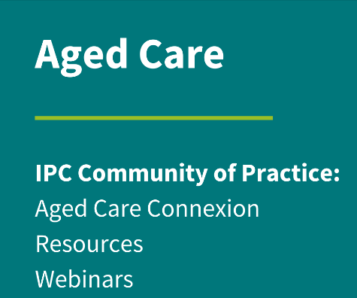

Journey of an IPC Lead
Chloe Tilson
Kelly Barton

Slide 2

  Acknowledgment of Country
  ACIPC acknowledges Aboriginal and Torres Strait Island people as the traditional owners of country throughout Australia and ngā iwi Māori as the people of the land of Aotearoa and respects their continuing connection to culture, land, waterways, community, and family.

Slide 3
Q&A
  Questions and comments are encouraged
  Please place all questions/comments in the Q&A function of the webinar for presenters to respond
  Any unanswered questions from the webinar will be posted in the ‘aged care connexion’ forum.
  Webinar recording and PowerPoint will be uploaded onto the ACIPC Aged Care IPC Webinar Series webpage https://www.acipc.org.au/acipc-aged-ipc-webinar-series/ post the session

Slide 4
Aged Care IPC Resources
  One stop shop aged care IPC resources – anything you need in aged care IPC is located on this page
  https://www.acipc.org.au/aged-care/resources-australasian-aged-care/
  Webinar resources, templates, guides are all also located her
  You do not need to be a member to access
  Aged Care - this is your space!

Slide 5
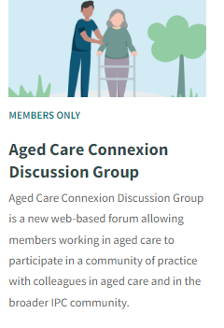
Aged Care Connexion
  For further discussions or questions, please jump onto the ACIPC website Aged Care Connexion and add a post.
  The forum is moderated and a safe place for aged care communications.
  https://www.acipc.org.au/members/aged-care-connexion/
  You do not have to be an ACIPC member to post

Slide 6
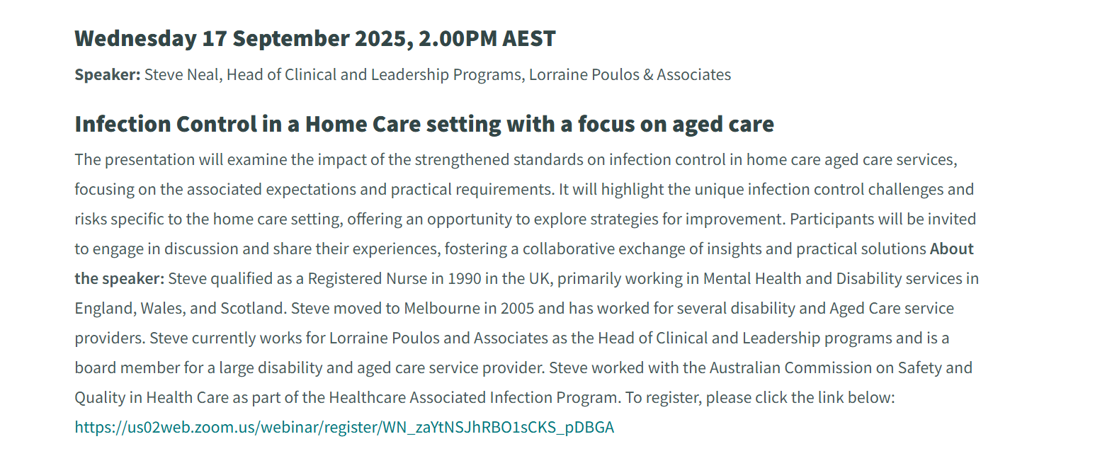
ACIPC Aged Care Community of Practice
-Webinar Series
  Next webinar:

Slide 7



Do not edit
How to change the design
Join at slido.com
#1894583
The Slido app must be installed on every computer you’re presenting from

Slide 8

Do not edit
How to change the design
Where are you from?
The Slido app must be installed on every computer you’re presenting from

Slide 9
Do not edit
How to change the design
What is your role?
The Slido app must be installed on every computer you’re presenting from

Slide 10
Do not edit
How to change the design
Do you feel the IPC lead has been instrumental to changing the face of IPC in aged care residential settings?
The Slido app must be installed on every computer you’re presenting from

Slide 11
Introductions
  Chloe Tilson
  I work in a small rural country town in North East Victoria. I am one of two IPC Leads and cover as the IPC Lead for two of the sites. I have been an Enrolled Nurse for 17 years and an IPC Lead 5 years. I have always had an interest in Infection Prevention and Control during my nursing career and becoming an IPC Lead has allowed me to continue to explore my interest within this field.
  Kelly Barton
  Is an Infection Control Consultant with 14 years’ experience in the role at Alpine Health in Northeast Victoria. Kelly completed her Masters in Infection Control at Griffith University in 2022 an has a Graduate Certificate in Advanced Acute Care. She is passionate about One Health, Aged Care and AMS. In 2023 she went to Cambodia with the charity Supporting Silk Sisters to help a rural referral hospital with their first ever accreditation preparations.

Slide 12


Journey of an IPC Lead –
Chloe Tilson. IPC Lead. Kelly Barton . IPC Officer

Slide 13
Declarations:
Nil

Slide 14



Alpine Who?
Northeast Victoria
Largest Multi-Purpose Service (MPS) in Australia.
MPS = RAC, Community & Acute
Three sites, three towns
Residential Care, Rural Urgent Care Centers, Acute, Dialysis, Day surgery, Community Packaged Care (across Alpine & Indigo Shires)
Approx. 100 beds across all sites – majority aged care
Notes:
Kelly . Even the “Acute” ward is really “sub acute” - with generally about ½ of the inpatients are waiting for RAC beds. Diverse Service - Over 1000 packaged care clients in the community.

Slide 15
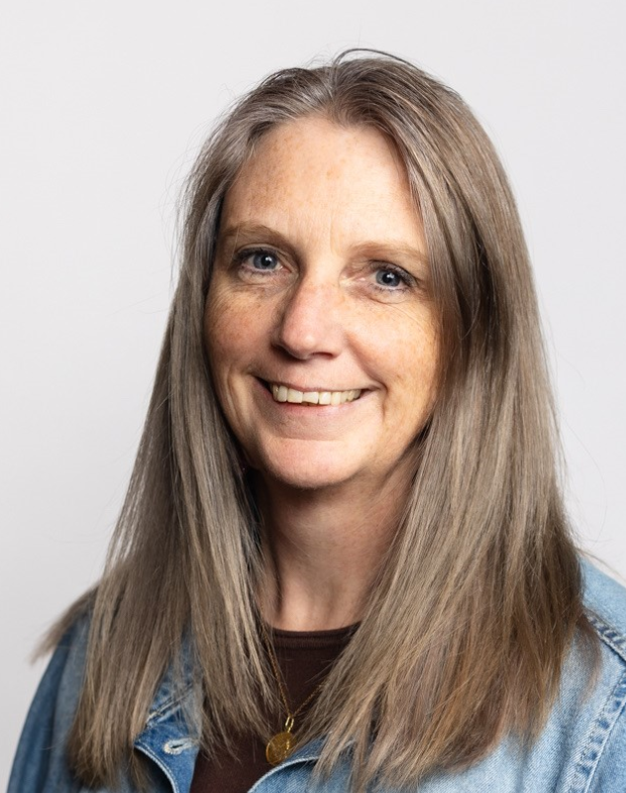
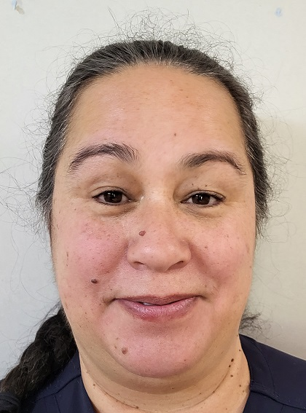
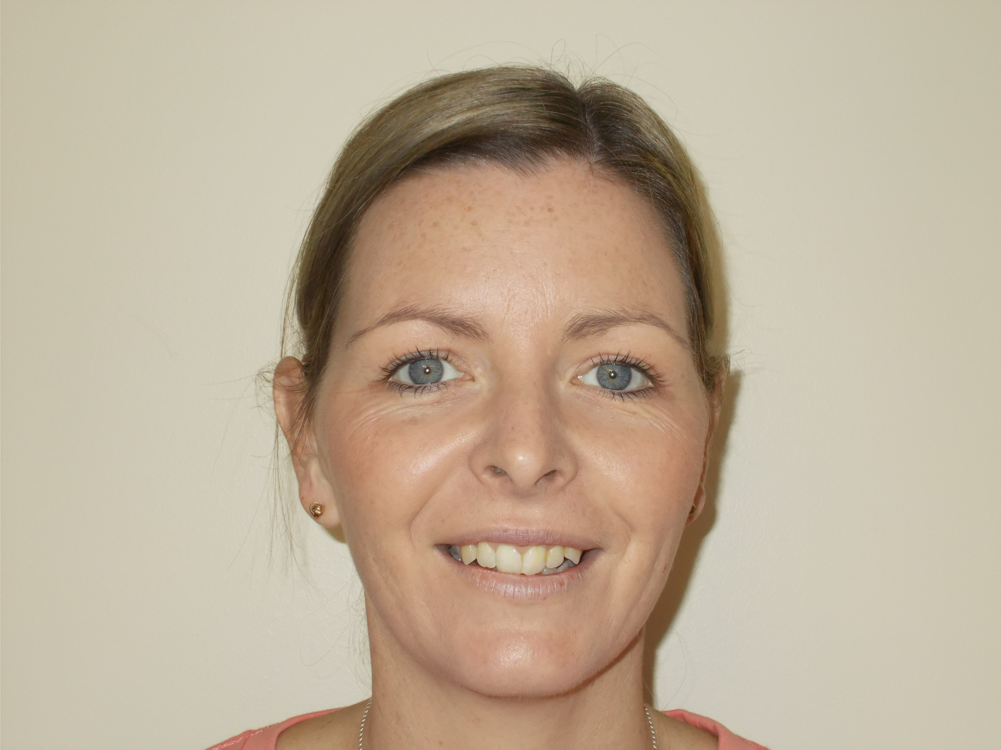
IPC Team
Alpine Health –
Infection Prevention & Control Officer – Kelly 1.0 FTE
Bright –
IPC Lead – Tania 0.1 FTE
Mt Beauty
IPC Lead – Chloe 0.1 FTE
Myrtleford
IPC Lead Chloe 0.1 FTE
Hawthorn Village
25 bed low care RAC
Kiewa Valley House -
mixed ward max of
20 high care RAC beds
Barwidgee Lodge
28 bed high care RAC
Notes:
Kelly

Slide 16

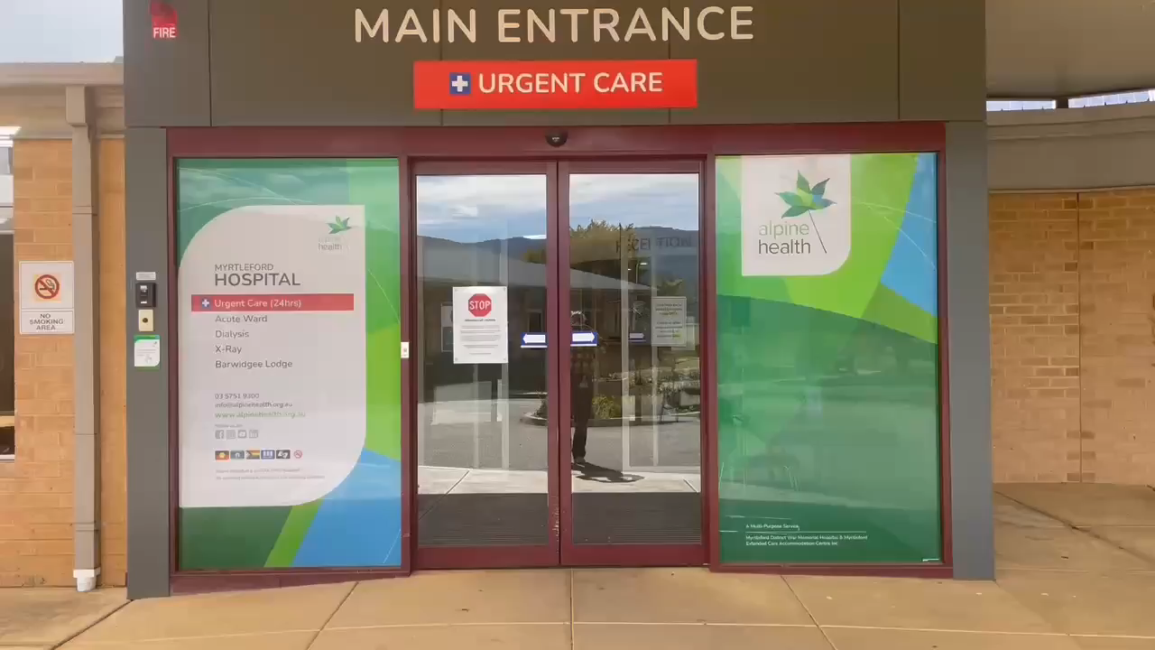
Notes:
Kelly

Slide 17
Who does what?
IPC Officer
  Is responsible for the Infection Control program organisation wide.
  Ensures compliance with Australian Commission for Quality and Safety Acute National Standards, Aged Care Quality Standards, Primary and Community Healthcare Standards for Accreditation. Includes:
    Respiratory Protection Program – Fit testing
    Ongoing Staff Education – ad hoc & planned
    Hand Hygiene
    Antimicrobial Stewardship Program
Notes:
Kelly

Slide 18
Who does What Continued:
  Includes:
    Staff Onboarding – vaccinations & immunity
    Outbreak Management
    Infection Surveillance
    Risk Mitigation in construction & renovation
    Overseas IPC Lead Program!
Notes:
Kelly

Slide 19
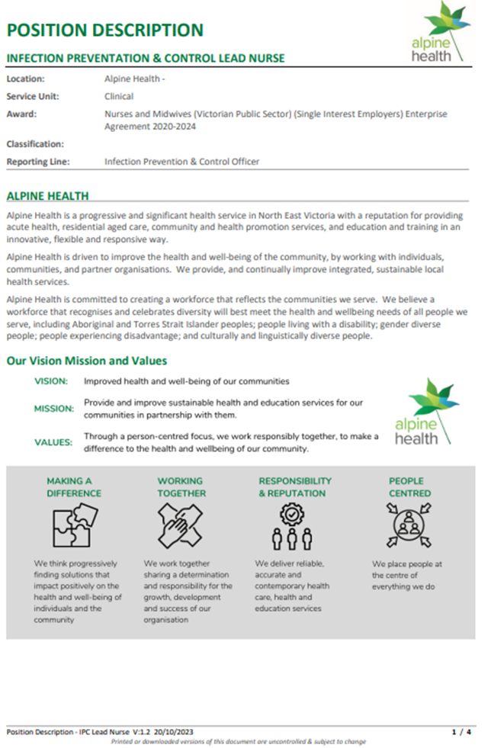
Set up of the IPC Lead program:
Role had to be desirable – increased pay
Needed structure – a role description
Dedicated time – if not would be in name only
Notes:
Kelly.

Slide 20
Set up of the IPC Lead program:
Dedicated program to follow – set up Leads & program for success
Focus: Residential aged care. However, being a multipurpose service, vast majority of staff work across RAC & acute, so program was extended across both areas. * But Lead role does not extended to the community side.
Notes:
Kelly: Looked at what tasks IPCO usually undertook and see what would be appropriate & achievable for an IPC Lead to take on.

Slide 21

Do not edit
How to change the design
What do you consider as the most important support from your senior management to implement IPC and support the IPC lead? (Rank in order 1-5, 1 being the most important)
The Slido app must be installed on every computer you’re presenting from

Slide 22

IPC Lead Role: Chloe’s Perspective
New role created in a time of many unknowns (early stages of COVID-19 pandemic) & changing health landscape (RAC royal commission)
Only Lead left of the first 3 Leads.
ACIPC “Foundations of Infection Prevention & Control” course.
Now: IPC Lead Nurse 0.2 EFT – Mt Beauty & Myrtleford & 0.7 Endorsed Enrolled Nurse.
Undertaking Bachelor of Nursing studies
Notes:
Chloe:
First 3 included Alison & Michelle, who where more acute focused, Chloe was only one that solely worked in RAC.
Chloe describe balancing act of IPC Lead, project work, RAC, study, mum of 3 boys!

Slide 23
IPC Lead Role – Chloe’s perspective
Structured program to follow
Ongoing Support
Attending Organisation & Networking meetings
  Alpine Health IPC Committee
  Hume regions’ “IPAC Network” meetings
  Education/training to take back to the workplace
Assist with coordinating vaccination within Residential Care
Notes:
Chloe:

Slide 24

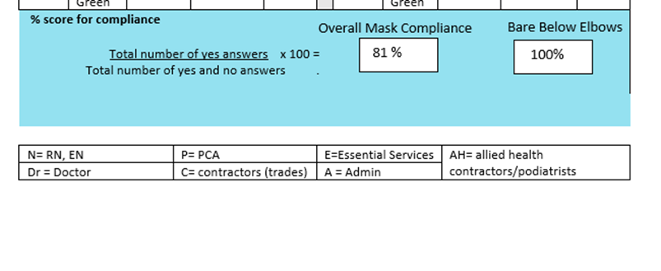
IPC Lead Role- Chloe’s Perspective:
Lots of Audits – done in Survey Monkey
Surveillance & IPC of infections within Residential Care
Improved vaccination rates in residents.
Promoting Antimicrobial Stewardship
  RAC audits
  Care plan audits
Notes:
Chloe:

Slide 25

Typical Day
Pre plan in advanced for days where I travel to other sites (book car/room)
Being the go-to person for IPC in BWL & KVH- gives me the ability to show my IPC knowledge and help staff problem solve
IPC Lead job list of tasks to complete- At times need to change them around due to tasks other staff are completing.
Often asked to complete other tasks in regard to Residential Care ( eg: follow up vaccination history )

Slide 26
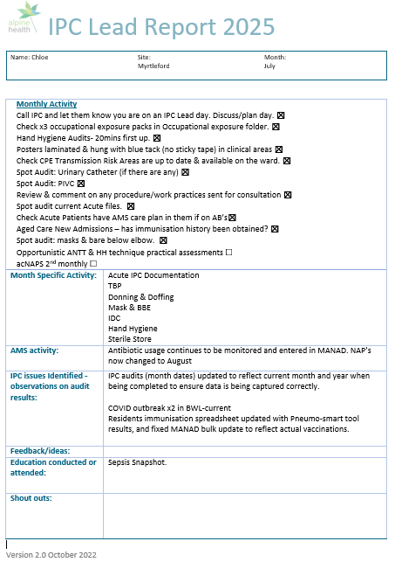
A typical day:
Infection prevention and control officer (IPCO) created a program plan
Monthly task list- Keeps auditing schedule up to date & on task
IPC Lead creates monthly report- received by NUM’s & IPCO details activities & audit results & any issues raised or addressed.
Notes:
Chloe:

Slide 27

Do not edit
How to change the design
What tasks are required of the IPC lead or person responsible for IPC (1-2 words only)
The Slido app must be installed on every computer you’re presenting from

Slide 28
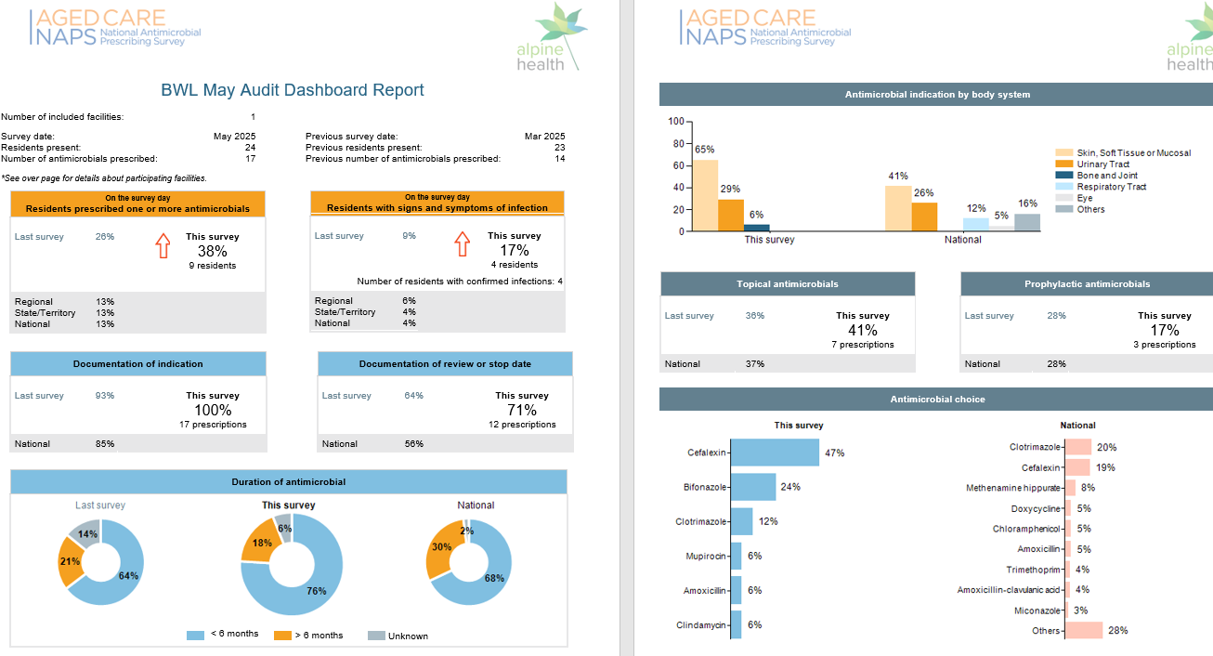
AMS activities
Aged Care NAPS audits
We audit every 2nd month.
Results get compiled & tabled at Drug & Therapeutics Committee meeting
Notes:
Chloe

Slide 29
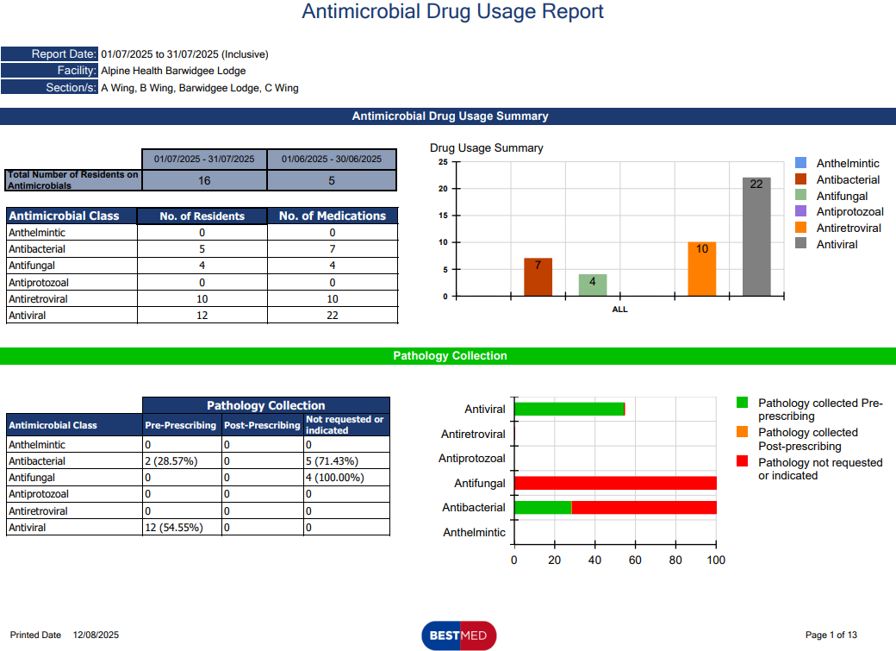
AMS Future Opportunity:
Electronic Medication Chart implemented in May/June 2025.
Antimicrobial usage reports available
Notes:
Chloe

Slide 30
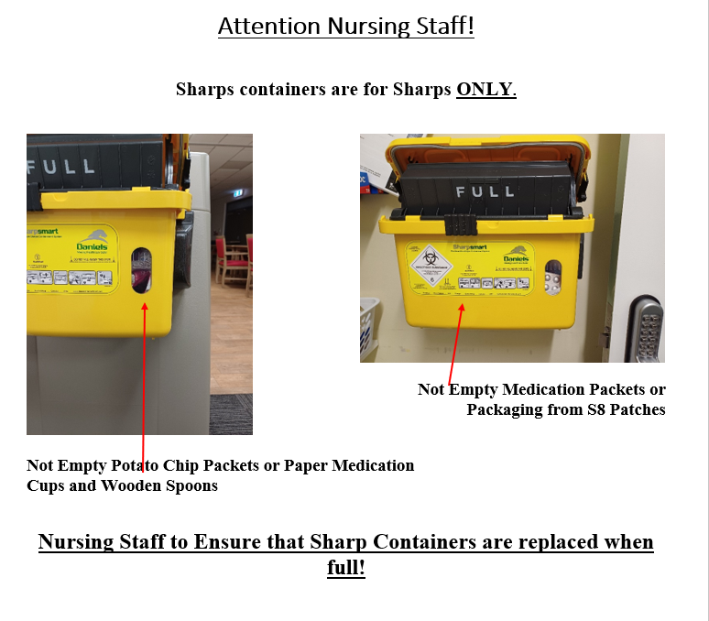
Auditing – getting creative with the results!
Creation of education material & posters for staff
Notes:
Chloe

Slide 31
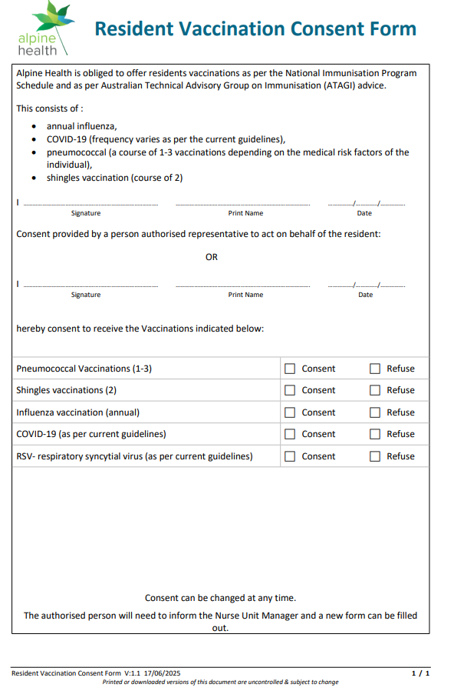
Quality Improvement:
Ideas turned into reality- assisting with the development of a one-off consent for vaccinations in Residential Care
This form is now part of the admission pack
Negates the need to get consent for every single vaccine – huge Time SAVER!!
Notes:
Chloe

Slide 32

Do not edit
How to change the design
What IPC quality improvements have you undertaken?
The Slido app must be installed on every computer you’re presenting from

Slide 33
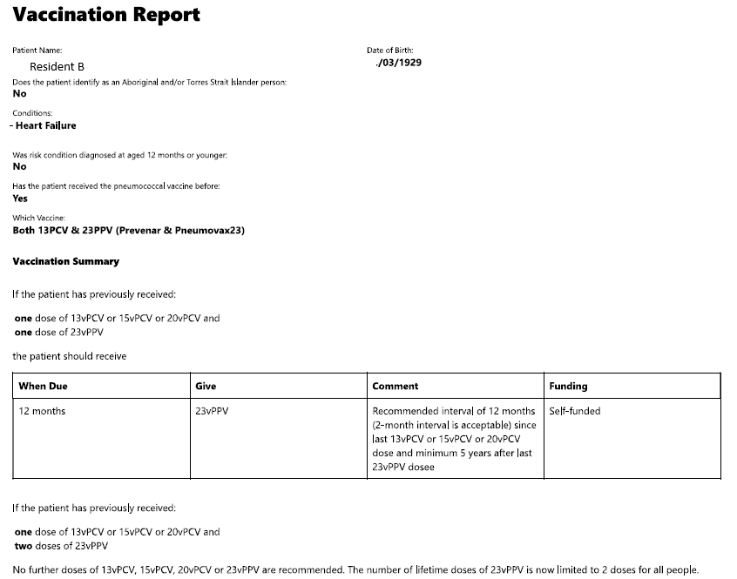
Resident Vaccinations
Victoria public RAC’s annual resident vaccination surveillance mandatory:
  Influenza
  Pneumococcal
  Shingles
  COVID-19 new in 2025.
Online PneumoSmart Vaccination Tool to assess residents need for pneumococcal vaccines:
Track all resident vaccinations in a spreadsheet
Notes:
Chloe

Slide 34
Outbreak Management
IPC Lead to assist with Outbreak Management tasks.
Advantage to also working on the floor ability to assist staff and implement the outbreak management kits that are available.
Assist staff with setting up donning & doffing stations
Assisting staff with Outbreak Management protocols (eg : respiratory symptoms/required reporting procedure)
Notes:
Chloe

Slide 35
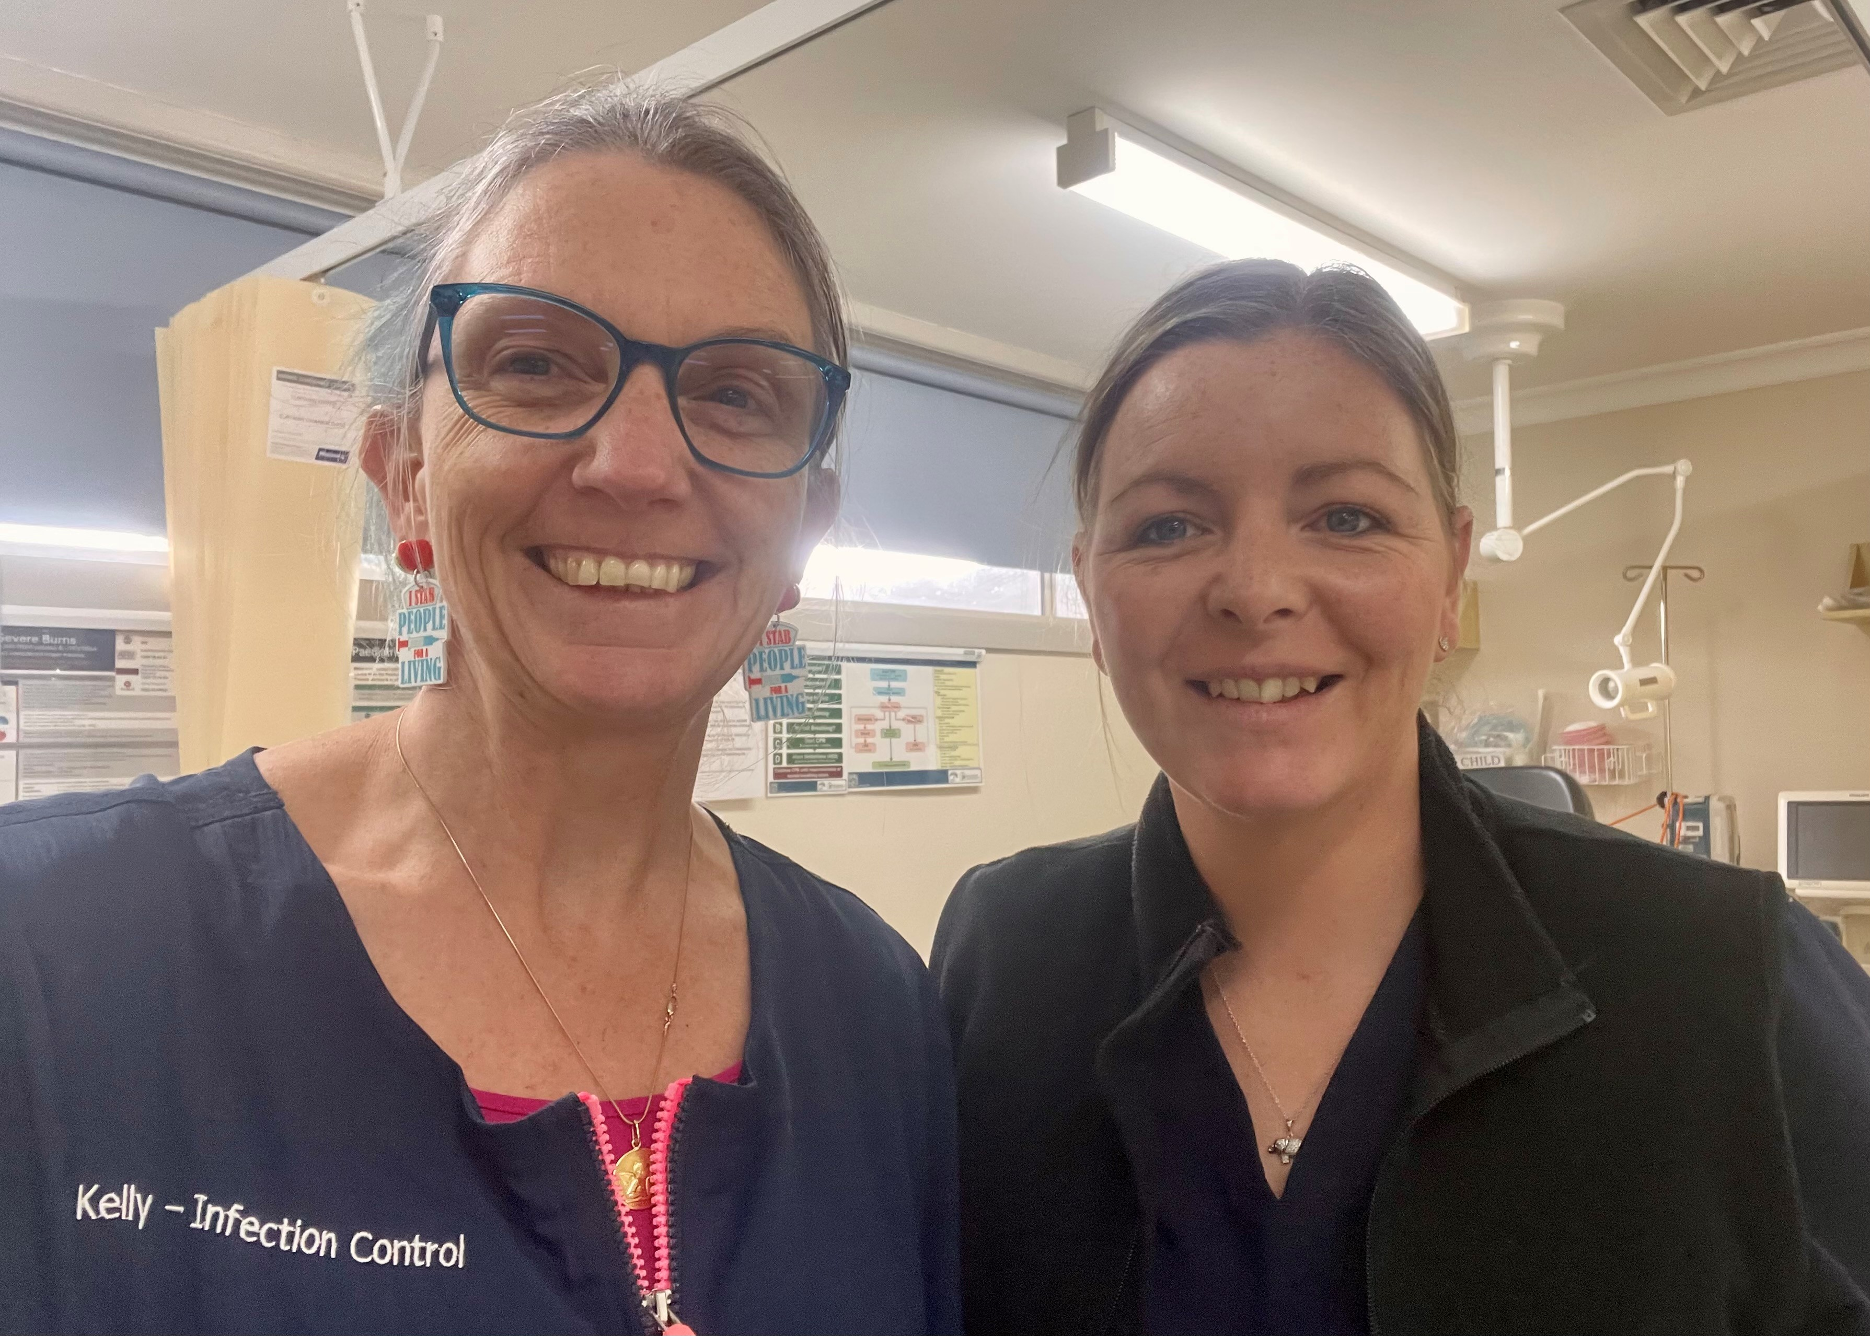
Professional Development
Communication
Improved time management
Contribution to development of the IPC Lead program
Mentoring new IPC Leads
Notes:
Chloe

Slide 36
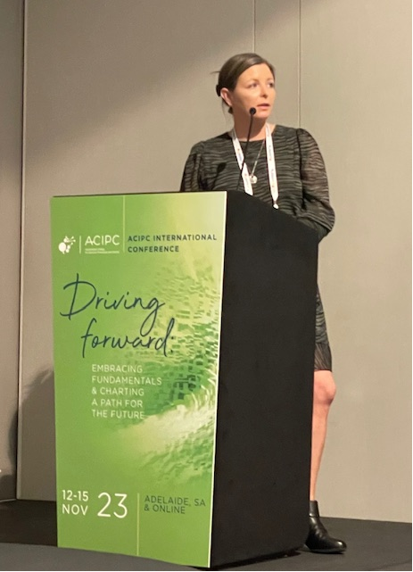
Opportunities so far:
Back fill role of the Infection Prevention & Control Officer
Sepsis Lead- 12 month project lead
Invited as a speaker at the 2023 ACIPC Conference
Leadership, educating others
Presenting today

Slide 37

What the IPC Lead Role has given me:
Career Development
Developing & expanding IPC knowledge
Assist with the improvement of IPC practices within the workplace
Participation in quality improvement projects
Development of leadership skills
Insert Image
Notes:
Chloe

Slide 38
Growth in Program: Kelly’s Perspective
Slow start
Auditing has grown +++
Depth of knowledge of IPC leads
Mentoring
Assurance for accreditation
Succession planning
Insert Image
Notes:
Kelly. Chloe more confidant, knowledge has deepened & expanded ++++. Confidence has grown. Succession planning. Program is still evolving.

Slide 39

Do not edit
How to change the design
Audience Q&A
The Slido app must be installed on every computer you’re presenting from

Slide 40
Thank You !
& Any Questions?
Insert Image
Notes:
Talk is 45minutes – is this enough content?

