Slide 1

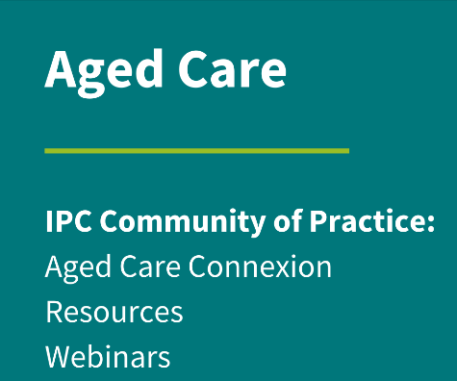

Laundry Practice

Slide 2
  Acknowledgement to Country
  ACIPC acknowledges Aboriginal and Torres Strait Island people as the traditional custodians of country throughout Australia and respects their continuing connection to culture, land, waterways, community, and family.

Slide 3

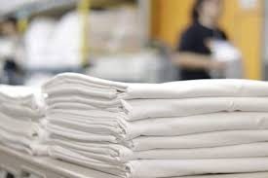
Linen
Healthcare linen refers to textiles used in healthcare settings, including resident bedding/towels, personal clothing, and reusable mop heads/cloths.

Slide 4

Health Care linen
Used Linen: Linen that has been used but is not visibly soiled.
Soiled Linen: Linen visibly contaminated with blood, body fluids, secretions, or excretions.
Infected Linen: Linen used in the care of residents with communicable diseases

Slide 5
Effective Linen Management
National and Local Guidelines, National Standards
Organisational commitment
Committed and trained manpower
Good management
Budgetary allocation

Slide 6

Aged Care Quality and Safety Commission
Aged Care Quality Standards – IPC is addressed across near all:
1 -Consumer dignity, choice
2 -Assessment and planning – vaccination/antiviral, indwelling devices, outbreak management, surveillance and action plans
3 -Personal and clinical care – IPC practices – standard and transmission precautions, AMS, educated staff
5 -Service environment – catering, cleaning, reprocessing, water testing, laundry
6 -Feedback & complaints
7- Human resources – IPC OH&S practices, staffing to meet IPC needs
8 -Organisational governance – IPC Lead, IPC policies/procedures

Slide 7
Linen Management Guidelines
Governance around linen management – national guidelines, standards and codes
Laundry guidelines – state/territory, jurisdiction and organisation led
  Australian laundry practice standard AS 4146:2024
  Codes of Practice for Public Healthcare Operated Laundries and Linen Services 2012
  State and Territory linen management policies and guidelines
  Australian Guidelines for the Prevention and Control of Infection in Healthcare 2019
  Aged Care IPC Guide 2024

Slide 8
Risks of Poor Linen Management
Cross-contamination – environment, clean linen
Healthcare-Associated Infections (HAIs) – residents, HCW
Exposure to biological hazards – body fluids and blood
Bioaerosol generation
Manual handling injuries
Damaged linen, clothing
Inadequate linen supply
Increased costs
Disrupted care

Slide 9
Who's at Risk?
Care, nursing staff
Catering staff
Housekeeping Staff
Contractors
Residents
Families/friends
Community

Slide 10

Soiled laundry protective measures
There is great difference in protective measures for:
  general items
  infectious items
  Cytotoxic contaminated items
The correct precautions must be utilised to ensure risk reduction and safety.

Slide 11
Standard Precautions and PPE
Required when handling soiled items not known to be infectious – floors and laundry
Standard PPE:
  Disposable Gloves
  Disposable Apron
  Any other PPE required on risk assessment
PPE and waste is disposed in general waste bins

Slide 12

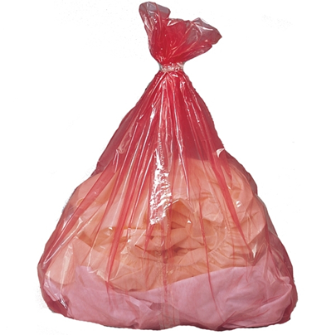
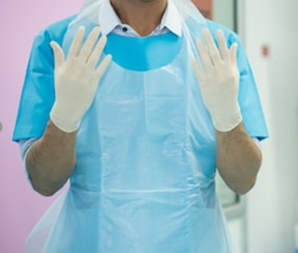

Slide 13
Transmission/Cytotoxic Precautions and PPE
Required when handling known infectious/cytotoxic contaminated items
Items are placed in a soluble bag and appropriate colour coded linen bag
Transmission PPE – dependant on the means of transmission:
  Disposable Gloves
  Disposable Long Sleeve waterproof Gown
  Eye wear (risk assessed)
  Surgical or N95 mask (risk assessed)
Cytotoxic PPE-
  Nitrile Gloves
  Disposable Long Sleeve waterproof Gown
  Eye wear
  N95 mask

Slide 14
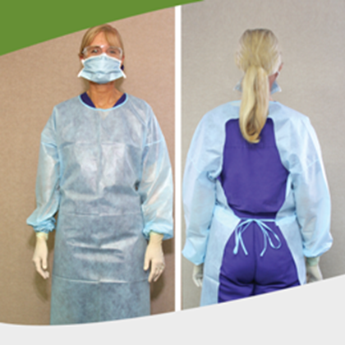
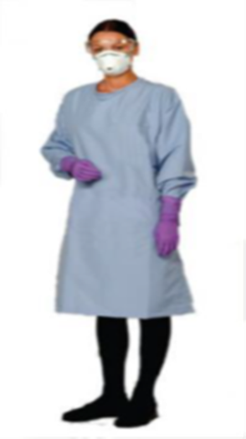
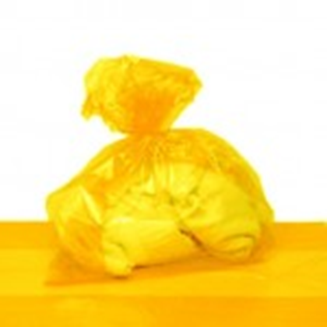
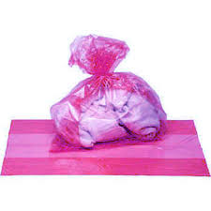

Slide 15

There is always hand hygiene

Slide 16
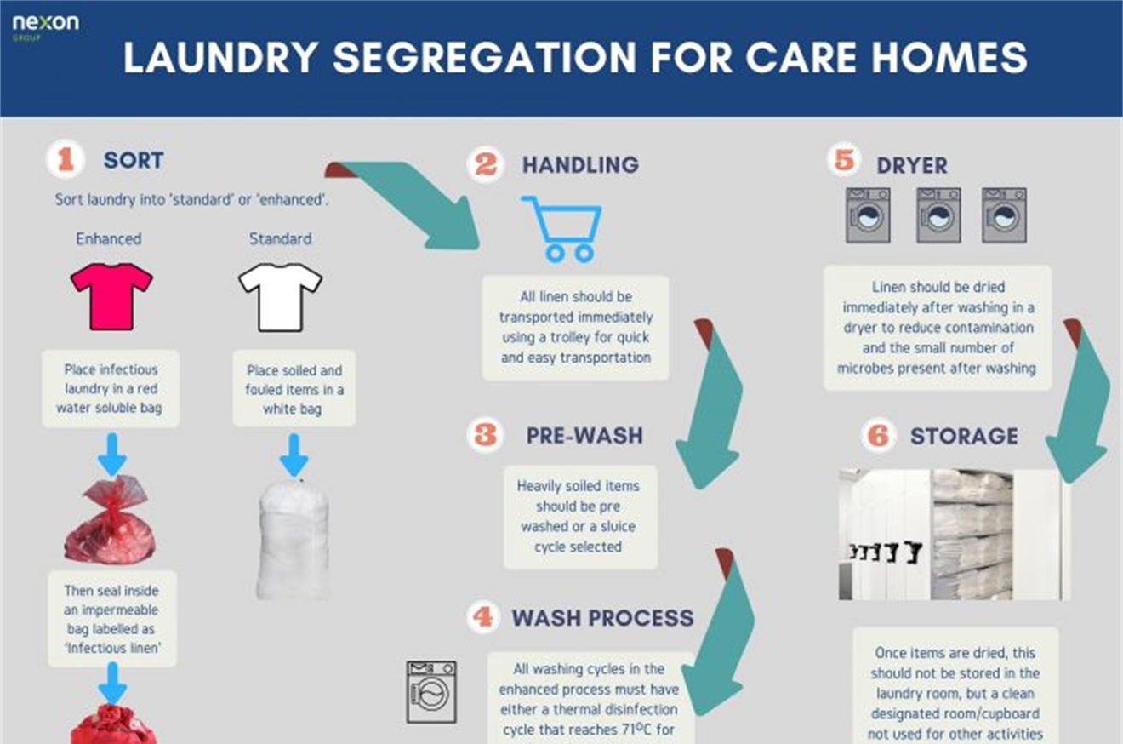
Laundering
Pathway

Slide 17
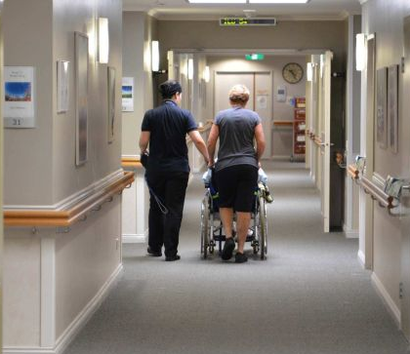
On the Floor

Slide 18

Handling, Collecting, Sorting and Transporting of Soiled Linen
PPE (risk assessed) and Hand Hygiene
Soiled linen never left on the floor
Solid matter (faeces/vomit) is discarded into toilet at care point
Pre-sort at the point of care and segregate into colour coded linen bags
Heavily soiled and infectious placed in soluble bag, and linen bag
Soluble bags never line a linen skip for multi client use
Linen bags are only ¾ filled and secured by the toggle
Bagged items are not dropped or stacked to prevent breakage
Transport occurs in designated soiled laundry trolleys/skips
Linen chutes are not recommended
Maintain correct moving, lifting and carrying techniques to prevent injury
All equipment to be regularly cleaned in accordance with the cleaning schedule
Cleaning equipment (mop heads, cloths etc.) are placed in impermeable bags (plastic bag), if infectious place in soluble bag first.

Slide 19
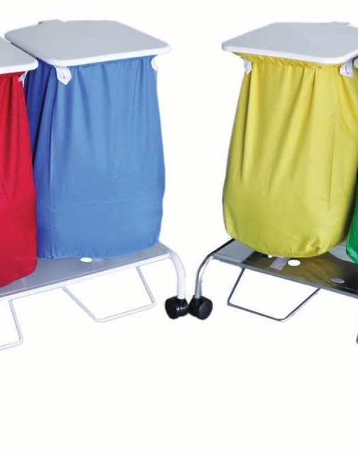
Colour Coding
Example of linen bag colour coding:
White bags = Sheets, towels, pillowcases
Blue bags = Resident clothing
Red bags = Heavily soiled items
Yellow bags = Infectious
Purple bags = Contaminated cytotoxic

Slide 20
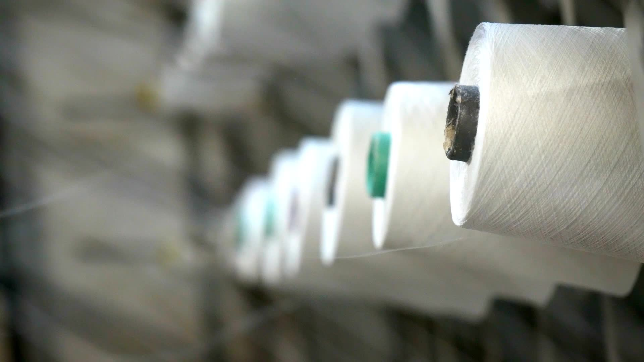
Transporting of soiled linen
PPE/Hand hygiene
Linen must be kept away from the body
Bags should be handled to avoid contents spilling
Filled soiled linen bags are transported in designated labelled soiled linen tubs/skips to unclean laundry area
Infectious, heavily soiled, cytotoxic linen is transported in designated labelled soiled linen tubs/skips (never not via chute), to the laundry
Maintain correct moving, lifting and carrying techniques to prevent injury
Soiled cleaning equipment is transported (never via chute) to the laundry and stored in designated holding container/tub

Slide 21
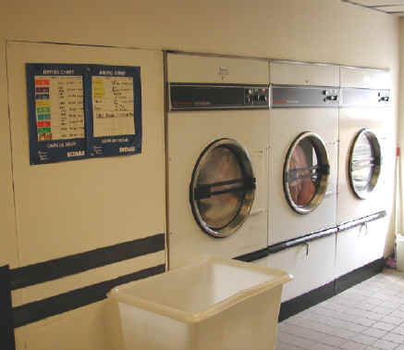
In the Laundry

Slide 22
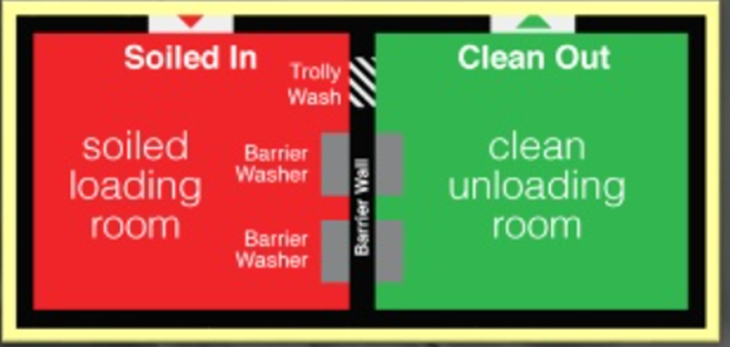
Laundry Lay Out

Slide 23
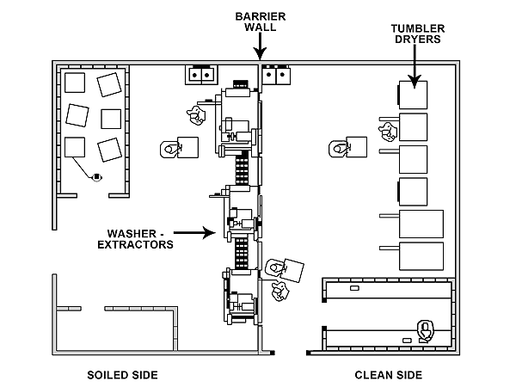
Laundry Lay Out

Slide 24
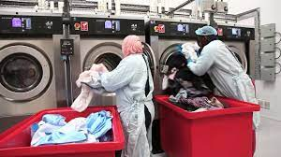
Unclean Laundry Area
Standard, Transmission or Cytotoxic PPE required (risk assessed)
Clean hands

Slide 25
Process in the laundry - unclean
Soiled Linen
Receive in designated dirty laundry area
Stored in soiled linen allocated tubs
Bags remain sealed until sorting.
Sorting
Staff wear PPE in accordance with risk.
Sort by contamination level (general, heavily soiled, infectious, cytotoxic contaminated) and fabric type (whites, colours, fragile fabrics).
Soluble bags are not opened and enter the machine whole
Loading Washer
No domestic washers
Load based on machine capacity – avoid over/underloading.
Select validated wash cycle (thermal or ozone).
Transfer to dryer
Clean apron and gloves, attend HH
Avoid contact between clean linen and dirty surfaces.
Use clean linen allocated tub to transfer

Slide 26
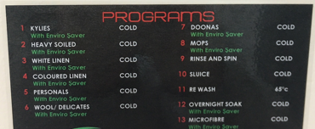
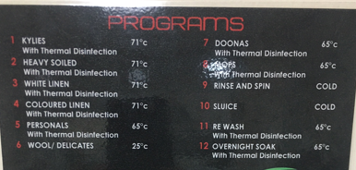
Washing machine process programs
Ozone disinfection
Thermal disinfection

Slide 27
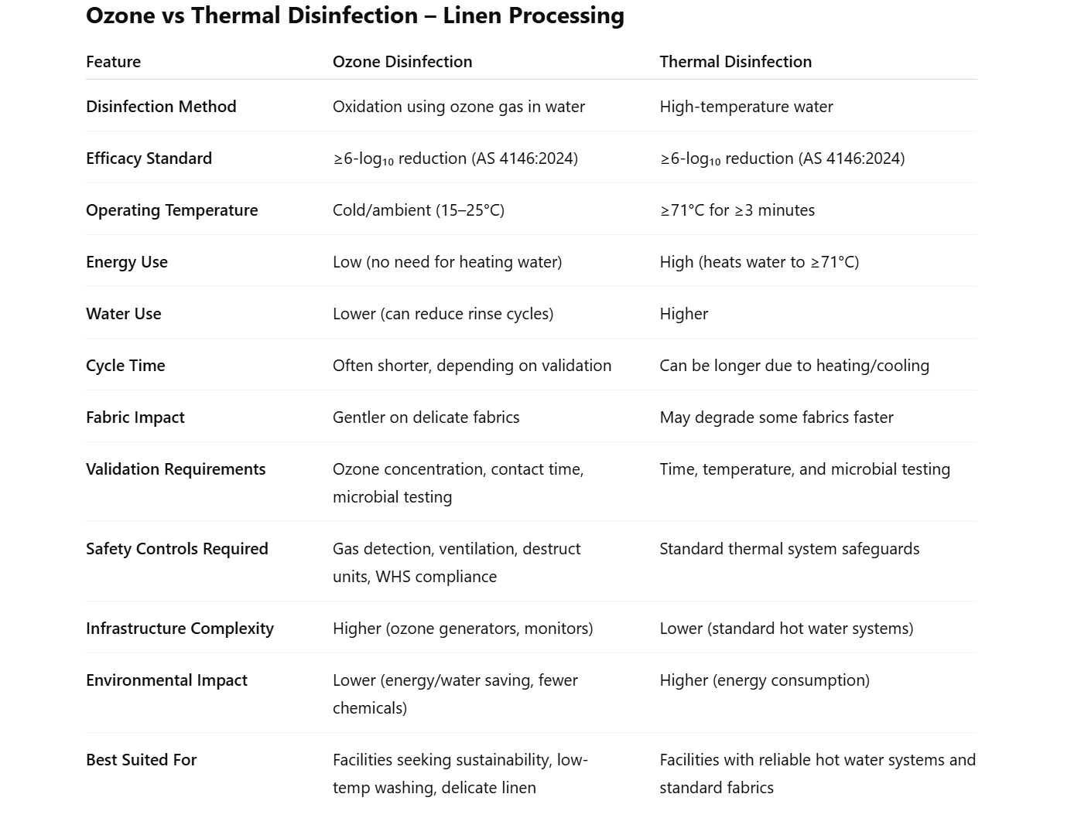


Slide 28
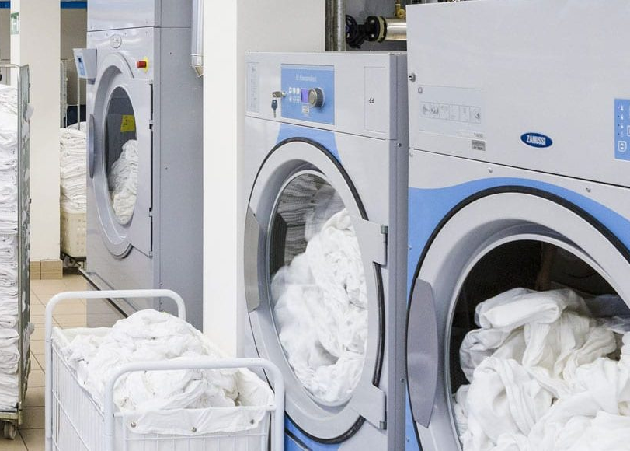
Clean Laundry Area
No PPE required in the clean area
Just:
  Clean hands
  Clean uniform

Slide 29
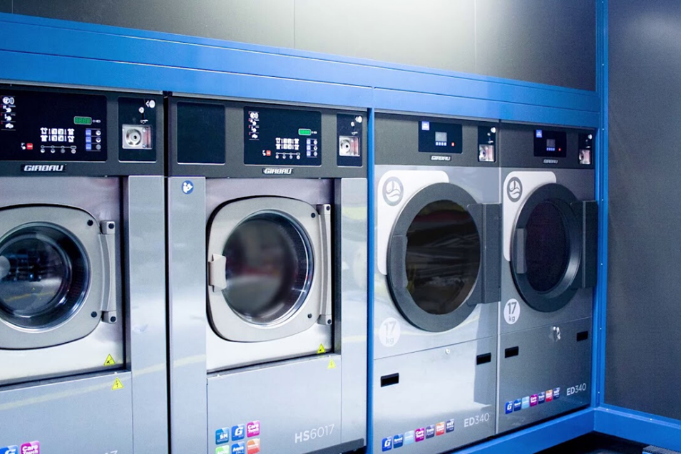
Dryers Process
Use healthcare-grade dryers (not domestic units).
Ensure ventilation with external exhaust; clean lint filters regularly.
Loading dryer
Sort by fabric type and heat capability
Avoid overloading – allows proper heat circulation.
Use moisture sensors – target <2% moisture.
Select validated temperature appropriate dry cycle
Perform regular maintenance and keep service records.

Slide 30
Process in the laundry - clean
Remove from dryer
No PPE, attend HH
Sort items for folding and hanging
Hanging and folding
Hang items – iron as per organisation guidelines
Use folding table to fold linen/clothing – not against uniform
Distribute items to transport trolleys
Note: There should be a process for external dry cleaning within the organisation

Slide 31
Transporting and Distribution of Clean Linen
Hand Hygiene
Clean linen is transported in a clean and aesthetic manner
The trolleys are covered to remain free from risk of contamination
Clean linen is not left in corridors or common areas, but taken directly to residents' rooms or storage areas
Storage areas for linen are dry and clean - a covered trolley, cupboard or secure walk-in shelved room
Linen distribution trolleys are returned to the clean area of the laundry
All equipment to be cleaned in accordance with the cleaning schedule

Slide 32
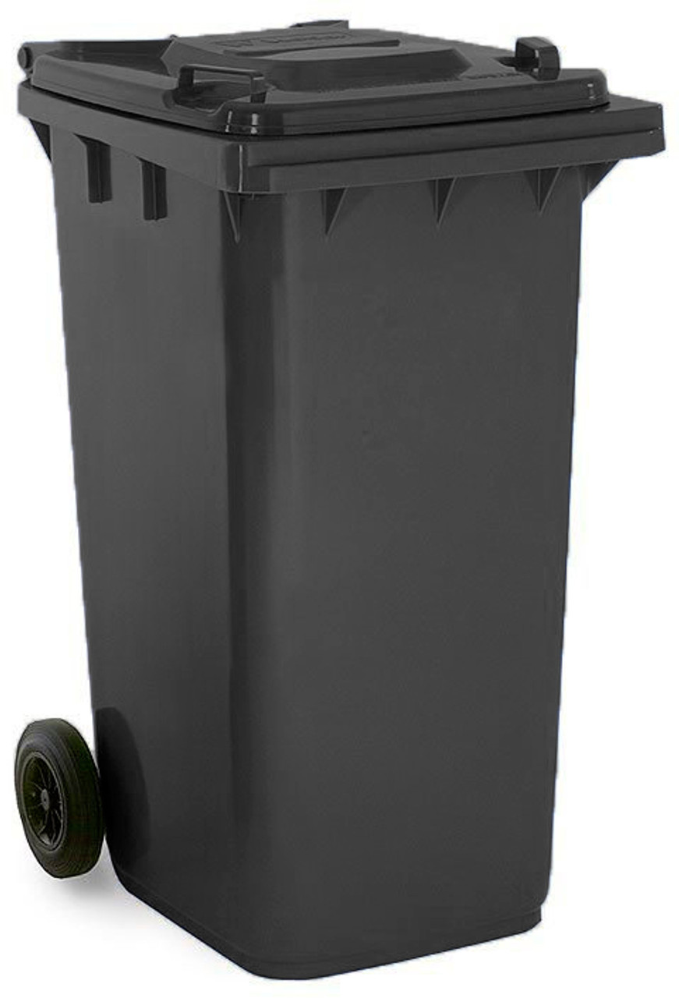
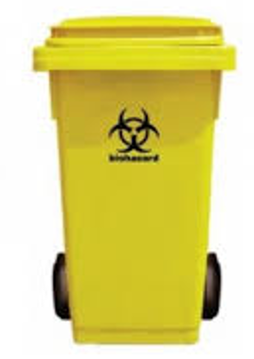
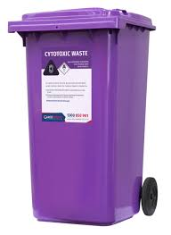
Laundry waste bins
General Clinical Cytotoxic

Slide 33
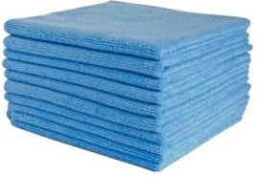
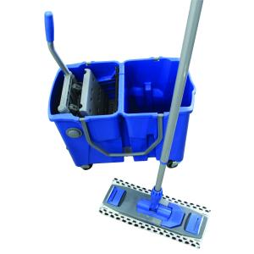
Laundry Cleaning Equipment and PPE
Different equipment required for clean and unclean areas
Standard PPE for general cleaning, Transmission PPE for infectious cleaning
Blue or noninfectious cleaning, yellow for infectious cleaning
Cleaning products inline with risk – detergent/detergent and disinfectant
Cleaning schedules and sign sheet

Slide 34
Review and Monitor of Process
Process testing
Outcome testing
Action Plan and Action
Ongoing Monitoring

Slide 35
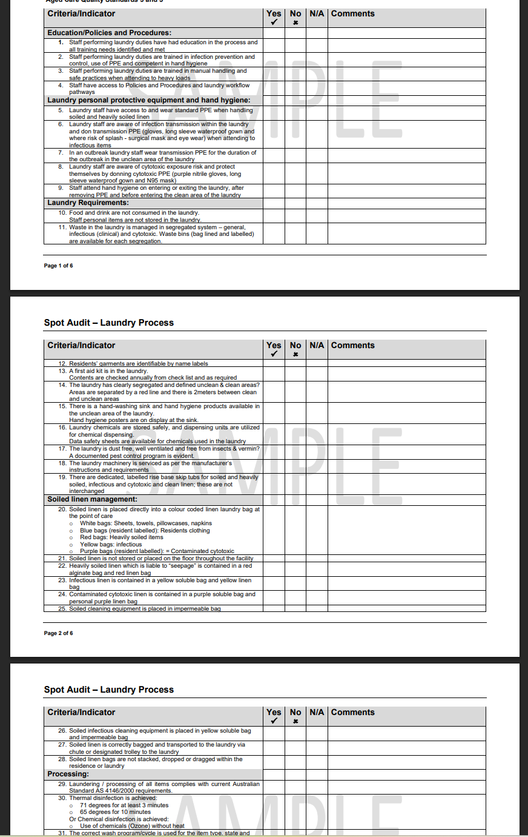
Laundry Management Auditing Example
Link:
https://www.acipc.org.au/wp-content/uploads/2024/08/Laundry-Process-Spot-Audit.pdf

Slide 36

Carrie Spinks
IPC Consultant
Australasian College for Infection Prevention and Control
Level 6
152 Macquarie Steet
Hobart TAS 7000
office@acipc.org.au
www.acipc.org.au

