Slide 1
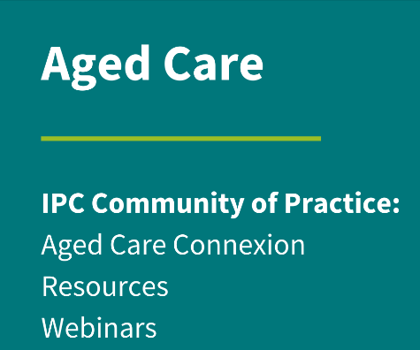
Strengthened Aged Care Quality Standards and IPC: What they mean for your facility
Logan Heather

Slide 2
ACIPC acknowledges Aboriginal and Torres Strait Island people as the traditional owners of country throughout Australia and ngā iwi Māori as the people of the land of Aotearoa and respects their continuing connection to culture, land, waterways, community, and family.

Slide 3
Aged care reform - Background
Royal Commission into Aged Care Quality and Safety (2021).
Ageing population.
Public concerns.
Reforms will bring positive, lasting changes to aged care to put the rights and needs of older people first.

Slide 4
Aged care reform – Key reform changes
Change | Replace current | Purpose of change
Aged Care Act 2024 | Aged Care Act 1997 Aged Care (Transitional Provisions) Act 1997 Aged Care Quality and Safety Commission Act 2018 | Improve how services are delivered to people in: Their homes Community settings Approved residential aged care homes.
Strengthened Aged Care Quality Standards | Aged Care Quality Standards (from 8 to 7 standards) | Recommendation from Royal Commission to be more comprehensive, detailed and objective. Rights are embedded Strengthened focus areas – dementia care, governance, food and nutrition, diversity, and clinical care.

Slide 5
New Aged Care Act 2024 – Implications for IPC
Statement of Rights:
increased autonomy and independence of older people;
strengthened person-centred care principles (…in IPC).
High Quality Care:
puts the individual first;
trauma-informed care (especially important in infection prevention principles i.e., isolation);
service upholds the rights of the individual;
individualised care, kindness, compassion and respect, person-centred care, timeliness and responsiveness, connection to community, natural environment and activities;
upskilling and empowerment of workers (with IPC knowledge and skills).

Slide 6
New Aged Care Act 2024 – Concern for IPC
Strengthened vaccination requirements.
Must provide clients and aged care workers free access to:
influenza vaccination; and
COVID-19 vaccination.
Strengthened IPC governance in the Standards (Standard 2, Standard 4, Outcome 4.2; Standard 5, Outcome 5.2).

Slide 7
Strengthened Aged Care Quality Standards
More comprehensive, detailed and objective.
From 8 to 7 standards.
Rights are embedded and strengthened focus areas (including clinical care and IPC).

Slide 8
Strengthened ACQS: Implications for IPC
Note: all standards have implications for IPC, but this presentation will only focus on 2 of them.
Standards that specifically apply to IPC:
Standard 4: The environment
Outcome: 4.2: Infection prevention and control (IPC).
Standard 5: Clinical care
Outcome 5.2: Preventing and controlling infections in clinical care.

Slide 9
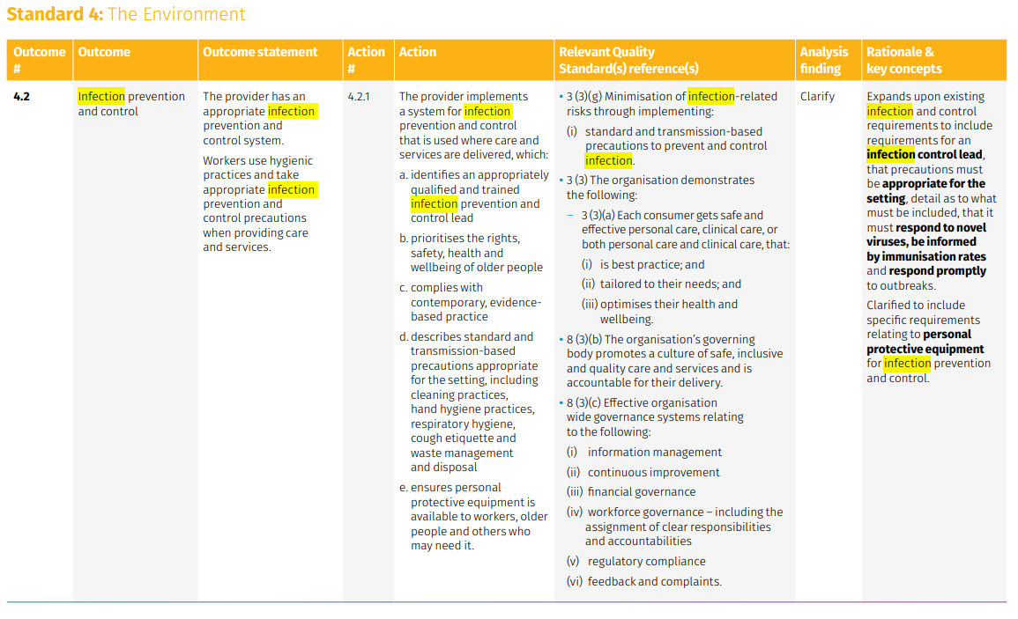
Standard 4 (Outcome 4.2)

Slide 10
Standard 4 (Outcome 4.2)

Slide 11
Outcome 4.2: IPC
Ways to apply this in practice:
ensure each facility has an IPC system (program).
support people receiving our care to feel safe in their home environment by identifying and reducing environmental risks.
provide a well-maintained service environment.
design a service environment that allows people to move freely.
use high-quality IPC processes.

Slide 12
Outcome 4.2: IPC
Detailed IPC procedures that cover:
Hand hygiene.
Cleaning and maintenance of equipment and the physical environment.
Disinfection methods.
Respiratory hygiene and cough etiquette.
Waste management.
Handling of linen.
Use of PPE.
Outbreak management.

Slide 13
Outcome 4.2: IPC
Existing resources to support your facility:
Australian Guidelines for the Prevention and Control of Infection in Healthcare | Australian Commission on Safety and Quality in Health Care.
The Aged Care Infection Prevention and Control Guide.
Infection prevention and control | Aged Care Quality and Safety Commission.
Aged Care - ACIPC - Australasian College for Infection Prevention and Control (great resources, tools, and templates).

Slide 14
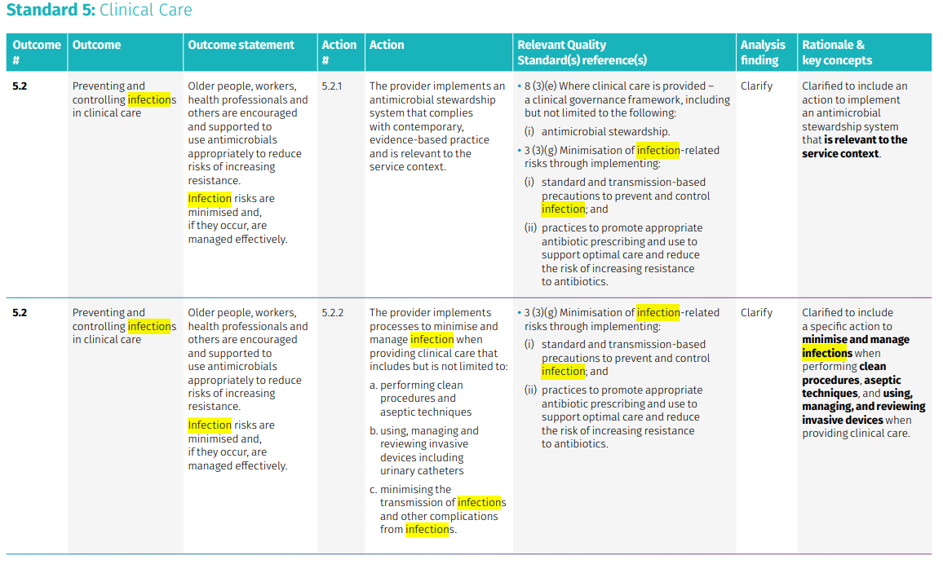
Standard 5 (Outcome 5.2)

Slide 15
Outcome 5.2: Preventing and controlling infections in clinical care
Ways to apply this in practice:
Follow evidence-based IPC strategies and national and local IPC guidelines.
Clinically trained and qualified workers and health professionals should use aseptic technique during relevant procedures.
Implement an AMS program to promote appropriate use of antimicrobials, improve care outcomes, and reduce negative effects of antimicrobials (including antimicrobial resistance, toxicity and unnecessary costs).

Slide 16
Outcome 5.2: Preventing and controlling infections in clinical care
Detailed IPC policy that cover:
Antimicrobial Stewardship principles.
Clean technique and aseptic technique.
Use, management, and review of invasive devices.

Slide 17
Outcome 5.2: Preventing and controlling infections in clinical care
Existing resources to support your facility:
The Aged Care Infection Prevention and Control Guide.
Antimicrobial Stewardship Self-Assessment Tool and User Guide | Aged Care Quality and Safety Commission.
To Dip or Not to Dip audit tool | Aged Care Quality and Safety Commission.
Aged Care - ACIPC - Australasian College for Infection Prevention and Control:
AMS section
Australasia Aseptic Technique Resources - ACIPC - Australasian College for Infection Prevention and Control.
FACTSHEET for health service organisations and primary care providers AURA.

Slide 18
Strengthened ACQS: Is your facility ready?

Slide 19
Strengthened ACQS: Is your facility ready?

Slide 20
Strengthened ACQS: Is your facility ready?

Slide 21
Strengthened ACQS: Is your facility ready?

Slide 22
Strengthened ACQS: Is your facility ready?

Slide 23
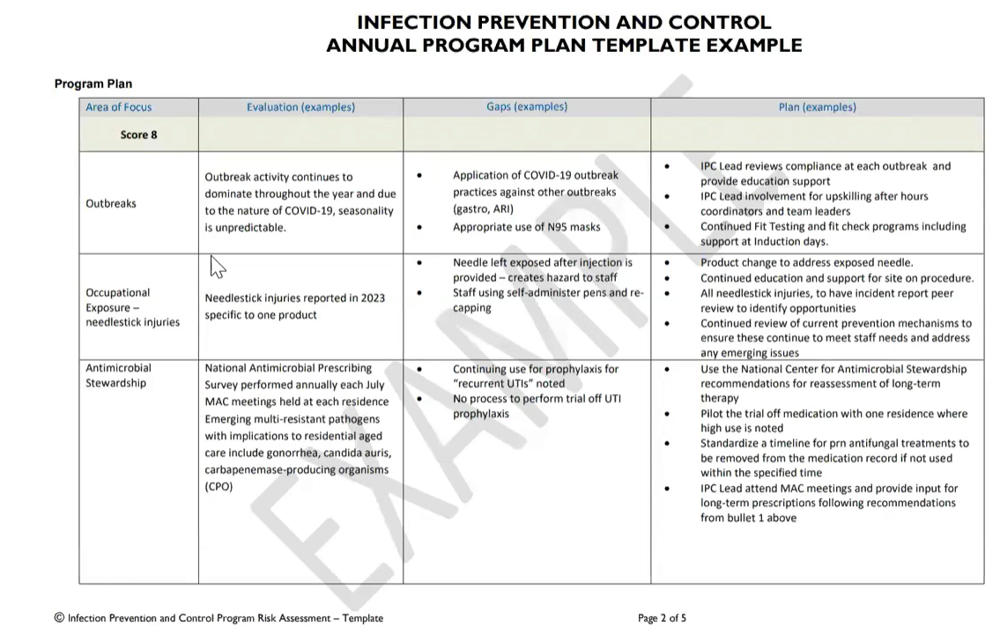
IPC Plan: Helpful resources
Refer to ACIPC – Aged Care IPC in Focus for more information.
Helpful webinar below: Looking at your facility through an IPC lens on Vimeo.
Hot tip: Document the frequency of reviews and date of next scheduled review in the IPC plan.

Slide 24
Strengthened ACQS Readiness: Person-centred care
As per the The Aged Care Infection Prevention and Control Guide:
Risk-based isolation: balancing the risk of isolation with the risk of acquiring and transmitting infection and psycho-social wellbeing of the individual (p. 88).
Person-centred IPC strategies: (p. 90 – 91):

Slide 25
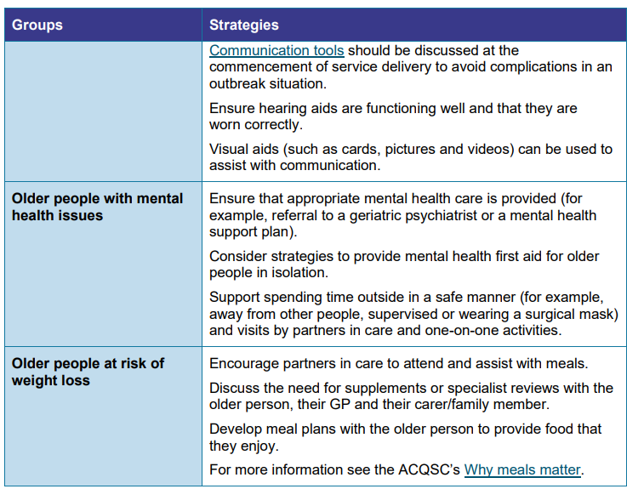
Strengthened ACQS Readiness: Person-centred care
As per the The Aged Care Infection Prevention and Control Guide:
Risk-based isolation: balancing the risk of isolation with the risk of acquiring and transmitting infection and psycho-social wellbeing of the individual (p. 88).
Person-centred IPC strategies: (p. 90 – 91):

Slide 26
Conclusion
Changes coming are not significantly new.
Vaccination and Antimicrobial Stewardship Principles are reinforced.
IPC in aged care must be person-centred and trauma-informed.
Always come back to the basics:
Standard precautions;
Transmission-based precautions;
Outbreak management principles.

Slide 27
References
About the new Aged Care Act and key changes for providers | Aged Care Quality and Safety Commission
Aged Care Act 2024
Supporters | Aged Care Quality and Safety Commission
Strengthened Aged Care Quality Standards – February 2025 | Australian Government Department of Health and Aged Care
About the Aged Care Act 2024 plain language fact sheet | Australian Government Department of Health and Aged Care
Draft: worker guidance
Strengthened Quality Standards framework analysis
The Aged Care Infection Prevention and Control Guide.
Antimicrobial Stewardship Self-Assessment Tool and User Guide | Aged Care Quality and Safety Commission.
To Dip or Not to Dip audit tool | Aged Care Quality and Safety Commission.

Slide 28
References
Aged Care - ACIPC - Australasian College for Infection Prevention and Control.
Australasia Aseptic Technique Resources - ACIPC - Australasian College for Infection Prevention and Control.
FACTSHEET for health service organisations and primary care providers AURA.
Australian Guidelines for the Prevention and Control of Infection in Healthcare | Australian Commission on Safety and Quality in Health Care.
Global report on infection prevention and control 2024.

Slide 29
Logan Heather Anglicare Southern Queensland Linked In Logan Heather MACN
Australasian College for Infection Prevention and Control
Level 6
152 Macquarie Steet
Hobart TAS 7000
03 6281 9239
office@acipc.org.au
www.acipc.org.au

