Slide 1
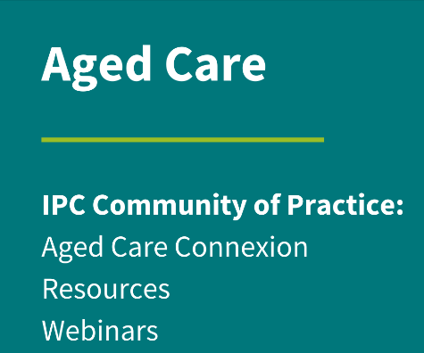
IPC in Home Care

Slide 2
Aged Care Space - Community of Practice: https://www.acipc.org.au/aged-care/
Aged Care 2025 webinar series: https://www.acipc.org.au/acipc-aged-ipc-webinar-series/

Slide 3
Join us and be interactive
Scan the bar code with your phone and join the polls
Q&A in the chat function of webinar and within Slido
Broader questions can go on the Aged Care Connexion: https://www.acipc.org.au/members/aged-care-connexion/

Slide 4
Please download and install the Slido app on all computers you use
Join at slido.com #2848621
ⓘ Start presenting to display the joining instructions on this slide.

Slide 5
Please download and install the Slido app on all computers you use
What is your role?
ⓘ Start presenting to display the poll results on this slide.

Slide 6
Please download and install the Slido app on all computers you use
Where are you from?
ⓘ Start presenting to display the poll results on this slide.

Slide 7
Please download and install the Slido app on all computers you use
What sector are you in?
ⓘ Start presenting to display the poll results on this slide.

Slide 8
Irene Barron
Manager, Infection Prevention and Control
Irene is a Registered Nurse with a Post-Graduate Diploma in Infection Control, a Master of Nursing, and Expert Infection Control Professional (CICP-E) credentials. She began her career in infection control at King Faisal Specialist Hospital in Riyadh, Saudi Arabia, serving as a practitioner, coordinator, and Assistant Director. Upon returning to Australia, Irene worked as the infection control and staff health nurse at the SA Health Dental unit, followed by six years as Manager of Infection Prevention and Control at Silverchain, a nationwide health and aged care service provider. Irene is dedicated to continuous learning in infection control and is committed to ensuring the safety of staff, clients, and families while inspiring others in the field.

Slide 9
Infection Prevention and Control in Home Care
Irene Barron
Manager, Infection Prevention and Control
Email: irene.barron@silverchain.org.au

Slide 11
Disclaimer
No conflicts of interest to declare.

Slide 12
Home Care Purpose
Support the discharge of clients from acute care to a community-based setting
When extra help or care is needed, to support people to continue living in their home or other community-based setting (such as in-home, clinic, hotel, social centre, residential care, respite, long-term care facility, other)
Provide specialist care within a community-based setting

Slide 13
If you work in home care what kind of services does your organisation offer?
Health care services
Social care services
Acute and chronic disease management
(e.g. dementia care, diabetes, oncology, renal, etc)
Allied health services (e.g. physio, occupational therapy, podiatry, dietitian, speech therapy, etc)
Assessment of care requirements
Disability support and care
Hospital in the home
Invasive device management and / or treatment (e.g. central, peripheral or subcutaneous line, urinary catheter, wound drain, trach, feeding tube, etc)
Medication management
(e.g. DOT therapy, IV or oral medication administration, e.g. antimicrobials, chemotherapy, etc)
Palliative / end of life care
Post discharge review and care
Respiratory care
Virtual care / telehealth services
Wound, stoma, or fistula (e.g. dialysis) care
other
Assessment of care requirements
Allied health services (e.g. physio, occupational therapy, podiatry, dietitian, speech therapy, etc)
Domestic assistance
(e.g. cleaning, meal preparation, laundry, etc)
Equipment and supplies
(e.g. beds, medical equipment and supplies)
Gardening
Home modifications and maintenance
Personal care (e.g. showering, dressing, etc)
Respite and carer support services
Safety and alert alarms
Social support and companionship
(e.g. in-home, community centre, outings, shopping, picnics, restaurant, etc)
Transport (social, non-emergency)
other

Slide 14
Who is your workforce and what is their learning and support needs?
Health care services
Social care services
Physician
Nursing
Allied Health
e.g. pharmacy, occupational therapy, physiotherapy, podiatry, speech therapy, social services, dental)
other
Nursing
Allied Health
Care aide
Domestic worker
Home help
Contract workers
Volunteer
Gardener
Maintenance
other

Slide 15
Goals of IPC Program/System
Provides IPC expertise and oversight of organisational infrastructure, clients, employees and others (as appropriate and as per role/responsibilities)
Meets organisational and strategic priorities – with support and standardisation
Is relevant to the client population and services being offered
Meets accreditation and jurisdictional (e.g. state or national) requirements
Collaborates with key stakeholders (internal and external)
Applies strategies to address, manage and decrease IPC related risks (i.e. infections and infectious risks)
Undertakes compliance auditing, reporting and implementing measures to meet or exceed benchmark
Strives for continuous improvement
IPC is everyone’s responsibility
Management
IPC team or leads responsible for IPC oversight
Workforce
Clients & Carers

Slide 16
References
Aged Care Quality Standards
Australian Commission on Safety and Quality in Healthcare
National Safety and Quality Health Care Standards (NSQHS)
National Safety and Quality Primary and Community Healthcare Standards
Australian Guidelines for the Prevention and Control of Infection in Healthcare
The Aged Care Infection Prevention and Control Guide
Food Standards Australia New Zealand
Food Safety Standards
Department of health and aged care food standards and safety
Australian Government Department of Health and Aged Care
The Australian Immunisation Handbook State-based - Infection Prevention and Control or Communicable Disease Branch
Accreditation demonstrates that an organisation is:
providing high quality care,
meets evidence-based standards
can highlight key areas for improvement.

Slide 17
Key IPC Policy/Procedures
Key IPC Policy/Procedures
Standard precautions principles (i.e. hand hygiene (cleansing & skin care) , PPE selection, donning & doffing sequence, fit testing, respiratory hygiene and cough etiquette, aseptic technique, sharps management, BBFE occupational exposure, reprocessing/disinfection of reusable equipment or instruments, cleaning of environment, equipment & vehicle, linen handling, waste management,…)
Transmission-based precautions principles (i.e. contact, airborne and droplet - appropriate management, commencement and discontinuation)
Management of outbreaks/clusters
Incident and near miss reporting

Slide 18
Key IPC Policy/Procedures
Key IPC Policy/Procedures
Antimicrobial stewardship (i.e. prescribing & administration within scope of practice, monitoring for resistance)
Device management (for specific invasive and non-invasive devices)
Animal and pest control
Biohazard spills (body fluids, body fluids while on chemotherapy)

Slide 19
Key IPC Policy/Procedures
Key IPC Policy/Procedures
Storage and/or transportation of reusable equipment and supplies
Management of clinical consumables; storage and/or transportation of sterile supplies, single use, temperature and humidity sensitive clinical supplies
Cleaning and disinfection
Food handling ( i.e. receiving, item recall, storage, preparation and serving)
Construction & renovation
Other…

Slide 20
IPC Activities & Risk Reduction
Worker Health
Sick leave and attendance
Immunisation program (i.e. Hep B, MMR, Tetanus/Pertussis, Varicella and TB screening)
Sharps, splash and spray incidences to blood and body fluids
Annual seasonal influenza and COVID-19 vaccination
Respiratory fit checking / testing program

Slide 21
IPC Activities & Risk Reduction
Infection / Infectious Risks
Vulnerable, high risk or complex clients (i.e. invasive devices, wounds, immunosuppressive treatment, acute or chronic comorbidities, physical and psychological health, disabilities, cognitive, behavioural & social issues, communal living, etc…..)
Surveillance and monitoring for healthcare associated infections
Identification of infection and infectious risks and hazards (i.e. Assessments & communications during transitions of care, use of an infectious disease (ID) screening tool, conversation with clients or through observation during care delivery)
Escalation processes
Communication of clients on transmission-based precautions across providers and disciplines (i.e. referral and assessment documentation)
Incident, near miss and consumer feedback reporting

Slide 22
IPC Activities & Risk Reduction
Infection Prevention and Control Education, Training and Compliance
Qualifications, experience, mentorship and meeting learning needs
Incident reporting and consumer feedback
Consumer awareness, education and engagement (hand hygiene, transmissible diseases, infection prevention, device care, antimicrobial usage, etc)
New employee (and volunteer) induction education
Regular interval or one-off educational activities
IPC Link/team lead education
Compliance auditing, analysis, reporting and dissemination, implementation of improvement strategies

Slide 23
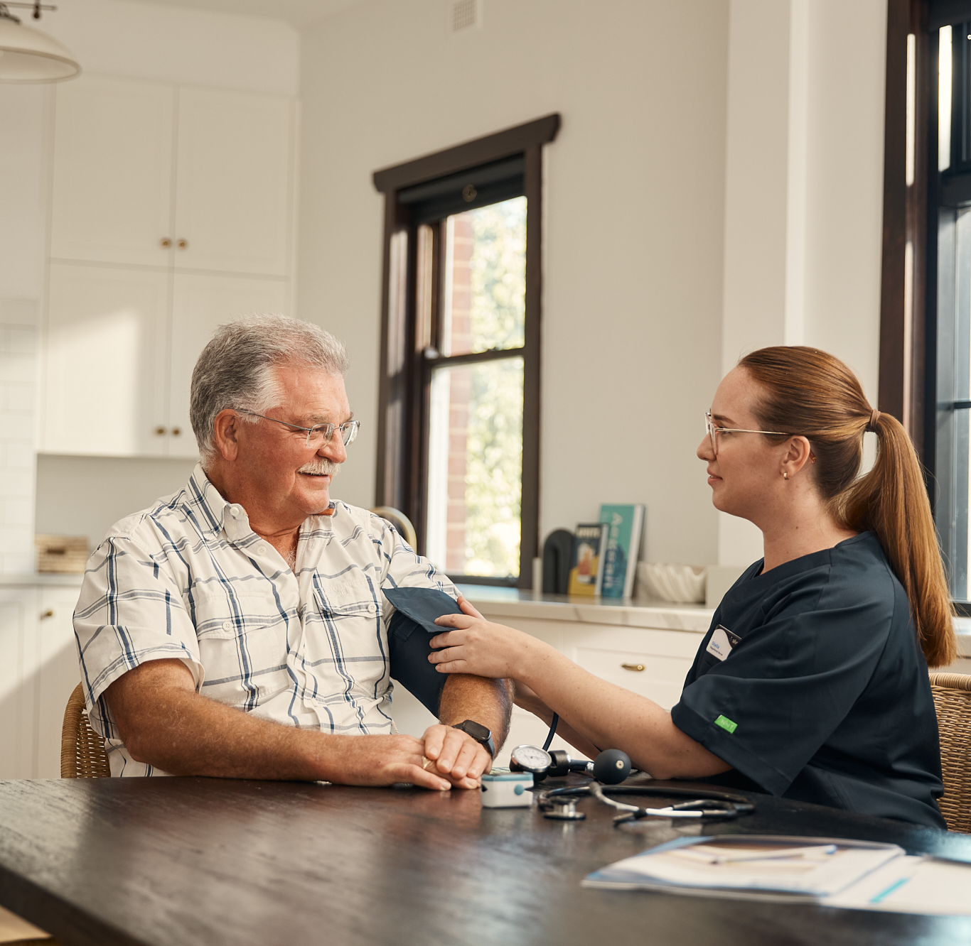
Video – Home Care
IPC in action and opportunities to reduce risk

Slide 24
Notes:
Video
4:15.13min

Slide 25
Please download and install the Slido app on all computers you use
Do you believe your organisation's IPC activities meet staff and clients needs?
ⓘ Start presenting to display the poll results on this slide.

Slide 26
Please download and install the Slido app on all computers you use
For your own organisation, in one to two words list some IPC areas that may represent opportunities for improvement?
ⓘ Start presenting to display the poll results on this slide.

Slide 27
Please download and install the Slido app on all computers you use
Audience Q&A
ⓘ Start presenting to display the audience questions on this slide.

