Slide 1



Welcome to ACIPC CoP webinar series 2025

Slide 2

  ACIPC acknowledges Aboriginal and Torres Strait Island people as the traditional owners of country throughout Australia and ngā iwi Māori as the people of the land of Aotearoa and respects their continuing connection to culture, land, waterways, community, and family.

Slide 3


  Aged Care Space - Community of Practice: https://www.acipc.org.au/aged-care/
Aged Care 2025 webinar series: https://www.acipc.org.au/acipc-aged-ipc-webinar-series/

Slide 4
  Join us and be interactive
  Q&A in the chat function of webinar
  Broader questions can go on the Aged Care Connexion: https://www.acipc.org.au/members/aged-care-connexion/

Slide 5
Mariana Crank
Mariana is currently a Director in Pharmacy Branch at the Department of Health and Aged Care. Her team has responsibility for a diverse range of programs including the Aged Care On-site Pharmacist Measure.

Slide 6
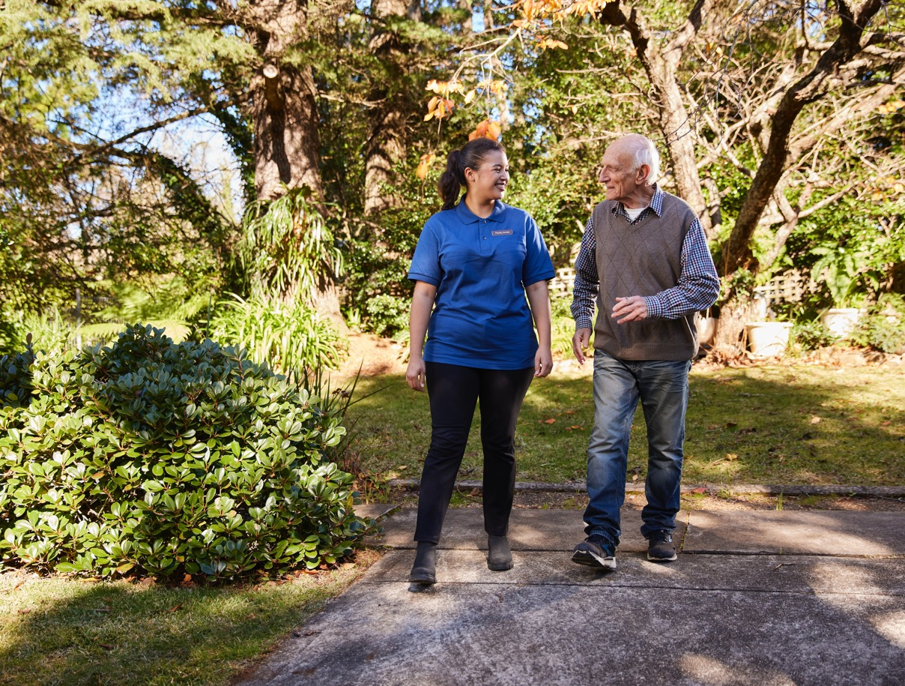
Aged Care On-site Pharmacist Measure
ACIPC Aged Care Community of Practice – 19 February 2025
Mariana Crank
Pharmacy Branch
Agedcarepharmacist@health.gov.au

Slide 7
Overview
The Australian Government is providing funding for pharmacists to work on-site in residential aged care homes (RACHs) in a clinical role.
$333.7 million allocated over four years, to be ongoing.
The Measure is a response to the Final Report of the Royal Commission into Aged Care Quality and Safety (Recommendation 38).
The Measure commenced on 1 July 2024.
The payment and claiming system for RACHs went live on 1 October 2024.

Slide 8
How the Measure works
The Measure provides funding to:
  RACHs to engage an ACOP, where:
      the RACH and a community pharmacy don’t come to a suitable agreement; or
      the RACH’s community pharmacy of choice can’t or chooses not to participate
community pharmacies can also receive funding directly to employ aged care on-site pharmacists (ACOPs) to place in RACHs.
RACHs must commit to uptake of the electronic National Residential Medication Chart (eNRMC) to access an ACOP.
Participation in the Measure is not mandatory.

Slide 9
Funding
The Measure provides funding for ACOP salaries.
  The salary is based on a grade 2 hospital pharmacist award salary averaged across the states and territories.
  The salary of $138,282 p.a. for a full-time equivalent is inclusive of on-costs including annual leave, personal leave, public holidays, and superannuation.
The ACOP salary is to be negotiated between the pharmacist and the employer (RACH or community pharmacy).
  The salary negotiation may be influenced by a range of factors such as the ACOP experience, geographical location, and workforce availability.
  Where a salary is higher than the government funded amount, any additional salary would be funded by the employer.

Slide 10
Funding Entitlement
The Measure provides funding for one full-time ACOP per 250 beds in a RACH.
Funding is blocked into 50 bed increments, equivalent to an ACOP one day per week.

Slide 11
Eligibility – employers of ACOPs
RACHs | Community Pharmacy
The RACH must be An Aged Care Facility that receives residential care facility subsidy from the Australian Government in accordance with the Aged Care Act 1997, or An Australian Government funded transition care facility, or A Multi-Purpose Service, or A Facility receiving funding under the National Aboriginal and Torres Strait Islander Flexible Aged Care program. Respite-only facilities are not eligible to participate. | Must be an approved Section 90 Community Pharmacy.

Slide 12
Eligibility – pharmacists
To participate in the Measure pharmacists must either
  have completed an Australian Pharmacy Council (APC)-accredited ACOP training program or associated recognition of prior learning process (RPL)
  have an existing Medication Management Review credential and commit to completing either:
    an APC-accredited ACOP training program
    an APC-accredited ACOP RPL program

Slide 13
ACOP credentialing and training
The Department contracted the Australian Pharmacy Council (APC) to develop accreditation standards and an accreditation system. This was to provide oversight and quality assurance of training programs for the ACOP credential.
This work concluded on 31 August 2023.
Training programs that have been APC-accredited for ACOP credentialing are published on the APC website.
  https://www.pharmacycouncil.org.au/education-provider/accreditation/pharmacist-education-programs/accredited-pharmacist-education-programs/

Slide 14
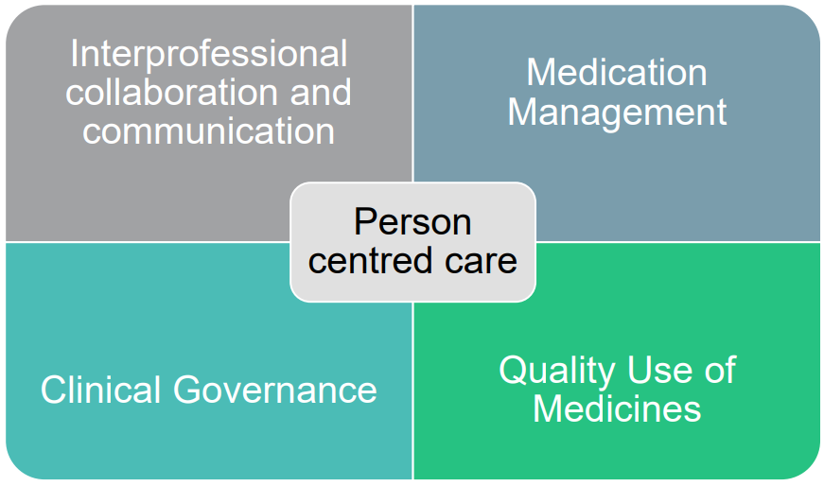
Role of the Aged Care On-site Pharmacist
The ACOP will be uniquely placed to undertake a clinical role in a RACH.
The ACOP role description is available on the APC webpage:
  https://www.pharmacycouncil.org.au/resources/pharmacist-education-programs-standards/Indicative-Role-Description.pdf

Slide 15
Person Centred Care
Be readily available and a point of contact for the RACH
Collaborate and communicate effectively with residents, their families and carers
Provide culturally safe care
Support informed and shared decision making for medication related decisions

Slide 16
Interprofessional collaboration and communication
Integrate within the multidisciplinary team
Assist with medication management and communication during transitions of care
Liaise with community pharmacy supplying medications
Communicate findings from day-to-day medication management tasks
Participate in medical rounds and case conferencing

Slide 17
Medication Management
Provide continuity in medication management by conducting regular and timely reviews of medications
  Assist with rationalising and deprescribing medications
  Identify residents taking high risk medications
  Minimise medication-related harm and use of inappropriate medicines
Medication reconciliation
Provide vaccinations if appropriately trained

Slide 18
Quality Use of Medicines
Whole-of-facility Quality Use of Medicine (QUM) activities such as:
  Observing medication administration rounds
  Conducting clinic audits and medicine use evaluations such as for psychotropics, antimicrobials and other high-risk medications
  Review of RACH policies and procedures involving medicines and recommending improvements
  Assist with the implementation and use of the electronic National Residential Medication Chart (eNRMC)

Slide 19
Clinical Governance
Help set up a Medicines Advisory Committee (MAC) where there is not one already present
Advise, attend and report to the MAC as part of governance and oversight in the RACH
Responding, analysing, reporting and proposing response to potential medication related incidents and adverse events.
Assisting the RACH with reporting of their medication management quality indicators

Slide 20
How to Participate
Australian Healthcare Associates operating under the banner of the Pharmacy Programs Administrator (PPA) is the administrator for the Measure.
Visit the PPA’s website www.ppaonline.com.au for:
  Measure rules, FAQs and to apply to participate.
Measure funds (ACOP salaries) can be claimed through the PPA portal.
Where community pharmacies employ ACOPs to place in eligible RACHs, this is referred to as Tier 1.
Where eligible RACHs directly engage ACOPs, this is referred to as Tier 2.

Slide 21
Pharmacy programs delivered in residential aged care homes
To avoid duplication of activities and funding, RACHs that take up an ACOP are not able to receive Quality Use of Medicines (QUM) and Residential Medication Management Review (RMMR) Program services from a visiting pharmacist at the same time.
Where an ACOP is not engaged, there will continue to be funding for aged care residents and RACHs to receive visiting pharmacist support under the QUM and RMMR Pharmacy Programs.
The longer-term future of QUM and RMMR Pharmacy Programs will be influenced by future funding arrangements, noting the QUM and RMMR Programs are not part of the Eighth Community Pharmacy Agreement (8CPA).

Slide 22

Supporting resources
The Department has published a guide for pharmacists and RACHs participating in the Measure, which is available for download:
Aged Care On-site Pharmacist Measure – Pharmacist and Residential Aged Care Home Guide | Australian Government Department of Health and Aged Care

Slide 23
Grant Opportunity for PHNs
ed
The Measure includes grant funding of up to $10.64 million over three years for the ACOP Measure Residential Aged Care Home Support Grant, which is designated for PHNs.
This is based on the Australian Government’s decision in MYEFO Budget 2023-24 (13/12/2024) that funding would be provided to PHNs as part of implementation of the Measure.
The Grant Opportunity was published on GrantConnect on 29 October 2024. It is a non-application based and closed non-competitive grant, only available to PHNs.
The objectives are to increase uptake of aged care on-site pharmacists by RACHs around Australia and improve access to aged care on-site pharmacists in RACHs.
The intended outcomes are improved medication management and safety in RACHs, and integration of aged care on-site pharmacists with the health care team in the RACH.
Note: PHNs will not employ aged care on-site pharmacists. That is the role of the RACHs and community pharmacies.

Slide 24


Questions?
Email: Agedcarepharmacist@health.gov.au

