Slide 1
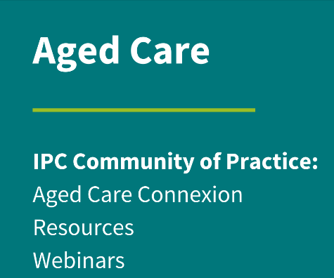
Surveillance in Aged Care

Slide 2
ACIPC acknowledges Aboriginal and Torres Strait Island people as the traditional owners of country throughout Australia and ngā iwi Māori as the people of the land of Aotearoa and respects their continuing connection to culture, land, waterways, community, and family.

Slide 3
Disclosures
No conflicts of interest

Slide 4
What is surveillance?
To keep a close watch kept over someone or something
Also known as audits or surveillance audits
Its not just bugs!
Audits can be powerful
Failing is not always a bad thing.

Slide 5
Developing an IPC Surveillance Program
You don’t need to re-invent the wheel
There are audits already out there
Use tools that are made for the purpose

Slide 6
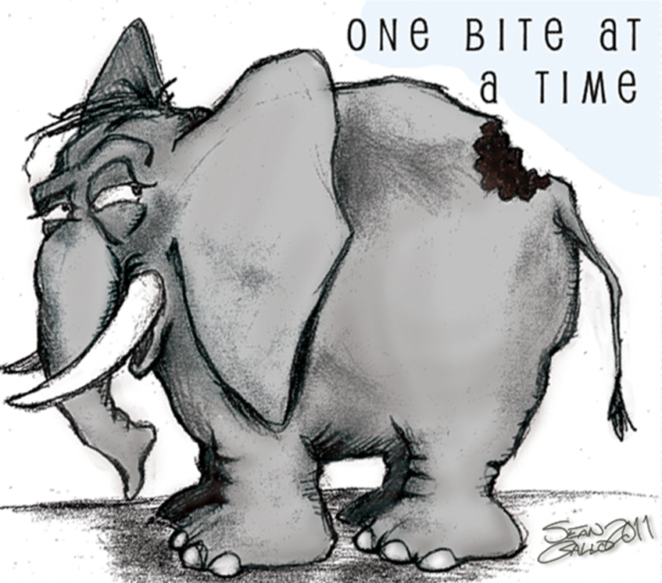
Developing an IPC Surveillance Program
Measure your progress
Set up an auditing schedule
Set a frequency that make sense for your organisation/your role
Set yourself up for success!
Choose audits that are doable
Make sure the audit suits your facility
Make it less daunting.

Slide 7
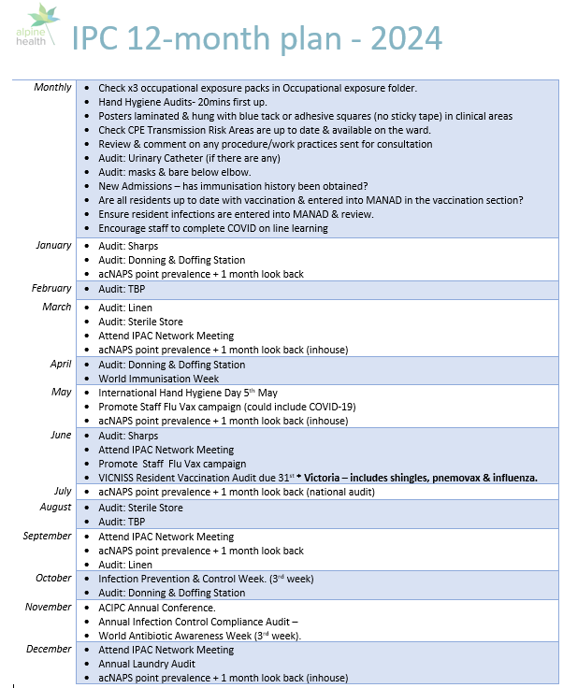
Example
Update annually
Things change
Show accreditors that you are doing a horizon scan of the changing RAC space
Not onerous
Can submit to IPC/like committee for approval
Important to tailor to your specific facilities
Content

Slide 8
Make the audit powerful!
Link it to standards!
Australian Guidelines for the Prevention and Control of Infection in Healthcare
Standard 3 Personal care and clinical care – Infection Control and AMS (3g) https://www.agedcarequality.gov.au/providers/quality-standards/personal-care-and-clinical-care
Standard 5 Service Environment – Safe Clean environment (3c) https://www.agedcarequality.gov.au/providers/quality-standards/service-environment
Standard 8 Organisation Governance (3a, b, c, d, e) https://www.agedcarequality.gov.au/providers/quality-standards/organisational-governance
AS/NZS 4146:2000 Laundry Practice *
Australian Health Facility Guidelines 0350 – Small Rural Hospitals / Multipurpose Services (MPS)
AS/NZS 5369: 2023 (formally AS4187). Reprocessing of reusable medical devices and other devices in health and non-health related facilities. *
* These are not free and on the Standards Australia website.

Slide 9
Possible things you can audit
Transmission-Based Precautions
Sharps
Laundry/Linen
Cleaning/disinfection, waste
Sterile Stores
Bare Below Elbows
Mask compliance
Catheter Care
Incontinence associated dermatitis
Staff vaccination status
Resident vaccination status
Antibiotic Use
Antifungal Use
ABHR Use
Antimicrobial Stewardship*
Infections~
Multi-resistant organisms~

Slide 10
You don’t need to re-invent the wheel
Aged-Care-Home-IPC-Operational-Compliance-Audit---August-2019-V8.pdf (grampianshealth.org.au)
Google: Grampians aged care facility infection control audit
Do once a year – measure your progress
Create an action plan - pick non-compliant items to focus on

Slide 11
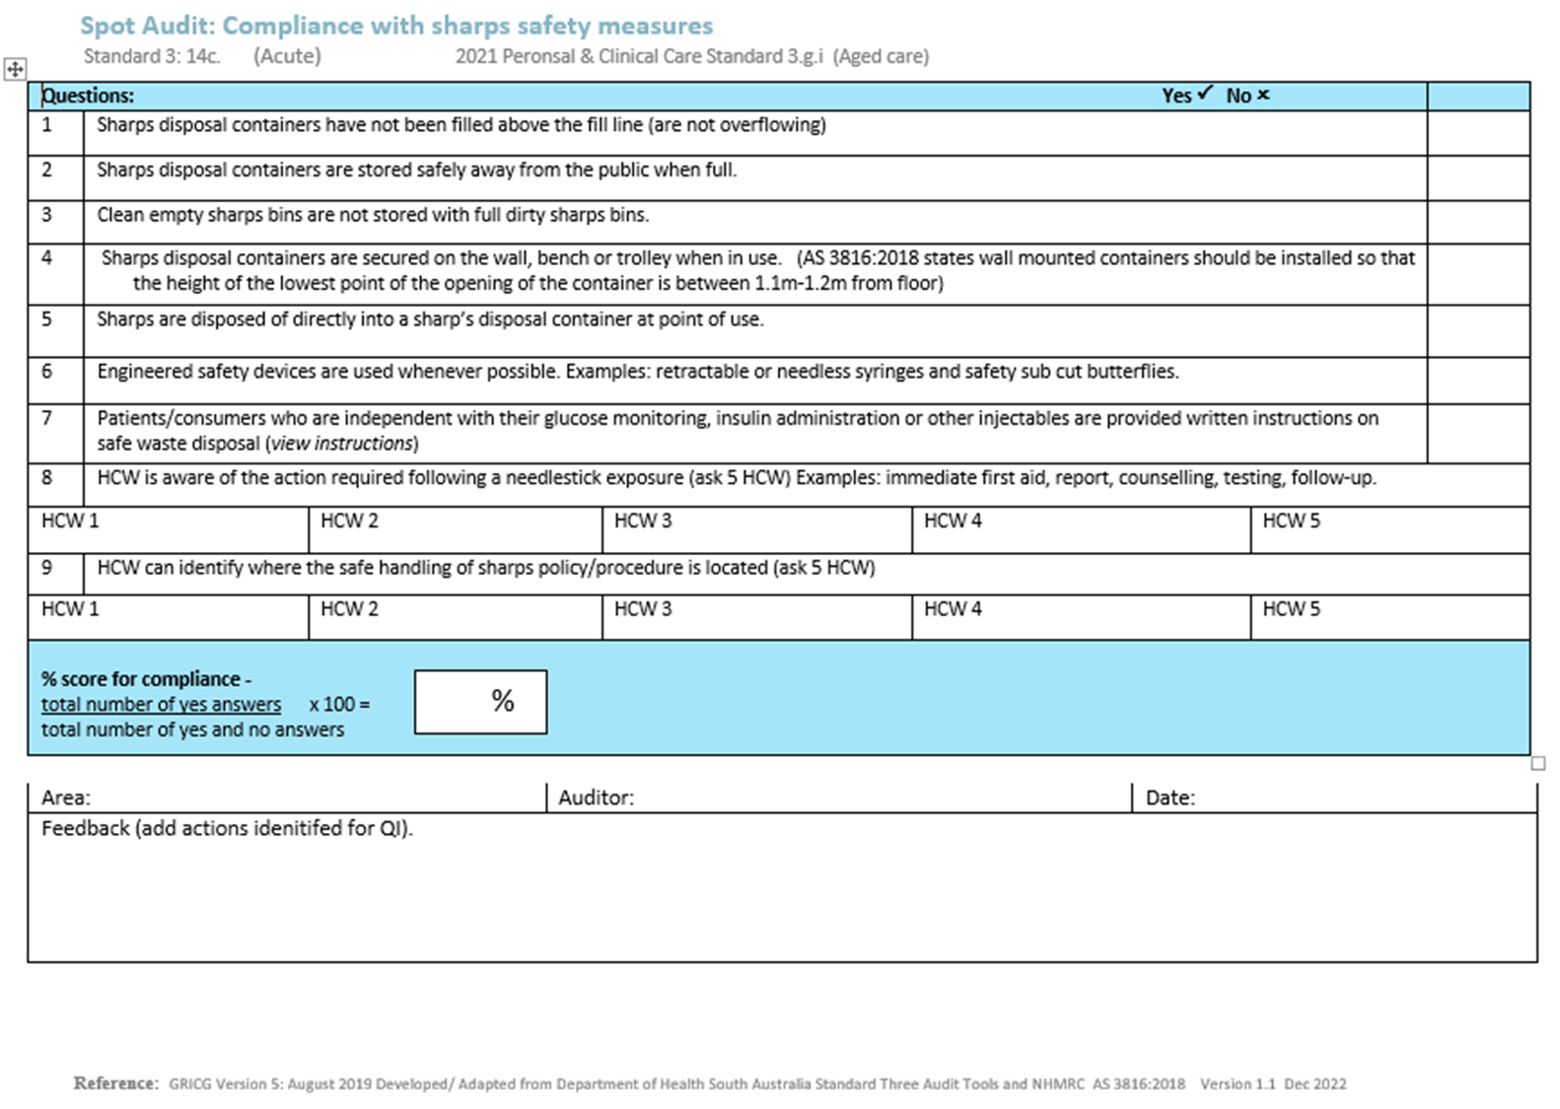
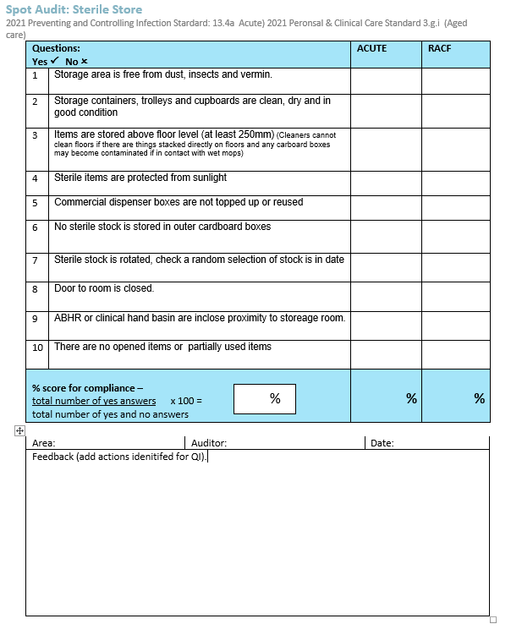
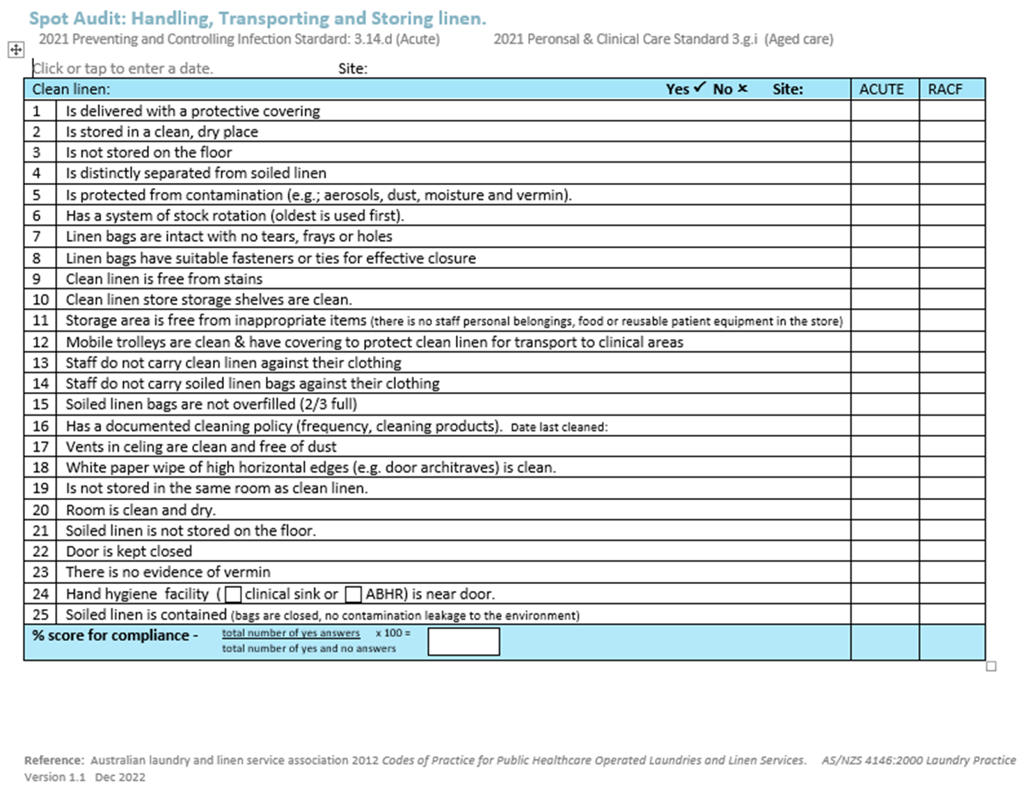

Slide 12
Format

Slide 13
NAPS
Free
Anyone can sign up
Provides consistency
Education module for auditors on the site
Benchmarks nationally
Reporting function gives instant reports
Uses McGeer Infection Criteria

Slide 14
Infection Surveillance
Consistency - Clear definitions of infection:
McGeer Infection Criteria.
Administration/documentation software – if you have it.
May have ability to monitor and track infections.

Slide 16
So…. now what?

Slide 17
Use the data
Benchmark
Floors/ wings / sites.
Partner with like facilities
Create healthy competition
Feedback
Staff
Consumers
Committee
Handover
Education Boards

Slide 18
Action Plans
Don’t need to be fancy
May have software or template already
Great way to keep focus & tract progress
Good evidence for accreditation

Slide 19
Action Plan Examples
https://www.acipc.org.au/aged-care/resources-australasian-aged-care/

Slide 20
Celebrate Successes!
Even the small success.
Create an annual report
Be creative & have fun
Tie surveillance to a promotional day/event:
World Immunisation Week – April
World Hand Hygiene Day 5th May
Infection Prevention Week October
Thank your cleaner day – 16th October
World Antimicrobial Awareness Week - November

Slide 21
Resources
ACIPC- aged care connexion
ACIPC - IPC Resources for Australasian Aged Care and Home Care
Ask Questions
Mentor
Colleagues – you are not alone
National Center for Antimicrobial Stewardship -NCAS
National Antimicrobial Prescribing Survey - NAPS

Slide 22
More Resources
Centers for Disease Control – CDC (USA and Australia’s is coming!!)
info@agedcarequality.gov.au
Melbourne Vaccination Education Centre - MVEC
Australian Immunisation Handbook
National Centre for Immunisation Research and Surveillance Australia – NCIRS
Aged Care Quality and Safety Commission

Slide 23
Remember….
A waterfall begins from only one drop of water.

Slide 24
Kelly Barton Infection Control Consultant Alpine Health kelly.barton@alpinehealth.org.au
Australasian College for Infection Prevention and Control
Level 6
152 Macquarie Steet
Hobart TAS 7000
03 6281 9239
office@acipc.org.au
www.acipc.org.au

