Slide 1
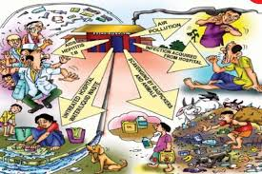
WASTE MANAGMENT

Slide 2
Waste
Everything is made for a defined purpose.
Any thing which is not intended for further use is termed ‘Waste’

Slide 3
Health Care Waste and Waste Management
Health care waste includes waste generated by health-care establishments
Waste Management/Disposal includes the actions required to manage waste from its point of generation to its final disposal

Slide 4
Effective Waste Management
National Policy, Legislation, Strategy Plan, Local Guidelines
Political and organisational commitment
Committed and trained manpower
Good management
Budgetary allocation

Slide 5
Governed By
Standard AS/NZS 3816: 2018 Management of clinical and related waste
Waste Management Association of Australia’s industry code of practice
State and Territory waste management resources
Aged Care Quality - Standards 5

Slide 6
Types of Waste
Waste | Example
Infectious waste | Blood and other bodily fluids - waste from residents with infections (e.g. swabs, bandages, indwelling devices, PPE and disposable medical devices)
Sharps waste | Syringes, needles, disposable scalpels and blades, etc.
Chemical waste | Solvents and reagents and batteries
Pharmaceutical waste | Expired, unused and contaminated drugs and vaccines
Cytotoxic waste | Waste containing substances with genotoxic properties –such as chemotherapy
General waste | Any waste that does not pose any particular biological, chemical, radioactive or physical hazard

Slide 7
Generated Waste Composition

Slide 8
Risks Of Poor Waste Management
Injuries from sharps
Infection transmission risks, personal, facility and community wide
Water contamination
Air contamination
Environment contamination
Burns from chemicals
Manual Handling – personal damage

Slide 9
Who's at risk?
Nursing staff
Environmental staff
Housekeeping/Catering Staff
Contractors
Residents
Families/friends
Community

Slide 10
Ideal Waste Management

Slide 11
WHO Waste Management Cycle

Slide 12
Waste Management Process

Slide 13
Waste Sorting and Identification
Sort waste into different colour coding
Colour coding identifies type of waste
Identification enables safe handling, transportation and waste treatment

Slide 14
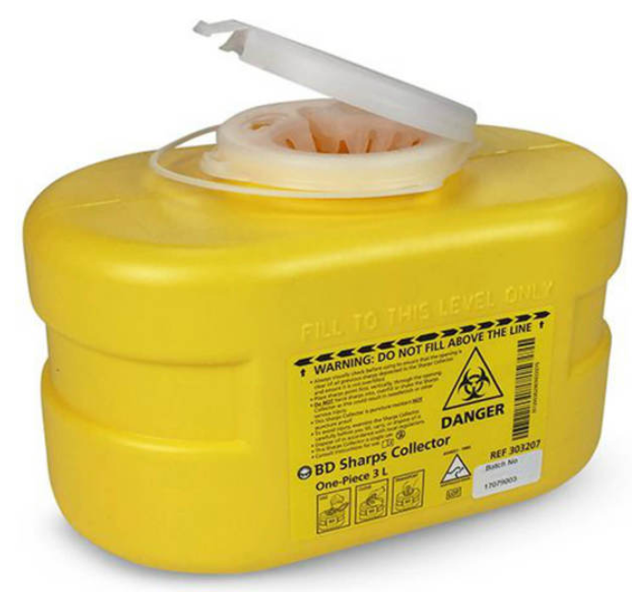
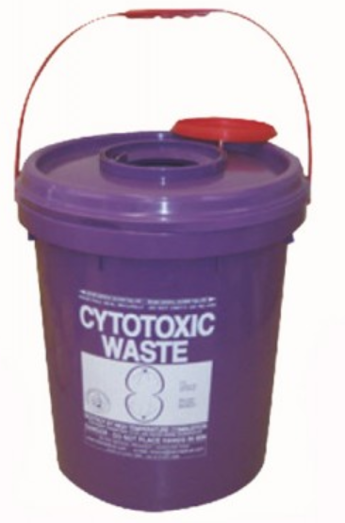
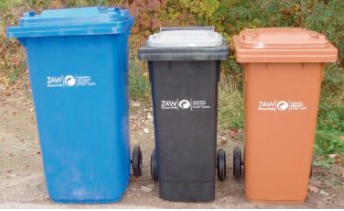
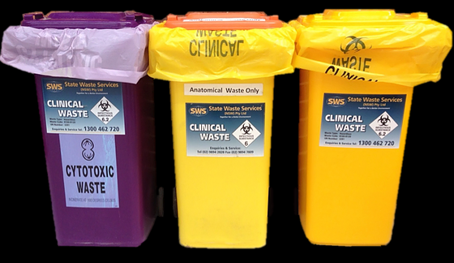
RAC Waste Types
Type of Waste | Colour Code
Infectious Waste | Yellow
Sharpe’s Waste | Yellow
Chemicals Waste | Brown
Cytotoxic Waste | Purple
General Waste | Black
Paper Waste | Blue

Slide 15
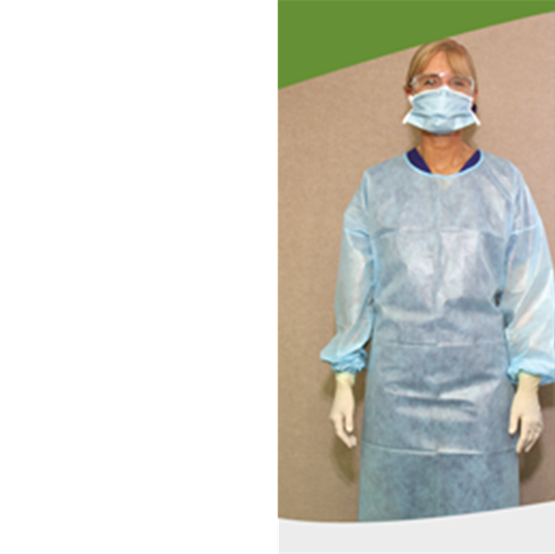
Waste PPE
General Waste Clinical Waste Cytotoxic/Chemical Waste

Slide 16
Hand Hygiene
On arrival
Removal of gloves/PPE
When hands visibly soiled
Before entering
On leaving
When ever else required

Slide 17
Waste Handling
The links between packing, collection, storage and transportation of waste from every area of the facility
Designated individual.
PPE must be worn
HH

Slide 18
Waste Collection
Person/organisation generating the waste is responsible
All handlers of waste must wear PPE, HH
Waste must be in colour coded bags and bins
Contents should not be more then ¾ full
Waste bags are tied at the neck with the knot upwards
Bags/sharps containers should not be left on the ground
Avoid throwing, dragging or carrying waste bags
Sharps containers must be sealed

Slide 19
Waste Transport
Waste is transported from the point of generation to the storage area within the facility
Waste should be transported by designated trolley and/or waste shoot (clinical or cytotoxic waste should not go down shoot)
Waste to be taken a designated route and on a time schedule

Slide 20
Waste Storage
Waste is to be stored in a waste room or designated area
The area should be:
Signposted with storage contents (general, biohazard cytotoxic symbol)
Secure and not visible or accessible to the public
Restricted to authorized persons only
Weatherproof (i.e. roof above storage and side walls)
Spill kits must be available and contain all items necessary to clean up spills

Slide 21
External Collection of Waste
Licensed contractors collect, transport and dispose of waste
When engaging a service ensure it is known:
What waste they collect
Their availability/frequency to collect
Time required to collect full bins and supply new empty bins
Provide additional services in the event of outbreak

Slide 22
Not All Waste Is Disposed The Same

Slide 23
Review And Monitor Of Process
Process testing
Outcome testing
Action Plan and Action
Ongoing Monitoring

Slide 24
Thank you
Carrie Spinks
Infection Control Consultant

