Slide 1
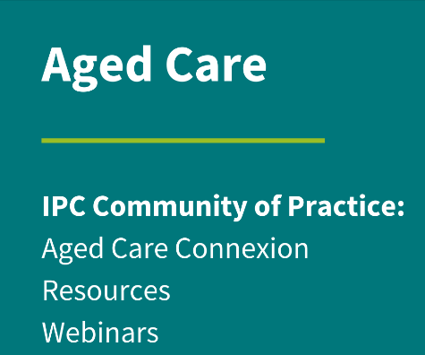
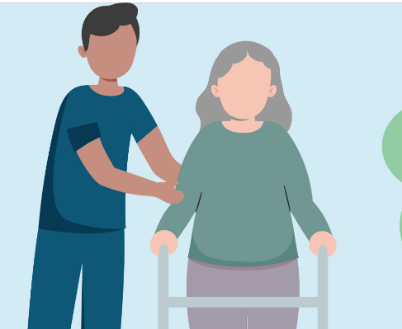
The Chain of Infection & Standard and Transmission Based Precautions in Aged Care

Slide 2
ACIPC acknowledges Aboriginal and Torres Strait Island people as the traditional owners of country throughout Australia and ngā iwi Māori as the people of the land of Aotearoa and respects their continuing connection to culture, land, waterways, community, and family.

Slide 3
Learning Outcomes
Define an Infection
Understand and provide examples of The Chain of Infection
Standard Precautions
Explain Standard Precautions and why they are so important Aged Care
Transmission Based Precautions in Aged Care
Identify why and when we would introduce Transmission Based Precautions

Slide 4
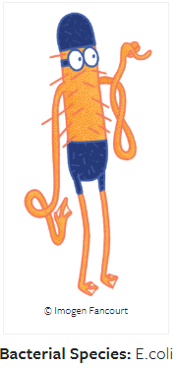
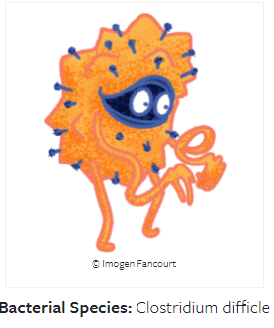
What is an Infection?
Infection means the microorganism has entered and multiplied inside the body and is spreading.
Notes:
Infection means the microorganism has entered and multiplied inside the body and is spreading. A person with an infection is usually unwell. An infected person may or may not have symptoms, depending on their health and immune status, age and the severity (also known as virulence) of the microorganism. If a person is showing signs of being unwell, then careful consideration is needed to work out the appropriateness of using antimicrobials.​
Infection is the result of a complex relationship between a host and a microorganism, as shown in the chain of infection. The clinical progression of an infection is also complex, as each person responds differently to each microorganism.
A person exposed to a microorganism may: ​
• Never develop an infection​
• Become temporarily or permanently colonised but never become infected ​
• Become infected but never develop symptoms or have only minimal symptoms​
• Become moderately unwell or very sick but recover, with or without complications ​
• Become very sick and die.​
The transmission of microorganisms occurs via a series of interlinked events called the chain of infection. ​
​
TRANSMISSION of an INFECTIOUS AGENT (pathogen) to a ​
​
SUSCEPTIBLE HOST (resident)
​
​

Slide 5
A common Viral Infection in Aged Care
Noroviruses are a group of related viruses that can cause gastroenteritis (GAS-tro-en-ter-I-tis), which is inflammation of the stomach and intestines. This leads to cramping, nausea, vomiting, and diarrhea. Common symptoms include cramping, nausea, vomiting and diarrhea.

Slide 6
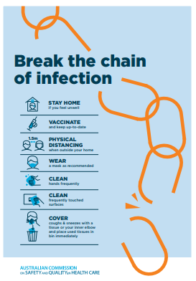
What is The Chain of Infection?
A model to describe how an infection spreads.
The aim of infection prevention and control is to
Interrupt/break this Chain.
This can be achieved through a
number of ways.
Notes:
How about the drug keys???
Blood pressure cuffs
WOW

Slide 7
Six Sequential Elements of the Chain
Source -Infectious agent
The reservoir
Portal of exit
Means of transmission
Portal of entry
Susceptible host

Slide 8
The Source
Mike Mycoplasma
Harry Haemophilus
Kev Klebsiella Poppy Pneumococcus Eric enterococcus
Images by Imogen Fancourt
Badu the Bacterioides
Notes:
TRANSMISSION of an INFECTIOUS AGENT (pathogen) to a
SUSCEPTIBLE HOST.
Microorganisms are very small living things such as bacteria, viruses, fungi and some parasites. Inappropriate use, and overuse, of antimicrobials (such as antibiotics, antivirals and antifungal medication) contributes to an increase in resistant microorganisms, meaning these microorganisms become resistant to antimicrobial treatment.
A special note on Fungal infections in aged care: Fungi are mostly found in the environment. Yeast, mildew, and moulds are types of fungi. There are millions of fungal species, but only relatively few species make people unwell. Anyone can get a fungal infection. However, they are more likely to cause infections in people with weakened immune systems, or after receiving antibiotics. So, often this will include many older people. Common types of fungal infections are vaginal candidiasis, nail infections, oral thrush and ringworm

Slide 9
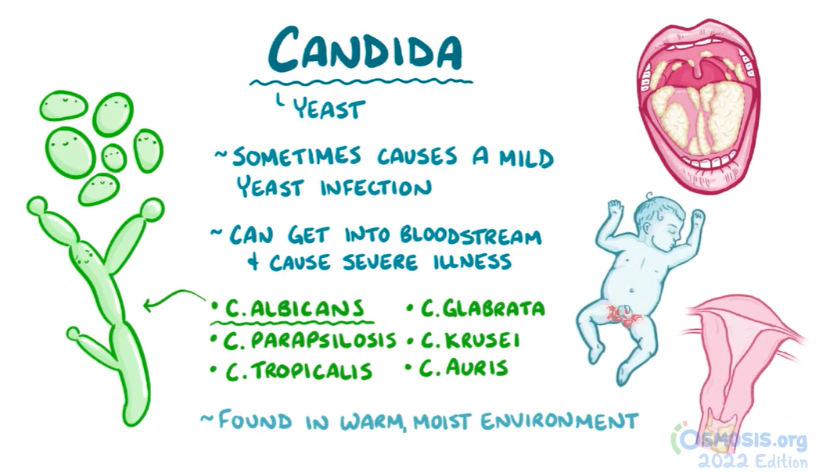
Candida (Yeasts)
Notes:
A special note on Fungal infections in aged care: Fungi are mostly found in the environment. Yeast, mildew, and moulds are types of fungi. There are millions of fungal species, but only relatively few species make people unwell. Anyone can get a fungal infection. However, they are more likely to cause infections in people with weakened immune systems, or after receiving antibiotics. So, often this will include many older people. Common types of fungal infections are vaginal candidiasis, nail infections, oral thrush and ringworm.

Slide 10
The Reservoir
• equipment and instruments
• clothing, uniforms
• soiled linen and dressings
• keys, pens, and other utensils
Notes:
The reservoir is where a microorganism lives. Microorganisms can live in a variety of environments including people, animals, food, soil, water or on an object. Following the correct procedures for environmental cleaning, equipment reprocessing, and linen management can stop microorganisms from living on surfaces and equipment, limiting the risk of infection to yourself, and the people you care for.
MOBILE PHONES
Smart watches
Patient notes/folders
How about the drug keys???
Blood pressure cuffs
WOW
Sinks

Slide 11
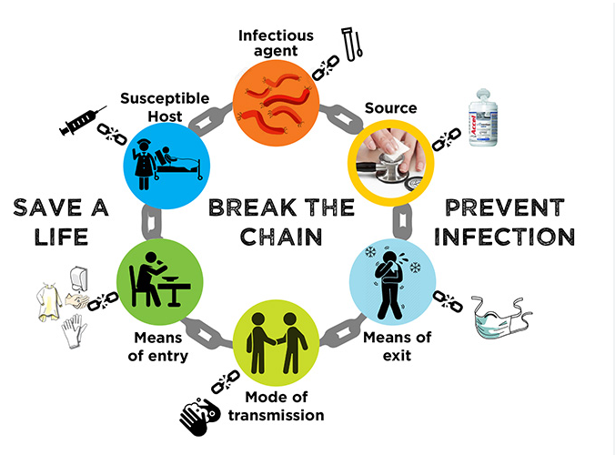
The Portal of Exit
Notes:
The portal of exit is how a microorganism gets out of where they live. Microorganisms can be spread via the mouth (such as saliva, vomit, sneezes or coughs), wounds, the gastrointestinal and urinary tracts (such as faeces and urine). Basic IPC interventions such as hand hygiene, personal protective equipment (PPE) and practising appropriate respiratory hygiene can stop microorganisms from spreading via the mouth, nose, or open wounds.

Slide 12
The Means of Transmission
Transmission can be via:
contact
droplet
airborne
Notes:
The means of transmission is how a microorganism is spread or travels between reservoirs. Microorganisms can spread through contact with contaminated surfaces, body fluids or blood, by ingestion or by inhalation of respiratory particles. Basic IPC interventions such as hand hygiene, PPE and environmental cleaning can stop microorganisms from spreading from one person to another.

Slide 13
Portal of Entry
• the nose by inhalation
• the mouth by ingestion
• breaks in skin by exposure to blood or body fluids
EYES
Notes:
This refers to how a microorganism enters the reservoir which may be a person, animal or surface. Often, microorganisms enter a new reservoir the same way that they exited the old one. Microorganisms can be acquired through absorption, inhalation or ingestion. Hand hygiene and the correct use of standard and transmission-based precautions and PPE can stop microorganisms being inhaled, absorbed or ingested.

Slide 14
A Susceptible Host
Why are Aged Care residents susceptible hosts?
Comorbidities
Impaired immune function(influenced by immunosuppressive therapy or disease)
Weakened skin integrity
Diet, nutrition, hydration issues
Frequent hospitalisations
Age
Notes:
The susceptible host or is the person at risk of infection. Vaccinations, treatment of underlying disease, and the appropriate use of invasive devices such as catheters can stop the microorganisms from reaching susceptible people.

Slide 15
Breaking the Chain
Notes:
Most bacterial infections that are linked to urinary catheterisation gain access to the body through the urinary tract either through:
-A break in aseptic technique when managing or inserting the catheter (the infection may come from the aged care worker’s hands)
-A reflux of bacteria from a contaminated urine drainage bag
The longer a urinary catheter is in place, the greater the risk of a urinary tract infection (UTI). Aged care workers should know the signs and symptoms of a suspected UTI in an older person.

Slide 16
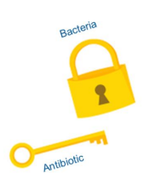
The type of pathogen matters
Think of the two most common groups
of microorganism – Bacteria and Viruses.
Then consider bacteria as a lock and
an antibiotic as the key.
This key will not work on a virus as it
does not fit.

Slide 17
Standard Precautions
Our seatbelt for preventing infection and breaking the chain.
Assumes all humans and inanimate objects may cause infection
Notes:
9 Key Elements – All play a role in braking the chain

Slide 18
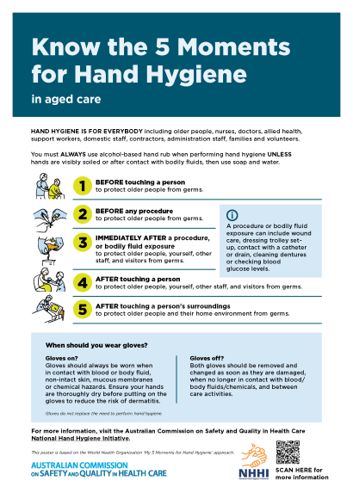
1. Hand Hygiene in Aged Care
Notes:
Hand hygiene is one of the most effective interventions to reduce the risk of infections in aged care. Hand hygiene is a general term referring to any action to clean the hands and includes:
• Applying an alcohol-based hand rub (ABHR) to the surface of hands (rubs can be liquids, gels or foams)
• Washing hands with a soap solution and water.
In addition to the 5 Moments, hand hygiene should be performed in many situations:
Before: • Putting on gloves • Starting or leaving work • Eating or handling food or drinks • Using a computer keyboard, tablet or mobile device in a care environment.
After: • Removing gloves • Hands become visibly soiled • Eating or handling food or drinks • Visiting the toilet • Using a computer keyboard, tablet or mobile device in a care environment • Handling laundry, equipment or waste • Blowing, wiping or touching nose and mouth, or smoking.
Glove Use: Non-sterile gloves are commonly misused in clinical work, and healthcare workers are less likely to follow hand hygiene practices when wearing non-sterile gloves.
Glove overuse then leads to increased volume of avoidable waste sent to landfill.
Gloves do not provide complete protection against hand contamination
Glove use is widely accepted to be associated with poor hand hygiene compliance

Slide 19
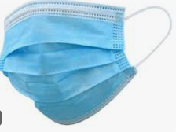
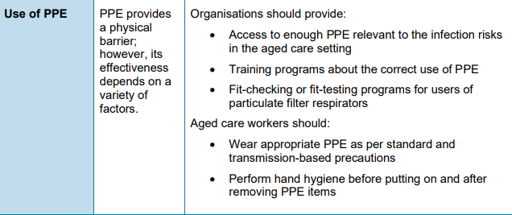
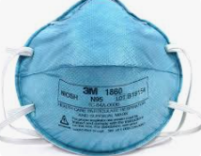
2. Use of Personal Protective Equipment (PPE)
Surgical mask
N95 or P2 Respirator
Notes:
Appropriate PPE should be selected to prevent contamination of skin and/or clothing. Selections should be guided by the anticipated type and amount of exposure to blood and body substances and the likely transmission route of microorganisms.
When you are selecting PPE, consider three key things:
First is the type of anticipated exposure. This is determined by the type of activity, such as touch, splashes or sprays, or large volumes of blood or body substance that might penetrate the clothing. PPE selection, in particular the combination of PPE, also is determined by the category of isolation precautions a patient is on.
Second is the durability and appropriateness of the PPE for the task. This will affect, for example, whether a gown or apron is selected for PPE, or, if a gown is selected, whether it needs to be fluid resistant, fluid proof, or neither.
Third is fit. PPE must fit the individual user, and it is up to the employer to ensure that all PPE are available in sizes appropriate for the workforce that must be protected.
Aprons and gowns: Aprons or gowns should be worn by aged care workers when: • There is an increased risk that close contact with the older person, or equipment, may lead to contamination of skin, uniforms or other clothing with infectious material • There is a risk of contamination with blood, body substances, secretions or excretions (except sweat)
The mouth, nose and eyes are easy routes for microorganisms to enter the body and cause infection, as are areas of the skin when skin integrity is damaged (for example, dermatitis, wounds). Face and eye protection reduces the risk of exposure for aged care workers to splashes or sprays of blood and body fluids and respiratory particles. Procedures that generate splashes or sprays of blood and body substances require either a face shield or a mask worn with protective eyewear.

Slide 20
3. Cough Etiquette
Older people, carers, visitors and aged care workers should always be encouraged to:
• Cover their nose and mouth when coughing or sneezing
• Use tissues
• Dispose of tissues as soon as possible after use
• Cough or sneeze into their inner elbow rather than their hand if tissues are not available
• Perform hand hygiene after coughing or sneezing, and after having contact with respiratory secretions and contaminated objects or materials
Notes:
Aged care workers should also support older people who need assistance with containment of respiratory secretions. Those who are immobile will need hand hygiene facilities and a place to throw away tissues (for example, a plastic bag) readily at hand for the immediate disposal of used tissues

Slide 21
4. Aseptic Technique
In aged care settings, aseptic technique should be used when a procedure or medical device enters one or more of the body’s normal defences, such as the skin, mucous membranes or body cavity. For example:
• Wound care
• Inserting a urinary catheter
• Accessing an indwelling device.
Notes:
Asepsis is the absence of all microorganisms. Aseptic technique is a set of practices used to protect the older person from contamination and the introduction of microorganisms during clinical procedures. More information on clinical procedures can be found in Chapter 5 of the aged care IPC Guide

Slide 22
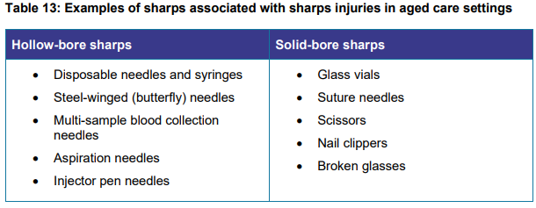
5. Use and Dispose of Sharps Safely
It is good practice to follow safe sharp handling practices including: not passing sharps directly from hand to hand
keep handling to a minimum
not recapping, bending or breaking needles after use.

Slide 23
6. Clean and dispose of Reuseable Resident Equipment
Reprocessing of reusable equipment in aged care primarily includes cleaning and disinfection of reusable equipment such as commodes, blood pressure machines and nail clippers.
Notes:
Reusable equipment is that equipment that is intended by the manufacturer to be appropriately cleaned, disinfected (if needed) and reused. Reusable equipment can include blood pressure cuffs, stethoscopes, nail clippers, commode chairs and hoists, but can also include items such as smart phones and tablets. Any piece of equipment that is reusable requires reprocessing, meaning that it requires cleaning and (if needed) disinfection after each use

Slide 24
6. Routine Environmental Cleaning
Environmental cleaning is a basic part of standard precautions and is an essential part of any infection prevention and control (IPC) program.
• Cleaning involves the use of neutral detergent, water and physical scrubbing to remove microorganisms from surfaces.
• Disinfection is the process of using a disinfectant, a chemical that rapidly kills most microorganisms and that is usually only effective in the absence of organic material.
Notes:
Cleaning schedules should be tailored to the risk of transmission of infection within a specific setting. All organisations should have a documented cleaning schedule that clearly outlines the responsibilities of all aged care workers, a roster of duties, frequency of cleaning required and the products that should be used to clean specific areas.

Slide 25
8. Waste Segregation
Notes:
There are four primary different categories of waste generated in aged care: • Clinical waste includes any waste that can potentially cause injury, infection or offence. Examples include o anatomical waste o clinical waste and pathology waste o radioactive waste o cytotoxic waste o pharmaceutical waste

Slide 26
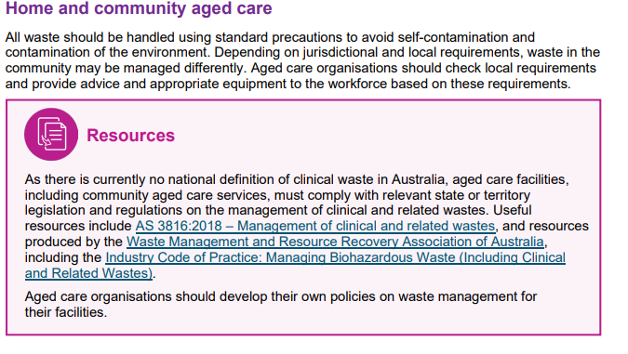
Clinical Waste
Notes:
There are four primary different categories of waste generated in aged care: • Clinical waste includes any waste that can potentially cause injury, infection or offence. Examples include o anatomical waste o clinical waste and pathology waste o radioactive waste o cytotoxic waste o pharmaceutical waste

Slide 27
9. Linen handling and storage
Linen items used by an older person with scabies can be decontaminated by machine washing in hot water and drying using the hot cycle, or by dry-cleaning. Scabies mites do not survive more than two to three days away from human skin. Linen that cannot be washed or dry-cleaned can be decontaminated by being placed in a closed plastic bag for at least three days or until a machine wash and dry can occur. Hanging clothes out in the sun to dry will also remove the mite
Notes:
Aged care workers should always use standard precautions when handling used linen. For example, hand hygiene must be performed after all contact with used linen, regardless of whether the linen is visibly soiled. Workers may need to use transmission-based precautions in addition to standard precautions if there is a risk that the linen is contaminated with a highly infectious microorganism or blood or other body fluids
Aged care organisations should have documented policies on the collection, transport and storage of linen. All used linen should be handled with care to avoid dispersal of microorganisms into the environment and to avoid contact with aged care workers’ clothing.

Slide 28
Transmission Based Precautions
A note on Respiratory Precautions: In addition to standard precautions, PPE recommended for respiratory precautions will generally include a surgical mask and facial/eye protection.
As per. Updated NHMRC Guidelines PFRs, including N95 and P2 respirators, are only recommended now in all settings during high-risk situations such as during an aerosol-generating procedure or other similar procedures for an older person with a suspected or confirmed respiratory infection.

Slide 29
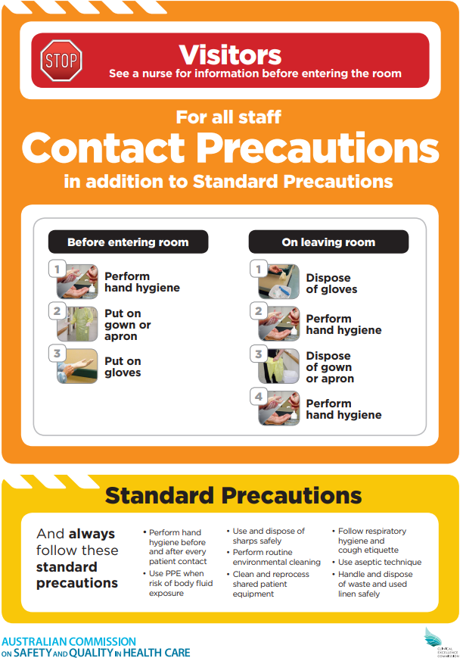
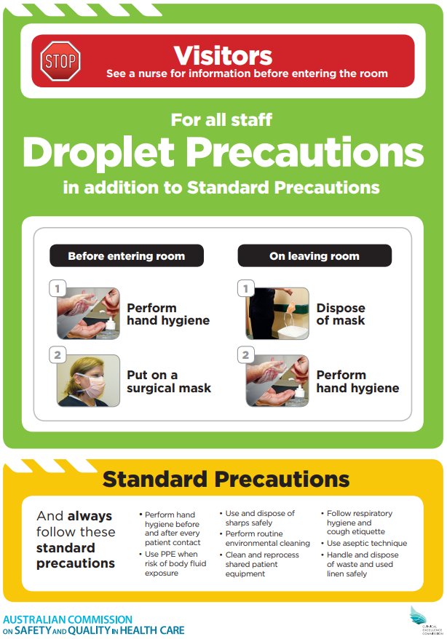
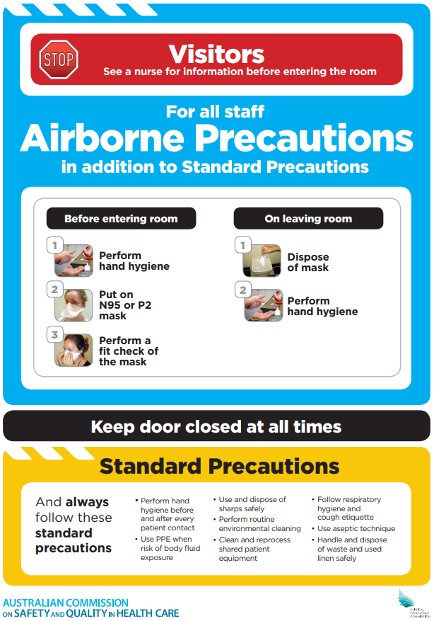
Transmission Based Precautions When Standard is not Enough
Notes:
REMINDER: Transmission-based precautions are always applied in addition to standard precautions that include hand hygiene, PPE, sharps management, respiratory hygiene/cough etiquette, aseptic technique and waste and linen management.
Understanding how an infection spreads and knowing when to apply standard and transmission based precautions are critical to preventing and controlling the spread of infections.
• Transmission-based precautions should only be used for limited periods of time until signs and symptoms of the infection have resolved, or according to recommendations of persons responsible for infection prevention and control (IPC).
• Prolonged periods of isolation (as an IPC intervention) can cause harm to the physical and psychological health of older people. The intervention should only be implemented, if necessary, for short periods of time, and after a comprehensive risk assessment
There are other sign formats available through the Australian Commission’s website. These are the original signs from before the Pandemic. See next slide
Risk assessment -

Slide 30
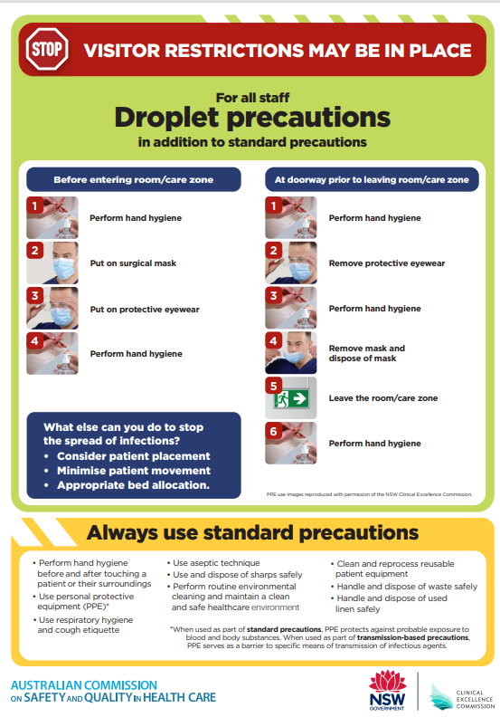
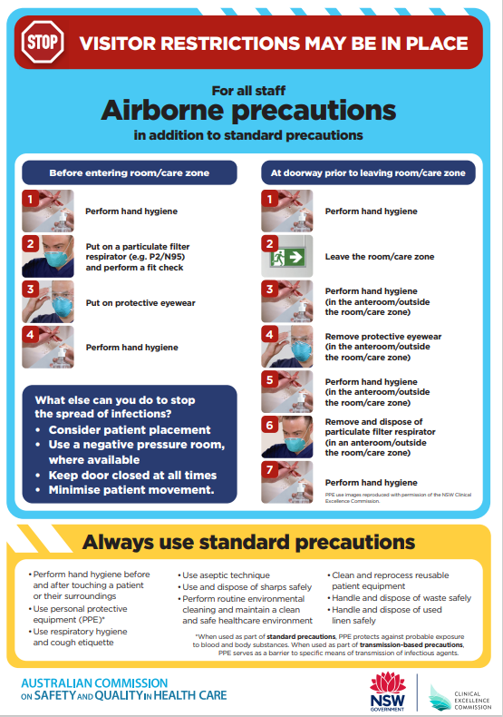
NEW SIGNAGE: Transmission Based Precautions
Notes:
The main ways that infections are spread is through contact or respiratory particles or a combination of these. The way that infections are spread will vary depending on the type of microorganism causing the infection. In some cases, the same microorganism may be spread by more than one way (both contact and respiratory). Transmission-based precautions are used when an older person is suspected to have or is diagnosed with an infection. Transmission-based precautions are always used in addition to standard precautions. There are different types of transmission-based precautions, which are based on how an infection can be spread. Each type of precaution requires different levels of PPE to be worn to prevent the infection from spreading
Contact: Clostridioides difficile, conjunctivitis, Herpes simplex, scabies
Combination (contact and respiratory) Description: Sometimes a combination of contact and respiratory precautions is required in addition to standard precautions, if the infection can be spread through a number of ways. Precautions: For most situations, combined precautions will require gloves, a gown, facial/eye protection and a surgical mask in addition to standard precautions. In some unusual and higher risk situations, a PFR might be used instead of a surgical mask. The IPC lead(s) or person(s) responsible for IPC should (if possible) be consulted before a PFR is used – examples are Tuberculosis, and when this illness is still unknown
Note the difference between an Infection or a colonisation with regard to a multiresistant organism (MRO)
• HWs to conduct a risk assessment on the requirement on type of PPE based on the episode care and anticipated contact with the patient and patient zone. All staff must risk assess before entering the patient care zone and deciding on application on appropriate PPE. • If the care involves body substance contact based on individual risk assessment an apron/gown should be donned to protect HWs uniform/personal clothing. PPE should be applied based on anticipated level of contact with the patient and or their environment • Facial and eye protection should be selected according to standard precautions. • HWs must perform hand hygiene, put on an impervious apron/gown on entering the patient zone based on anticipated contact with body substance. • The gloves are always the last PPE item to apply. They are put on inside the room directly before having contact with the patient where exposure to body substances is anticipated and after hand hygiene is performed (129). • Compliance with hand hygiene inside the patient care zone must continue regardless of glove use.

Slide 31
Thank You for Watching
Kylie Taylor
IPC Consultant and ACIPC Facilitator
Australasian College for Infection Prevention and Control
Level 6
152 Macquarie Steet
Hobart TAS 7000
03 6281 9239
office@acipc.org.au
www.acipc.org.au

Slide 32
References
Australian Commission on Safety and Quality in Health Care. Aged Care IPC Guide. Sydney: ACSQHC; 2024
IPC-Practice-Handbook-2020
Australian Commission on Safety and Quality in Health Care. IPC Workbook. Sydney; ACSQHC, 2022.
Infection Prevention and Control Workbook 2024 | Australian Commission on Safety and Quality in Health Care
Andrew Kirby & Imogen Fancourt, 2021. University of Leeds.
GermBugs | TiME: Technology in Medical Education
Clinical Excellence Commission. Infection Prevention and Control Precautions
Infection Prevention and Control Precautions - Clinical Excellence Commission
National Center for Immunization and Respiratory Diseases; Division of Viral Diseases
Norovirus | Norovirus | CDC

