Slide 1
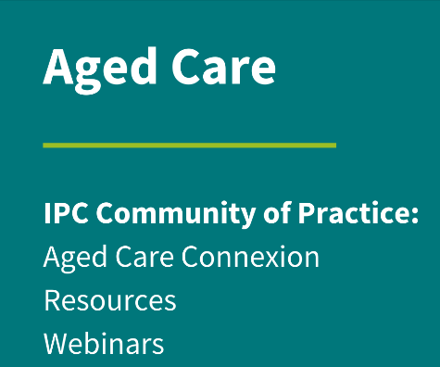
Outbreak Management
Notes:
Welcome to this, the ACIPC aged care community of practice Outbreak Management presentation my name is Louise and I am an infection Prevention Consultant with the Residential in reach program at Monash Health.

Slide 2
ACIPC acknowledges Aboriginal and Torres Strait Island people as the traditional owners of country throughout Australia and ngā iwi Māori as the people of the land of Aotearoa and respects their continuing connection to culture, land, waterways, community, and family.
Notes:
ACIPC acknowledges Aboriginal and Torres Strait Island people as the traditional owners of country throughout Australia and ngā iwi Māori as the people of the land of Aotearoa and respects their continuing connection to culture, land, waterways, community, and family.

Slide 3
Why is an outbreak management plan required?
Requirement Public Health response
Requirement of Aged Care Standards Infection Control Program
Reduce risk of illness and death
Ensure ongoing care for residents
Notes:
Why is an outbreak management plan required?
In the past four years outbreak management of COVID-19 has been one of the most discussed topics.
As part of a Public Health response in Australian aged care facilities outbreak management was nothing new, outbreak management plans had been part of “an effective infection control program” described in the first iteration of accreditation in care homes following the introduction of the Aged Care Act 1997 and was at that stage needed for gastrointestinal and influenza like illnesses. With both state and commonwealth bodies providing resources over the years for assistance. Given this it could be argued that responding to a COVID-19 respiratory illness outbreak wouldn’t have caused any major problems. Unfortunately, this was not the case, as the initial COVID-19 outbreaks in our aged care facilities proved. Unfortunately, in many facilities residents died and some facilities were left without sufficient staff numbers to provide desired levels of care. Many GPs would not do on-site visits, and facilities closed their doors in the hope of reducing the risk of illness to resident to visitors, which has had a lasting effect on the mental health wellbeing not only of the residents but families as well, especially those who lost loved ones.

Slide 4
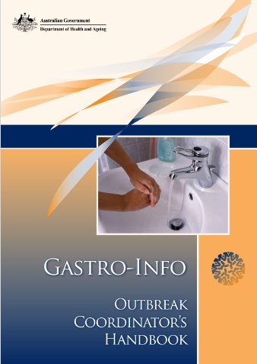
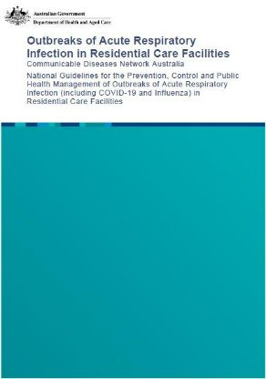
Identification of issue, definition and diagnosis
Communicable disease outbreaks
Know the disease
Know the transmission route
Are there preventions available
Notes:
What do I mean by the issue or in this case illness, how do we define an outbreak and looking at how it happened help in formulating a plan for improved outbreak management, looking at what worked, what went wrong helps inform our response to further outbreak situations.
Guidelines have been developed by Commonwealth and State Departments of Heath across Australia regarding actual disease management which are up-dated as needed. In 2020 the COVID-19 respiratory guidance updates occurred almost daily, unlike the gastrointestinal illness guidelines which haven’t been up-dated since 2010. With each publication of a new guideline, outbreak management plans should be reviewed and updated as needed.
The most important thing to remember is for staff and visitors not to come to work or visit if they have any symptoms of illness regardless of how mild the symptoms are, and for prompt recognition of the ill resident.

Slide 5
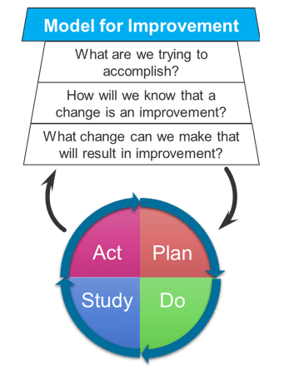
Outbreak Management
Why is there a need for an outbreak management plan?
How can you develop/review an outbreak management plan?
Risk assessment and mitigation strategies
Plan, Do, Study, Act – PDSA cycle
Downloaded from: Control Charts in Healthcare Drive 4 Improvement Basics (healthcatalyst.com)
Notes:
You are probably thinking ‘ We already have a plan’ but I am hoping that this presentation may make you think about whether you have considered the worst possible scenario that could happen and included how this can be avoided. I will be utilising a, Improvement methodology which is used nationally and internationally, to improve processes of care or resident outcomes. Clinical Practice Improvement (CPI) is a common methodology to address identified problems in the clinical area like a communicable illness outbreak.
It involves identifying, defining, and diagnosing a problem, before developing solutions and implementing interventions that may address the identified issues. Practical solutions or in this example the outbreak management plan is then tested using "Plan, Do, Study, Act" (PDSA) cycles.

Slide 6
Staff and visitor illness and prevention
Need to be aware NOT to work/visit if displaying any symptoms of being unwell
Respiratory illness between five to seven days
Gastrointestinal illness at least 48hrs symptom free
If respiratory symptoms and negative COVID-19 RA test recommended to have a respiratory PCR to exclude other causes for symptoms.
Vaccination
Notes:
A key factor in outbreak management is prevention. Many outbreaks have occurred due to the illness being brought in either through symptomatic staff or visitors. I ‘don’t feel too good but my R.A.T is negative, or when isolation requirements are not followed, respiratory illness between five to seven days, gastrointestinal illness at least 48hrs symptom free it is important to check your own state public health guidelines for the time frames. All people coming into a facility in any capacity should be made aware of these requirements and reminded frequently.
Encouraging all residents, visitors, and staff to be fully vaccinated against the vaccine preventable diseases. I am referring not just to influenza and Covid vaccinations but those listed in the Australian immunisation handbook. For example, Pertussis or whooping cough, varicella, or chicken pox, pneumococcal and shingles. Vaccines protect the vaccinated person as well as those with whom they have contact.

Slide 7
Plan -
Notes:
Let’s now look at the first step of our PDSA cycle Plan:
In formulating an outbreak management plan, risk mitigation strategies must be included, and requirements communicated with all; staff, residents, families, and contractors/suppliers so they understand what their role is.
As far as the causative organism of the outbreak is concerned, it should not matter providing the following principles are applied:
Recognition of the ill resident/ initial case and isolation according to the transmission of the disease
Identifying risks- People (Contacts), Place (environment) when (exposure period) and System risk –
Undertaking surveillance of those at risk
Notification and Communication
Implementing further control measures – tweaking responses as needed and documenting this to assist in the incident review at the study and act parts of the PDSA cycle.
Finalising – the outbreak is over then what?
Incident review

Slide 8
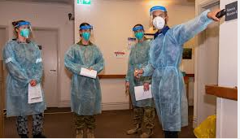
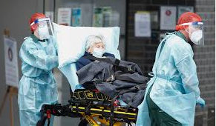
Risk Mitigation
What can go wrong = Risk
What can we do to reduce the risk?
Notes:
We need to ask ourselves two questions, the first being, ‘what could go wrong or what are the risks’ then, how do we eliminate or reduce the risk? By acknowledging risks and what we can do about them we are implementing risk mitigation strategies.
At the commencement of the COVID-19 pandemic many facilities found they did not have staff available, not just care staff but staff shortages also included administration, managers, and food services staff unlike most previous outbreaks of the past. Simple things like answering telephones, managing the reception, management of the facility was either not being done, done from afar or by people unfamiliar with the nuances of the facility. I remember in one facility when most of the kitchen staff were affected there was a need quickly find a food supply to provide meals. It was found that staff, did not have the skills to don and doff PPE safely. Alternative staff from agencies and surge staff were unfamiliar with the facility they were sent to and residents they were sent to care for. Medical practioners would not do face to face visits, and there was an expectation that acute hospitals could provide care.

Slide 9
Risk mitigation - how
The resident
Staffing – not just care staff
Outbreak management team roles
Consumable supplies
Medical management
Housekeeping
Notes:
How do we look at risk mitigation.
Let us start with the resident, do you know what the resident wishes are prior to becoming unwell, has their GP (General Practitioners) assessed and discussed prescribing antivirals with the resident? Do they want to go to hospital? Do they want to take leave and go home to their relatives? What about visiting, what about end-of-life care during this time?
What about staffing? It is important that there is guidance available with how the impact of staff loss can be reduced so that care continues for residents. This could include changing shifts to two 12 hour shifts rather than the usual 8, 8, 10 roster. Having details of staff who would be able to ‘pick’ up extra shifts, redeploying some staff to undertake care provision and lists of agencies which could help with supply of staff. For larger corporate facilities, there may be staff willing to be redeployed from another facility to cover shortfall. It is also about the staff that ensure the facility continues to function, being able to increase cleaning as per outbreak requirements. What about who is answering the phones, who is staffing the front door, who is doing all the paperwork and notifications. It is important to have a simple comprehensive orientation program available for those staff that are unfamiliar with your facility.
Have all key personal been identified, who co-ordinates the response and implementation of the outbreak management plan, who communicates and reports to authorities, residents and families, staff, supply contractors, waste management providers. Do they have clear direction is there a back-up plan if a nominated person is not available.
Ensuring that there are sufficient consumable products available for use during this time, especially PPE. There should be procedures available regarding how to undertake a stocktake to ensure sufficient supplies or if necessary, where to order more from. Commonwealth support for the supply of PPE has now been withdrawn so knowing who the suppliers are of these items and if they are able to provide deliveries at short notice should the situation arise.
Do you know which of the GPs (General Practitioner) will be available to review ill residents when needed or who should be contacted if the GP (General Practitioner) is not available, locum services, Virtual EDs, residential in reach services. If vaccination compliance is low is there a plan to provide vaccination to the vulnerable resident? and if so, do you have a provider who is able to undertake this. Have you included how antiviral medications will be accessed at short notice, do you know which residents will need them?
Have you thought about what you would do about food supplies if the foods services staff were affected?
What about waste management with the increased use of PPE. Do you have enough waste bins? Do you have a service able to increase pick-ups during this time? Something which caused considerable issues during the first year of the pandemic, with mountains of waste unable to be contained in the usual manner. Ask yourselves will the on-site laundry be able cope, or will some of the laundry need to be outsourced? If so, how? All these questions as well as those pertinent to your situation should be asked and the response included when formulating your outbreak management plan.

Slide 10
Disease recognition, isolation & diagnosis
Recognise the ill resident
Isolate – Transmission Based Precautions
Investigate cause
Diagnosis
Notes:
Disease recognition, isolation, and diagnosis
I have focused on the two common causes of outbreaks being acute respiratory illnesses and gastrointestinal illnesses. However, an outbreak management plan should be adaptable to any cause of an outbreak. Not all outbreaks are reportable but by informing your local public health authority regardless of the cause they can provide infection control advice.
Most importantly, staff providing care for residents should be aware of what signs and symptoms to look for. They should also be aware of subtle changes in a resident such as a change in their usual behaviour, falls or a change in their chronic condition like increasing breathlessness in a resident with heart failure or Chronic obstructive pulmonary disease, which maybe the first indication that something is not quite right. Respiratory symptoms, such as new or worsening cough, difficulty breathing, sore throat, runny nose/nasal congestion, with or without other symptoms such as, headache, muscle aches and pains, chills, tiredness, or they may have a temperature. Gastrointestinal illness symptoms can include, Nausea, not wanting to eat, vomiting, abdominal pain, diarrhoea, and some may also have a temperature.
Where possible it is best to isolate the symptomatic resident within their room, in transmission-based precautions appropriate to the mode of transmission of the suspected illness. The staff member should then report their findings and actions. Potential causes for the signs and symptoms should then be investigated. (Shut the gate before the horse has bolted). It is important to remember that most RA Tests usually only test for one or so respiratory viruses, so if that test is negative in a symptomatic resident a respiratory PCR specimen needs to be attended as this will either confirm or exclude up to 12 respiratory viruses or bacteria. For resident’s who complain of diarrhoea, if possible, send a faecal specimen for PCR testing? The results of either the respiratory or faecal specimen will further inform treatment such as provision of anti-viral medication or a change to antibiotic therapy if the faecal specimen is positive for Clostridium difficile.

Slide 11
Who’s at risk of illness
Contact tracing
Notes:
Once a diagnosis has been made of a communicable disease illness which may result in an outbreak it is then important to identify those further at risk.
Who has been exposed, staff, other residents or visitors and when were they exposed?
Are there any issues regarding the environment have a person vomited in a communal area has extra cleaning been implemented
After identifying any persons at risk, it is important that they themselves know of the need to be vigilant for signs of illness. Staff should also be aware of the need to monitor residents identified as contacts.
If a further resident or staff case is identified with symptoms it is likely that it is now an outbreak situation.

Slide 12
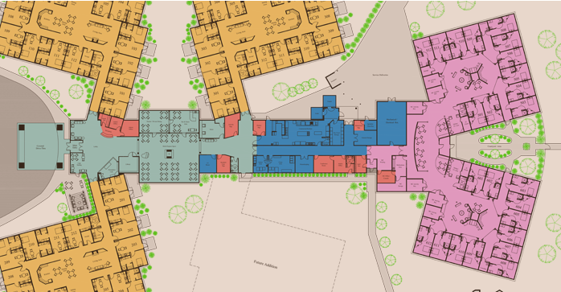
Oh no more cases
Ill residents
Contacts
Notes:
Oh no more cases.
What determines an outbreak? There are occasions when only one case is sufficient to illicit an outbreak response, for example, a case of scabies. Using the commonwealth definitions, a respiratory illness outbreak is defined as: Two or more residents test positive for COVID-19, Influenza or any other respiratory virus within a 72-hour period. Gastrointestinal illness outbreaks are defined similarly as; two or more people ill with vomiting or diarrhoea within 24 hours of each other. Although staff cases are not included in the respiratory outbreak definition unlike the gastrointestinal illness definition, these cases still require you to identify if any residents may be at risk
Once the outbreak definition has been met the facility outbreak management plan should be implemented.
Occasionally an outbreak may be due to transmission of a multi-resistant micro-organism between residents, such as MRSA (Methicillin Resistant Staphylococcus Aureus) but this would only be evident through a surveillance system where each resident case is identified and investigated.

Slide 13
DO!
Notification
Communication
Implement Infection Control strategies
Signage
PPE – in accordance with transmission means
Limit movement – including isolation for unwell
Cleaning, laundry and waste
Ongoing assessment
Resident – mental wellbeing and medical condition
Are cases increasing/decreasing
Stock supplies
Outbreak Management plan
Notes:
Do
We have now covered the P of the PDSA cycle and moved into the Do section.
Utilising the outbreak management plan, those persons nominated within the plan such as the outbreak management co-ordinator need to swing into action and ensure all outbreak management strategies contained within the plan are implemented as needed and communication to key-stake holders occur. Usually, once declared an outbreak management meeting will occur these meetings assist in monitoring the situation and evaluating whether stratgies in place are having the desired effect. It is usual that several individual strategies can be implemented concurrently to expediate the response and reduce the risk of illness to others.
It is important that infection control measures and the risks associated with an exposure MUST be balanced against the individual resident’s mental and physical wellbeing, something which was not done well in the initial pandemic response. Access to essential visitors must be maintained for residents, with the wishes and preferences of the resident being central to all decision making. The difficulty is balancing the right to have visitors for one resident verses the right to be protected from infection for another, as per the guidance in the COTA aged care visitors' code. For residents who are approaching end-of-life visitation should not be limited by time or number.
Communication and notification of the current situation should occur with staff, residents, and visitors. Regular updates including resident condition should continue for the duration of the outbreak.
Further notification to GPs, alerting service providers such as pathology providers of the possibility for increased number of specimens and if relevant the associated DoH/PHU outbreak code associated with the outbreak. This usually consists of year, month, and name of facility.
Commonwealth and state or territory health department notification including identification of cases, date/time of symptom onset, any testing that has occurred and results available, whether the resident remains symptomatic or not and may also include numbers of persons at risk. When reporting a gastroenteritis outbreak additional details of implemented infection control strategies may also need to be included.
As previously mentioned, notification to suppliers of the situation may be necessary to ensure prompt delivery of consumable supplies especially PPE supplies. Knowing what the trigger is to order more supplies when undertaking the PPE daily stocktake to ensure supply. Ensuring ongoing increased cleaning of high touch points is being undertaken with TGA approved and recommended cleaning and disinfectant agents at least twice daily, but also as required.
Is there a need to implement laundry contingencies? Have waste contractors been alerted regarding the need for increased bins and pick-up of waste, in the hope of reducing the need to store large volumes of waste as was needed at the start of the pandemic.
Other strategies which need to be implemented include:
reducing/stopping movement of staff from an affected area to a non-affected area by cohorting, limiting lifestyle activities, limiting visitors to designated persons
Looking now at further strategies requiring implementation,
Placing signage at the entry to the facility to ensure visitors are aware of outbreak situation and their personal responsibilities to mitigate further risks such as undertaking hand hygiene and what PPE they may be required to wear.
Closing doors and displaying signage on entry to an affected wing where the building design allows.
There should be appropriate transmission-based precautions signs alerting as to the residents affected for example: contact precautions or Respiratory precaution signage, dependent upon the transmission of the microorganism responsible for the outbreak.
Providing PPE stations where needed relevant to the outbreak illness. For example, mask donning doffing stations in a covid-19 outbreak. Help each other by making sure PPE is worn correctly and removed safely. (Posters available for display)
With increase in equipment needed for PPE stations and waste management making sure that this does not pose a falls risk to residents or staff
Check residents in isolation regularly, not just from a medical perspective but for their mental health and wellbeing, they may require having someone spending time with them, or having time outside
Maintain accurate records of fluid and dietary intake and output. Residents at risk of dehydration and/or weight loss, regardless of being ill. If the outbreak is due to gastrointestinal illness maintaining accurate objective records of their bowel habits using a bowel description chart such as the Bristol stool scale
Provide prompt medical intervention as the resident condition indicates. If a resident requires medical review or investigations off-site, that the transporting service and the receiving service are notified of the situation and especially if the resident is affected or not
In respiratory illness outbreaks, Ensuring enhanced ventilation such as closure of bedroom doors then opening external windows even if only for a brief time if the weather is inclement,
placing air purifiers in resident rooms, corridors, and staff spaces
Enhancing social distancing within communal areas but still allowing social engagement between the residents
Have Alcohol based hand rub (ABHR) readily available at point of care, even for gastroenteritis but ensuring hand washing with soap and water occurs if hands are soiled, or if going on a break including after bathroom breaks and when leaving the facility.
Ensure well residents and visitors undertake hand hygiene
Providing affected residents with their own care equipment and if this is not possible ensuring staff are aware of need to clean & disinfect the equipment when removing from resident room.
Implement increased waste/linen removal rounds, remembering to place waste/linen being removed from an affected resident’s room into a clean bag at the room exit to reduce the risk of possible environmental contamination.
Ensure appropriate PPE is used by staff undertaking, cleaning, laundry, and waste removal
Removal of shared condiments, bowls of fruit and preventing/restricting the use of tea/coffee making facilities only allow staff to provide these beverages.
If outbreak spreading it may be necessary to close communal areas.
Undertake surveillance testing as directed by local health agency.
Importantly the outbreak management coordinator needs to be informed of any changes, they need to know if cases are increasing or not. They need to ensure as previously mentioned there are sufficient consumables available and that cleaning, laundry and waste is being managed effectively. They also need to ensure that communication is maintained, and reporting requirements are met. They may also need to make changes to the way some residents are cared for. All of which should be documented and reviewed once the outbreak is no longer active in an incident summary document.

Slide 14
Is it over?
Symptom free residents
No new cases
Clean up
Incident summary
Notes:
s it over?
During the active phase of the outbreak maintaining accurate case lists which may need to include any treatments received by a resident as well as when they were on longer symptomatic will all inform the decision to stand down the outbreak by the authorities.
On average for gastrointestinal illness a person is considered ‘well’ if they have had no further symptoms for at least 48hours. For residents with respiratory illnesses please refer to your local health department guidelines for clearance requirements. They are usually around five to seven days or when symptoms resolve.
If the outbreak is due to scabies all persons identified as needing treatment or prophylaxis should have had their first treatment and any clothing, towels and bedclothes reprocessed in a high-level wash or dry-cleaned, particularly items used in the previous 48hours. If items are unable to be laundered in either manner, then place them into a sealed plastic bag for a week before usual laundering processes as the mites are unable to survive for lengthy periods off a human body. In a scabies outbreak it is essential that staff, visitor contacts and residents are treated simultaneously, not in dribs and drabs as this increases risk of re-infestation. However, if cases are in different areas, it may be worth treating one area of residents at a time to reduce some of the impact. But and it is a BIG BUT there should be absolutely no cross over between treated and untreated areas.
The clean-up should commence in each resident room as they become well, all items need to be cleaned following the national outbreak deep cleaning guidelines, steam cleaning carpets, potentially with high level cleaning across the home. Resident’s own bedding items should be laundered, their personal refrigerators emptied and cleaned and even a ‘declutter’ may well be in order.
Once the outbreak has been declared over the incident report should also be finalised.

Slide 15
Study
Review and discuss
what worked, why did it work
What didn’t work, why didn’t it work
Notes:
We now move to the S, study of the PDSA cycle. Were it is important that the response to the outbreak is discussed with all key persons, the outbreak coordinator, care staff, housekeeping personal, residents and families. Review the incident summary, what worked, why did it work, what did not work, why not? By doing this any gaps within the current plan can be found and changed using the findings from the recent outbreak as the impetus and rationale for the changes. Once changes have been made this needs to be communicated with the wider community.

Slide 16
Act
Living document
Review regularly
Notes:
Moving to the final part of the PDSA cycle, Act. Outbreak management plans should be living documents, which are updated regularly against newer guidance documents as they are published and using the findings from the recent outbreak as the impetus and rationale for the changes.
It is not always possible for guidance to be followed to the ‘letter’ but documenting a risk based rational for why something is or is not being adhered to shows application of knowledge.
As with any change, these need to be communicated with the wider community.
It is my hope that I have provided an alternative and comprehensive way of developing and reviewing your outbreak management plans

Slide 17
References:
New South Wales Government – Clinical Excellence Commission. (www.cec.health.nsw.gov.au/CEC-Academy/quality-improvement-tools/model-for-improvement-and-pdsa-cycles)
Australia Government – Department of Health and Aged Care.
national-guidelines-for-the-prevention-control-and-public-health-management-of-outbreaks-of-acute-respiratory-infection-including-covid-19-and-influenza-in-residential-care-facilities.pdf
Outbreak Coordinator's Handbook – Gastroenteritis Kit for Aged Care (health.gov.au)
CDNA Series of National Guidelines (SoNGs) | Australian Government Department of Health and Aged Care
Victorian Department of Health – The Blue Book. (Disease information and advice (health.vic.gov.au)
COTA For Older Australians Sector Code for Visiting in Aged Care Homes - COTA Australia

Slide 18
Thank you
Residential In-Reach
Infection Prevention & Epidemiology team
Infection Prevention Nurse consultant SEPHU
Carrie Spinks – ACIPC
Notes:
I would like to thank my colleagues in the Residential in-reach team who have allowed me the time, and my IP&C colleagues at Monash Health and the IP CNC within our local public health unit for their assistance and finally Carrie for having the confidence in me to undertake this presentation

Slide 19
P. Louise Wright IPCNC Residential in-Reach
Australasian College for Infection Prevention and Control
Level 6
152 Macquarie Steet
Hobart TAS 7000
03 6281 9239
office@acipc.org.au
www.acipc.org.au

