Slide 1

Cleaning and Disinfection
Front Line Infection Control

Slide 2

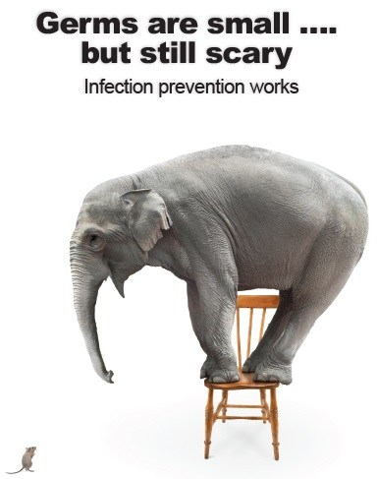
YOU CAN CAUSE OR PREVENT INFECTION TRANSMISSION

Slide 3

Risks in Health Care
Poor environmental cleanliness
Increased infection transmission - direct and indirect contact
Incorrect level and methods of cleaning/disinfection to the risk of contamination

Slide 4
Environmental Cleaning
Cleaning frequently touched surfaces
Minimal touch : Ceilings, walls, blinds
Frequently touched includes: Doorknobs, tabletops, call bells , light switches, railings lift buttons
Routine and frequency of cleaning general surfaces/fittings
Cleaning when visibly dirty
Spill cleaning
Specialty cleaning

Slide 5

Cleaning Methods
Cleaning methods, thoroughness and frequency of cleaning is determined by risk assessment and need
Cleaning strategies and schedules
Most organisms don’t survive long on clean surfaces when exposed to light and air

Slide 6
Product Choice
Surface and fixture properties– i.e. porous, plastic, metal, wood
Purpose of the product – remove or kill germ (detergent, hospital grade disinfectant)
Manufacturers instructions
Ease of use and application, available resourcing and trained staff
Efficiency against particular organisms and contact time to kill

Slide 7
Documentation Requirements
Minimum cleaning frequency, schedules and directives
Staffing – full time, part time, relief, management/supervisor
Equipment and product use (gloves , chux, microfiber, mops, neutral cleaner, disinfectant)
Management oversite and control at service level
Job/Task education/training for generalized and special cleaning

Slide 8
Cleaning Equipment
Cleaning equipment must be:
  In supply
  Maintained
  Clean and laundered
  Cleaned and dry after use
  Reusable items laundered

Slide 9
Cleaning Outlined
The mechanical action of cleaning using neutral detergent to remove dirt or matter
Physical cleaning is the most important step in cleaning.
Sole reliance of disinfection without cleaning is not recommended as it can be deactivated by organic matter

Slide 10
Disinfecting Outlined
Disinfectant is the chemical used to kill germs
Considerations:
  Contact time on surface to kill germs
  Correct concentration
  Applied to clean and dry surfaces only
  Effectiveness against differing germ (virus, fungi, bacteria)
Hard surface disinfectants include: hospital, household and commercial grade disinfectants

Slide 11
Infectious Cleaning and Disinfecting
Infectious or high-risk processes require both clean and disinfection process
Either:
  Two step clean = physical clean with neutral detergent followed by hospital grade disinfectant
  Two in one = Combine product of neutral and disinfectant to clean

Slide 12
Disinfection Safety
Subject to requirements under the TGA Order 104 of Therapeutic Goods act 1989
TGA referred to as ‘Other Therapeutic Goods’ (OTGs)
Refer to the product data safety sheet for WH&S information
New technologies:
Sodium hypochlorite
Ultra-violet light
Hydrogen peroxide vapour
Electrolyzed water

Slide 13
Shared Equipment
Equipment that comes into contact with intact skin and unlikely to introduce infection
But, can act as a means to transfer infectious agents (e.g. handles on equipment, chemical bottles, mop poles, dustpan and broom, commodes)
Shared equipment is to be cleaned between every use
Disinfectants must be compatible with equipment surface material to avoid damage
Cleaning supplies (wipes) to be available at the point of care and equipment storage
If infectious -use disposable products (thermometers, BP cuffs) or single client use

Slide 14
Spills and Kits
Spill kits should be readily available in a lidded bucket:
Scooper/scraper
Single use gloves
Apron
Surgical mask
Eye protection
Absorbent agent
Clinical waste bag
Neutral detergent
All items disposed post spill it use to prevent contamination
3 levels of spill cleaning:
Spot clean spill
Small spill <10cm
Large spill >10cm

Slide 15
Management of Spills
Strategies for spill decontamination differ based on the setting and the volume
Prompt matter removal followed by cleaning and disinfection
Health Care Workers (HCW) attend to spills in the first instance, cleaners follow with disinfectant clean

Slide 16

Governed By
National Cleaning Guidelines
State Cleaning Guidelines
Work Safety Australia
Australian Infection Prevention and Control Guidelines
Australian Commission on Safety and Quality
Aged Care Standards – Standard 5

Slide 17

Cleaning Standards Checks
Systems to ensure cleaning standards are met
  Check lists
  Colour coding to reduce infection transmission
  Cleaning manuals
  Model cleaning contracts
  Infection Control Guidelines
  Monitoring strategies
Some States and Territories have cleaning standards applied– irrespective of contractors or in-house

Slide 18
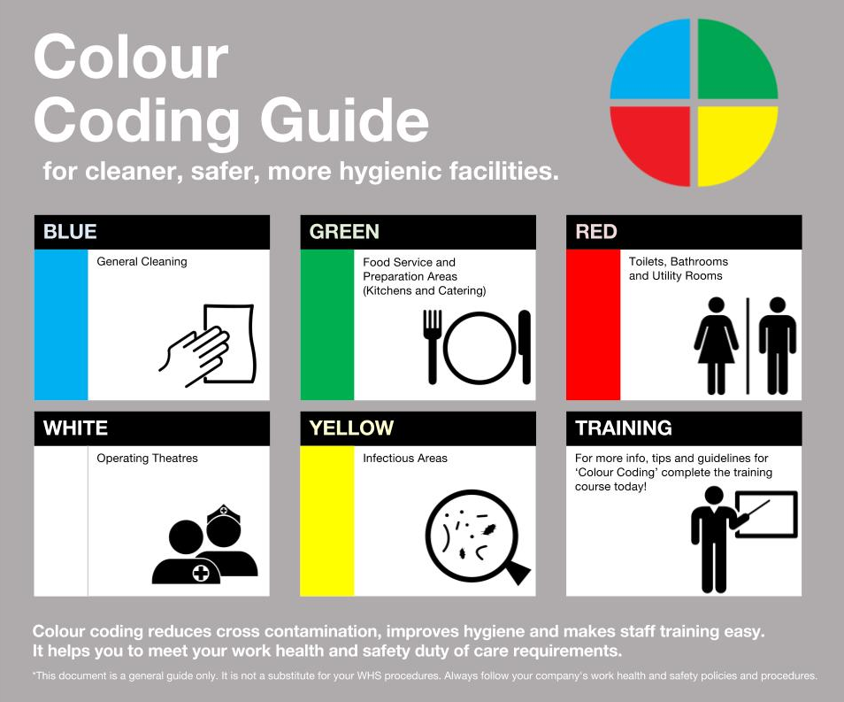

Slide 19
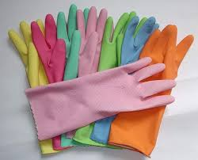
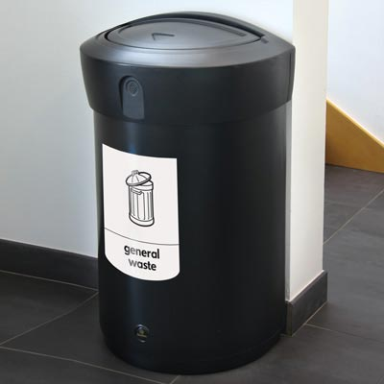
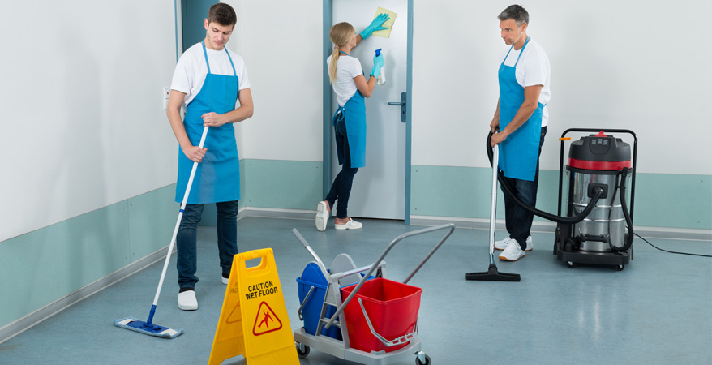
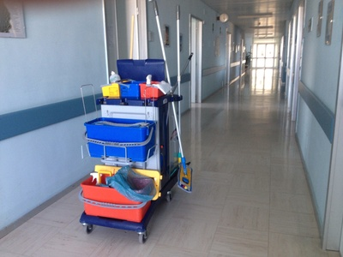
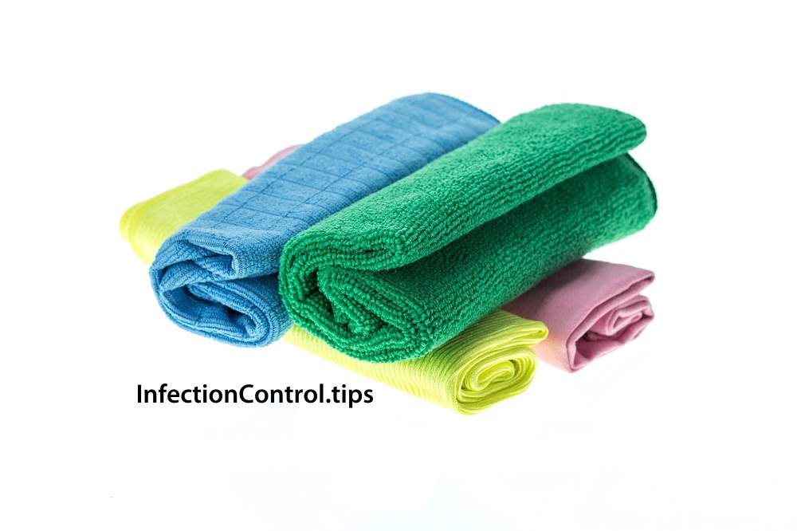


Slide 20
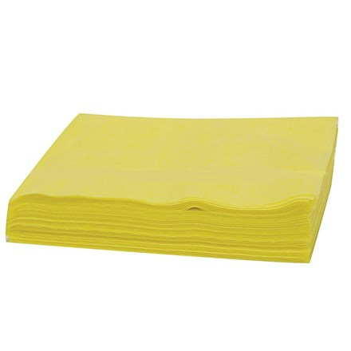
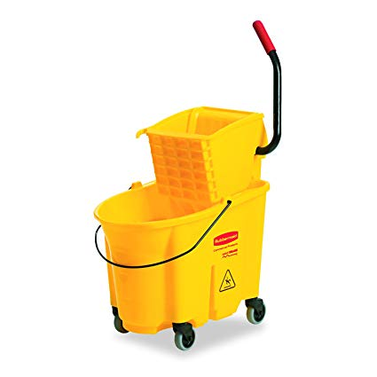
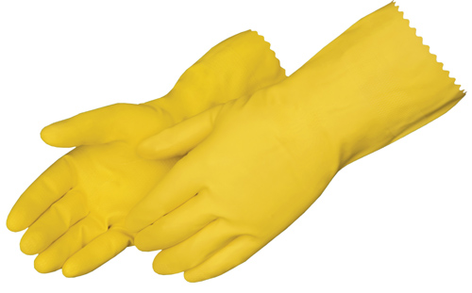
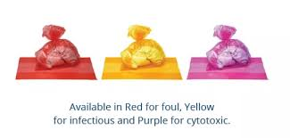
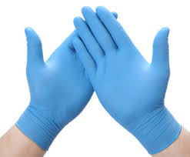

Slide 21
Cleaning Auditing
Auditing attended through differing methods:
  Process testing
  Outcome testing
Audits of environmental cleanliness can facilitate education programs and motivate staff to strive for improvements

Slide 22
YOUR PROTECTION

Slide 23
Cleaning Protective Measures
There is great difference in protective measures for:
General cleaning
Infectious cleaning
Cytotoxic contaminated item cleaning
The correct precautions must be utilised to ensure risk reduction and safety

Slide 24

No matter what- perform Hand Hygiene
Perform hand hygiene:
  On arrival
  Removal of gloves/PPE
  When hands visibly soiled
  Before entering
  On leaving
  When ever else required

Slide 25
Standard Precautions and PPE
Required when attending all NON-infectious areas
Cleaning should be attended using colour coded equipment.
PPE:
  Disposable Heavy-duty Gloves for chemical cleaning
  Disposable Apron
All used PPE must be placed in general waste bag in general waste bin

Slide 26
Transmission Precautions and PPE
Required when attending all infectious areas
Cleaning attended using yellow equipment
PPE:
  Disposable Heavy-duty gloves
  Disposable long sleeve waterproof gown
  Eye wear (splash risk)
  Surgical mask (splash risk)
All used PPE must be disposed in a clinical waste bag and clinical waste bin

Slide 27
Thank You
Carrie spinks
Infection Control Consultant
It is acknowledged that the construction and production of the video was attended at RSL LifeCare Ltd.

