Slide 1
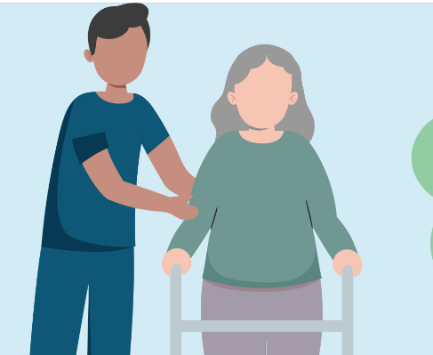
Caring for people with Blood Borne Viruses in the aged care setting
December 2024

Slide 2
ACIPC acknowledges Aboriginal and Torres Strait Island people as the traditional owners of country throughout Australia and ngā iwi Māori as the people of the land of Aotearoa and respects their continuing connection to culture, land, waterways, community, and family.

Slide 3
Blood Borne Viruses (BBV)

Slide 4
Overview
Introducing HIV, hepatitis B and hepatitis C
How many people are living with a Blood Borne Virus (BBV)?
How are BBVs spread?
What happens when someone has a BBV?
What is the treatment?
Ageing and BBVs
How do we prevent BBV transmission?
Universal application of standard precautions

Slide 5
Human Immunodeficiency Virus (HIV) fast facts
HIV is a virus that is spread through contact with blood and body fluids
Fluids must come into contact with mucous membranes or broken skin
Most common transmission routes:
Sexual
Parenteral (sharing injecting equipment, unsafe tattooing)
Vertical (mother to child)
Risk of contracting HIV after an occupational needle stick injury is 0.3%

Slide 6
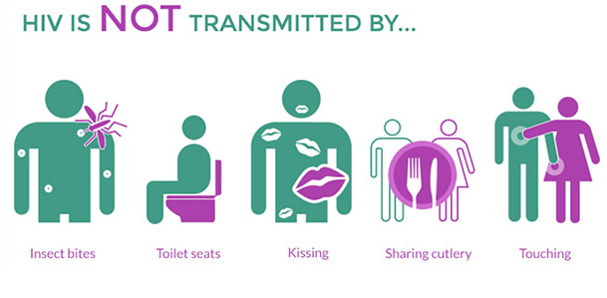
HIV fast facts

Slide 7
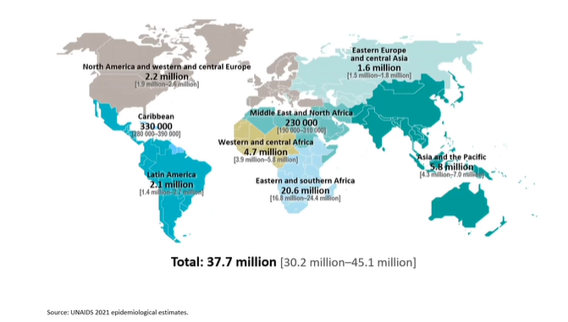
How many people have HIV?
In 2023, ~ 39.9 million people were living with HIV
1.3 million people were newly infected with HIV in 2023
630,000 people died from an AIDS-related illness

Slide 8
How many people have HIV in Australia?
~30,010 people are living with HIV in Australia at the end of 2023
92% have been diagnosed
97% were receiving antiretroviral therapy (ART)
Of all people living with HIV in Australia, an estimated 87% had a suppressed viral load.
Undetectable = Untransmissible

Slide 9
What happens when someone has HIV?
HIV can be treated (not cured) which reduces the morbidity (illness) and mortality (death)
If untreated, HIV can cause immunodeficiency and a range of opportunistic illnesses and cancers, known as Acquired Immunodeficiency Syndrome (AIDS)

Slide 10
Ageing with HIV
People with HIV now have a near normal life expectancy
A person living with HIV aged 20 years, who start Antiretroviral Therapy (ART) today has:
56.6 years (female) or 54.5 years (male) years left to live
By 2027, the greatest proportion of people with HIV will be aged 55 to 59 years
The success of ART means people are now ageing with HIV
HIV can promote and accelerate age-related conditions even when the ART is supressing HIV
Age related services may not be suited to the needs of people with HIV
Trickey A et al. The Lancet HIV 2023

Slide 11
Ageing with HIV
People living with HIV are at increased risk of cardiovascular disease
Other priorities for people with HIV as they age include:
Osteoporosis
Mental health
Menopause
The National Association of People with HIV Australia (NAPWHA) have made a submission to the Department of Health and Aged Care for people living with HIV to have access to Government funded Aged Care Services from the age of 50 years – results pending (Dec 2024)
Trickey A et al. The Lancet HIV 2023

Slide 12
Introducing the liver
Hepatitis is a general term that means inflammation of the liver
Caused by viruses, infection chemicals, alcohol, drug use or other factors
Hepatitis A, B, C, D and E are viruses that affect the liver
Different transmission and treatment
Hepatitis A and B are vaccine preventable

Slide 13
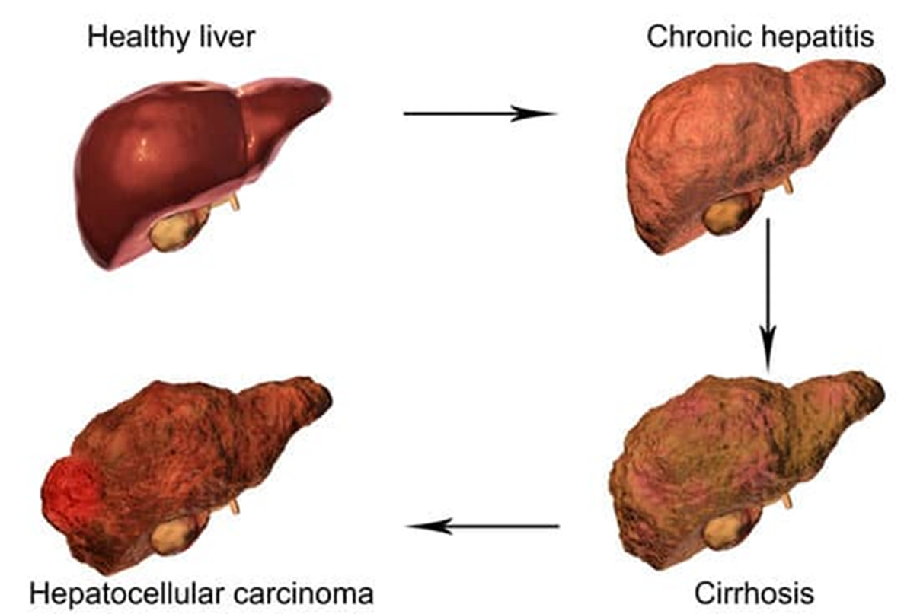
Impact of hepatitis on the liver

Slide 14
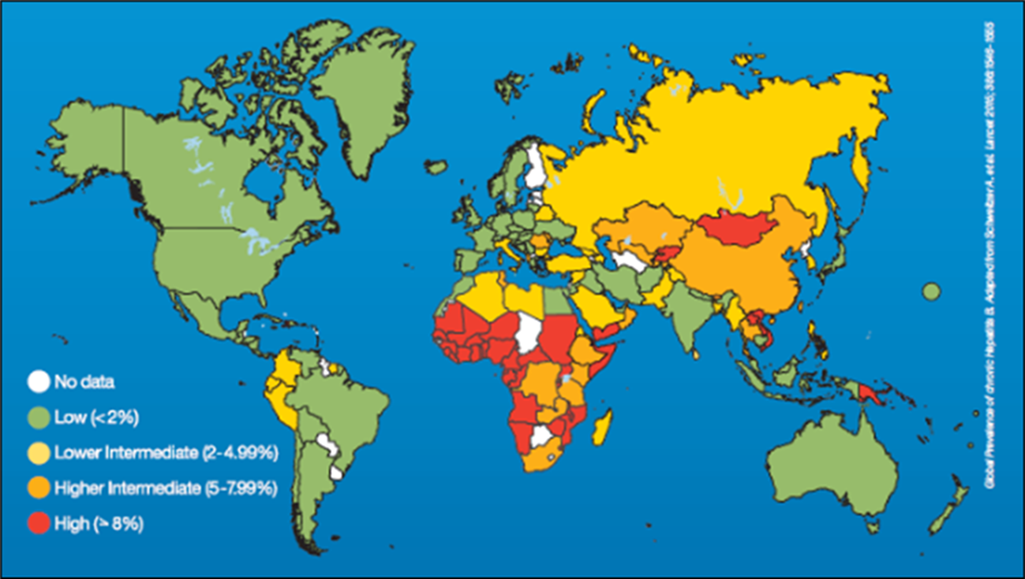
Hepatitis B fast facts

Slide 15
Chronic Hepatitis B (CHB) fast facts
250 million people live with CHB globally
205,549 people were living with CHB in 2022
~26% of people living with CHB are undiagnosed
Hepatitis B is the most common blood borne virus in Australia
Spread through contact with blood and body fluids
30% chance of transmission after an occupational needlestick injury if the source is unvaccinated
Estimated to be the 10th leading cause of death globally
2nd most important cancer-causing agent, after tobacco
Trickey A et al. The Lancet HIV 2023

Slide 16
Hepatitis B and Hepatocellular Carcinoma (HCC)

Slide 17
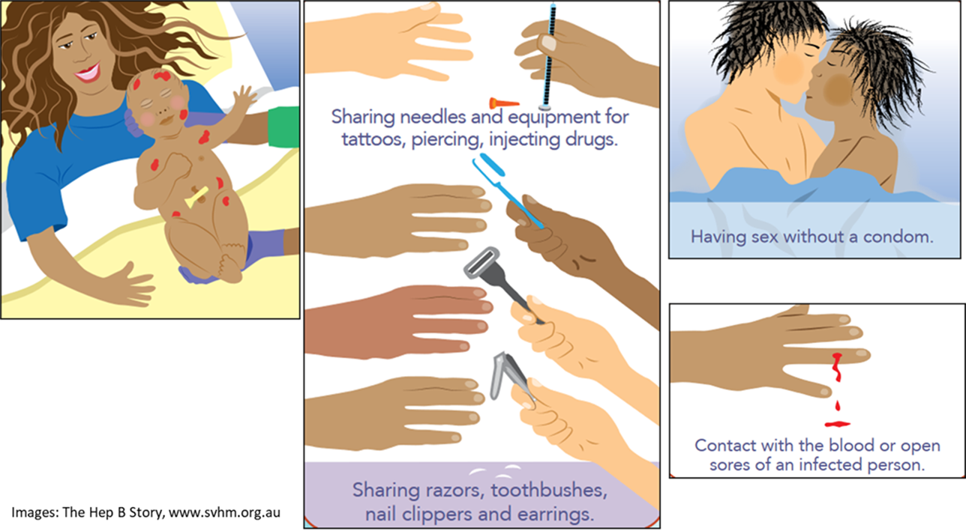
How is hepatitis B spread?

Slide 18
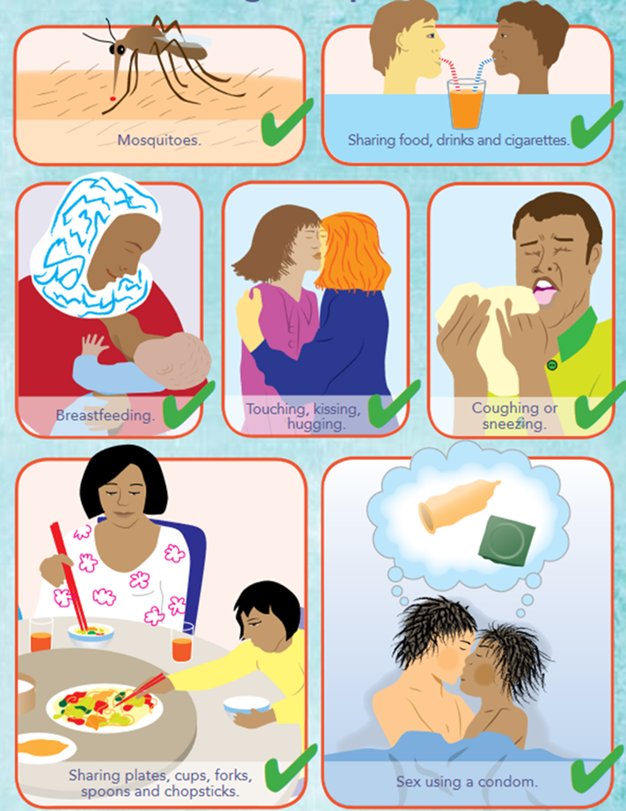
How is hepatitis B NOT spread?

Slide 19
Prevention of hepatitis B
Hepatitis B vaccine is the first anti-cancer vaccine
All babies born in Australia are offered hepatitis B vaccine at birth (0, 2, 4 and 6 months)
Adult course: 3 doses (0, 1 and 6 months)

Slide 20
Hepatitis B management
Monitoring recommended 6-12 monthly including liver function test, hepatitis B serology and viral load
Antiviral treatment (oral tablets, indefinite duration) is available dependent on viral load and disease activity - Tenofovir and Entecavir
The goals of treatment are:
To stop the virus from reproducing
Limit inflammation and fibrosis (developing scare tissue)
Prevent cirrhosis, liver failure and cancer
Reduce risk of mother-child transmission

Slide 21
Ageing with CHB
Globally, older adults carry the greatest burden of CHB as they were born before childhood vaccination programs were introduced
The longer an individual lives with CHB, the greater their risk of developing liver damage, cirrhosis, and cancer
This emphasises the importance of maintaining active surveillance and monitoring of liver disease
Physiological changes and the increasing prevalence of co-morbidities associated with ageing, may worsen outcomes in older people with CHB

Slide 22
Global elimination of hepatitis C
Australia has adopted the global hepatitis C elimination goal by 2030:
Reduce new infections, mortality and stigma
Increase diagnosis, treatment and cure rates

Slide 23
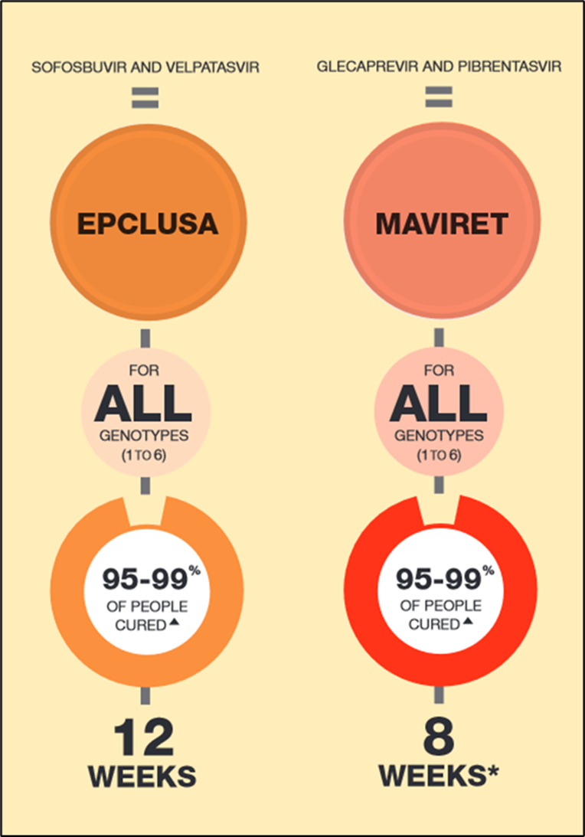
Hepatitis C is curable!

Slide 24
Hepatitis C fast facts
~68,900 people living with hepatitis C at the end of 2023
New infections have declined
105,940 people have been treated for hepatitis C between 2016 and the end of 2023
Fewer people need liver transplant for hepatitis C-related cirrhosis
Hepatitis C is spread through blood-to-blood contact
~3% risk of transmission after an occupational needle stick injury
Over 70% of people who use drugs surveyed experienced stigma and discrimination

Slide 25
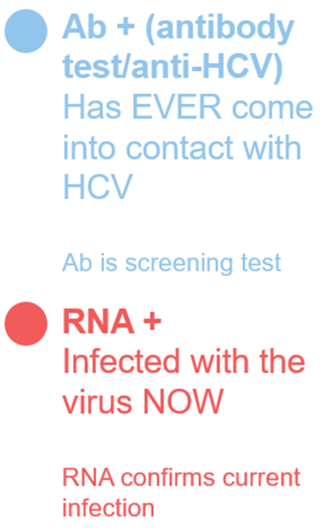
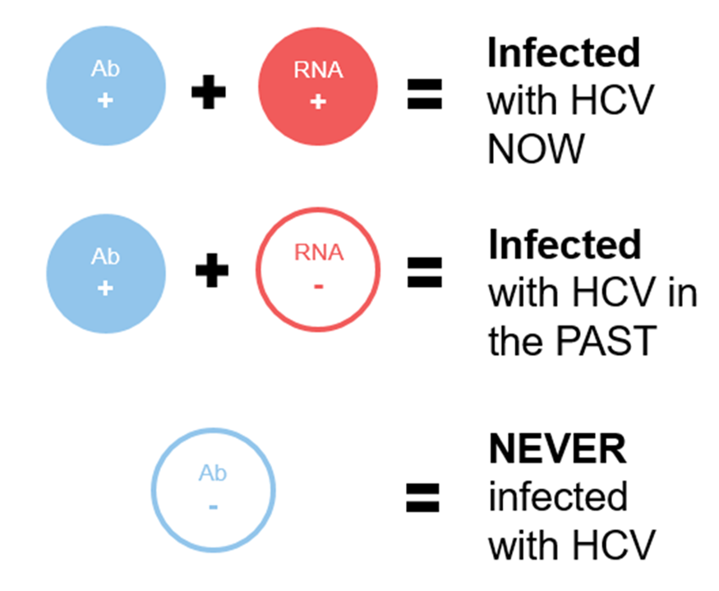
Hepatitis C fast facts

Slide 26
Hepatitis C and ageing
No one should age with hepatitis C!
Hepatitis C can be CURED!
Remember hepatitis C antibodies will stay in the blood forever, even when the person is cured (and no longer has hepatitis C infection)

Slide 27
Caring for people with a BBV
Delivering culturally appropriate care is an important consideration for people with HIV, hepatitis B and hepatitis C
Stigma sensitive care is critical
Language matters – avoid stigmatising language and terms

Slide 28
Stigma stops people with BBV accessing health care
Stigma and discrimination related to BBV status can prevent access to healthcare.
HIV, hepatitis B and hepatitis C-related stigma and discrimination is strongly associated with the risk behaviours of infection.
People being tested for BBVs often experience marginalisation and they may face additional barriers to accessing/navigating health services.

Slide 29
Stigma stops people with BBV accessing health care
Most commonly report context for hepatitis C–related discrimination is health care settings
Infection Prevention and Control leads have an important role in identifying and challenging discriminatory behaviour
We must model:
Respect
Empathy
Tolerance

Slide 30
Prevention of BBV transmission in aged care
According to the Australian Guidelines for the Prevention and Control of Infection in Healthcare (National Health and Medical Research Council (NHMRC), 2019):
Standard precautions should be used in the handling of all:
blood (including dried blood)
all other body substances, secretions and excretions (excluding sweat), regardless of whether they contain visible blood
non-intact skin; and mucous membranes.
www.nhmrc.gov.au/about-us/publications/australian-guidelines-prevention-and-control-infection-healthcare-2019

Slide 31
Prevention of BBV transmission in aged care
Standard precautions consist of:
Hand hygiene, as consistent with the 5 moments for hand hygiene
Use of appropriate personal protective equipment
Safe use and disposal of sharps
Routine environmental cleaning
Reprocessing of reusable medical equipment and instruments
Respiratory hygiene and cough etiquette
Aseptic technique
Waste management
Appropriate handling of linen (NHMRC, 2019).

Slide 32
Prevention of BBV transmission in aged care
Bouchaucha and Moore (2018) interviewed 29 nurses at a large metropolitan Australian hospital and found adherence to standard precautions was influenced by:
Organisational culture
Role modelling
Leadership
Presence of contextual cues
Judgement/risk assessment of the patient’s perceived health status
Bouchoucha SL, Moore KA. Infection prevention and control: Who is the judge, you or the guidelines? J Infect Prev. 2018 May;19(3):131-137

Slide 33
Prevention of BBV transmission in aged care
Sometimes, depending on the patient, if it is a normal patient I don’t wear gloves but if it is a patient that has very flaky skin, does not look very well kept and looked after then I would put gloves on to protect myself. You kind of eyeball the patient (Participant 15)
I can give examples of nurses getting needle stick injuries with a patient and not reporting it saying that she [the patient] doesn’t look like she has HIV or anything… so I guess as well as risk assessment some of it you could classify as prejudice assessment as well (Participant 24)
Bouchoucha SL, Moore KA. Infection prevention and control: Who is the judge, you or the guidelines? J Infect Prev. 2018 May;19(3):131-137

Slide 34
Prevention of BBV transmission in aged care
Another participant commented that:
[Standard Precautions] use should be universal and there is a need for a shift in mentality so that everyone [is viewed] as infectious. (Participant 12)
Bouchoucha SL, Moore KA. Infection prevention and control: Who is the judge, you or the guidelines? J Infect Prev. 2018 May;19(3):131-137

Slide 35
Summary
Everyone working in healthcare needs to understand BBV transmission and the importance of standard precautions as the primary prevention strategy
BBV-related stigma (real or fear of) prevents people from accessing health care and subsequently impacts healthcare outcomes
We all have a role to play in addressing BBV-related stigma by educating ourselves and treating everyone in the same way

Slide 36
ACIPC BBV testing course
www.acipc.org.au/education/blood-borne-virus-testing-course

Slide 37
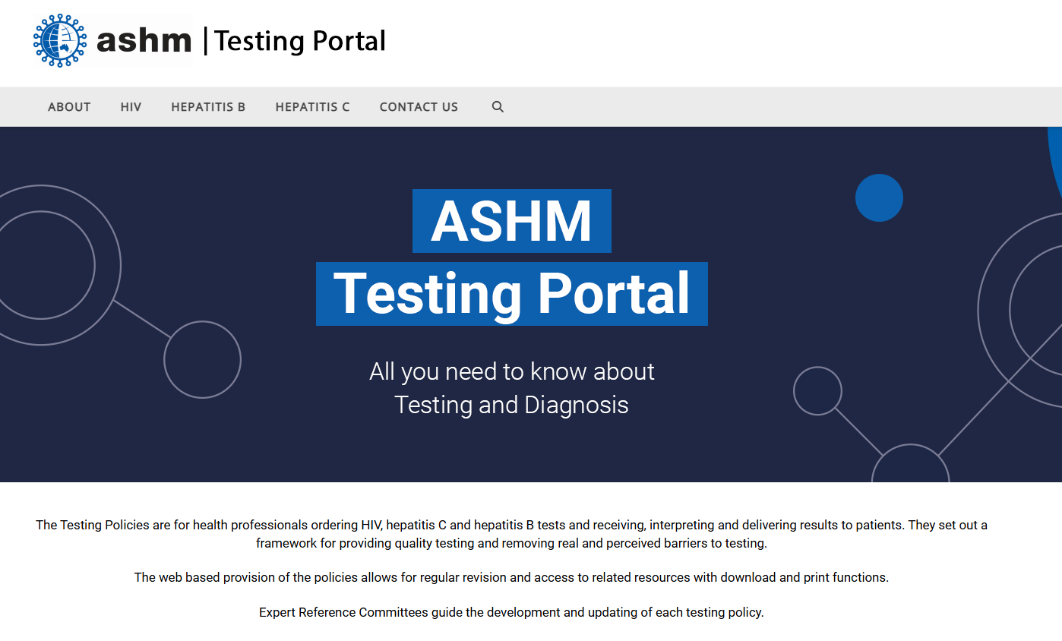
BBV testing policies
https://testingportal.ashm.org.au/

Slide 38
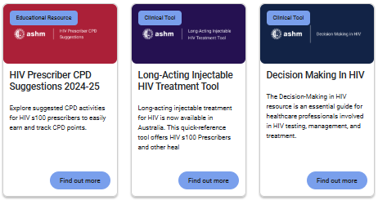
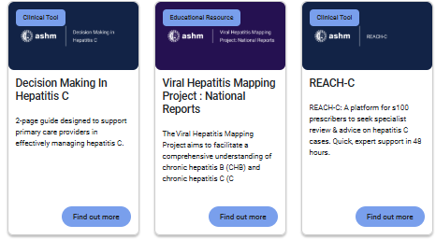
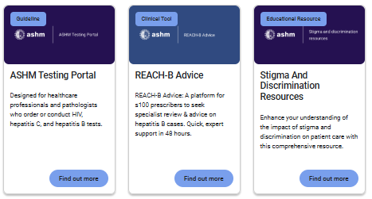
ASHM Health – BBV info for health professionals
www.ashm.org.au

Slide 39
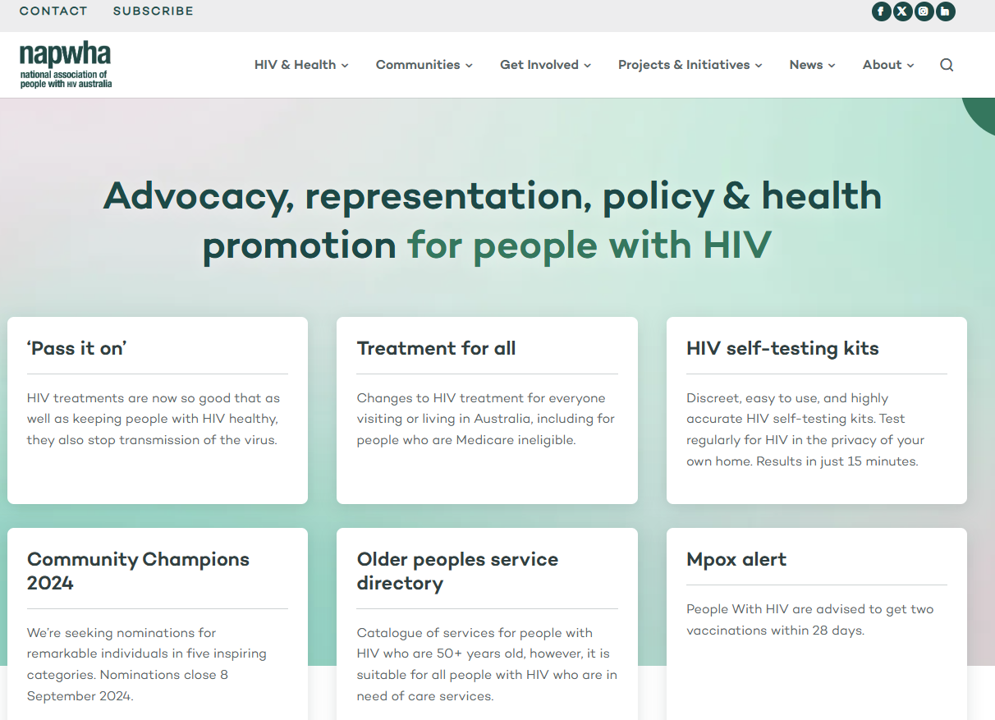
Consumer information on HIV - National Association of People with HIV Australia (NAPWHA)
https://napwha.org.au/

Slide 40
Hepatitis Australia
https://www.hepatitisaustralia.com/

Slide 41
Hepatitis B resources

Slide 42
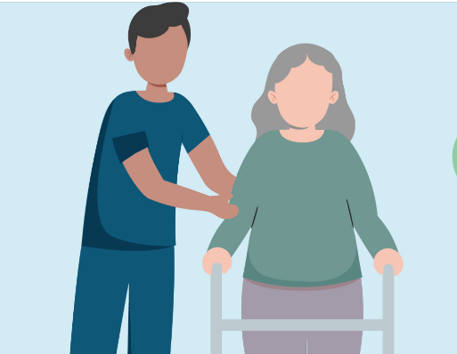
Jacqui Richmond PhD, MPH, RN Burnet Institute, Melbourne ACIPC Education Facilitator. Jacqui.Richmond@acipc.org.au Jacqui.Richmond@burnet.edu.au
Australasian College for Infection Prevention and Control
Level 6
152 Macquarie Steet
Hobart TAS 7000
03 6281 9239
office@acipc.org.au
www.acipc.org.au

