Slide 1
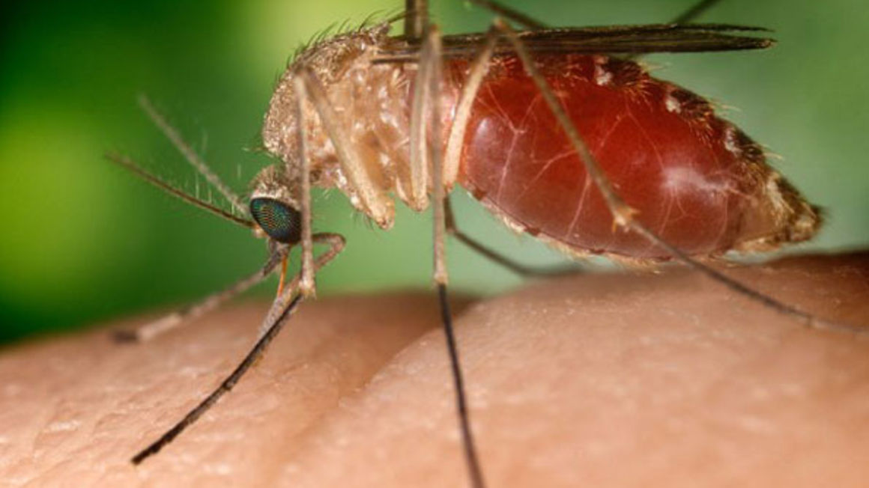
Malaria bites..
Peter Massey
CNC Public Health
Hunter New England Population Health, NSW

Slide 2
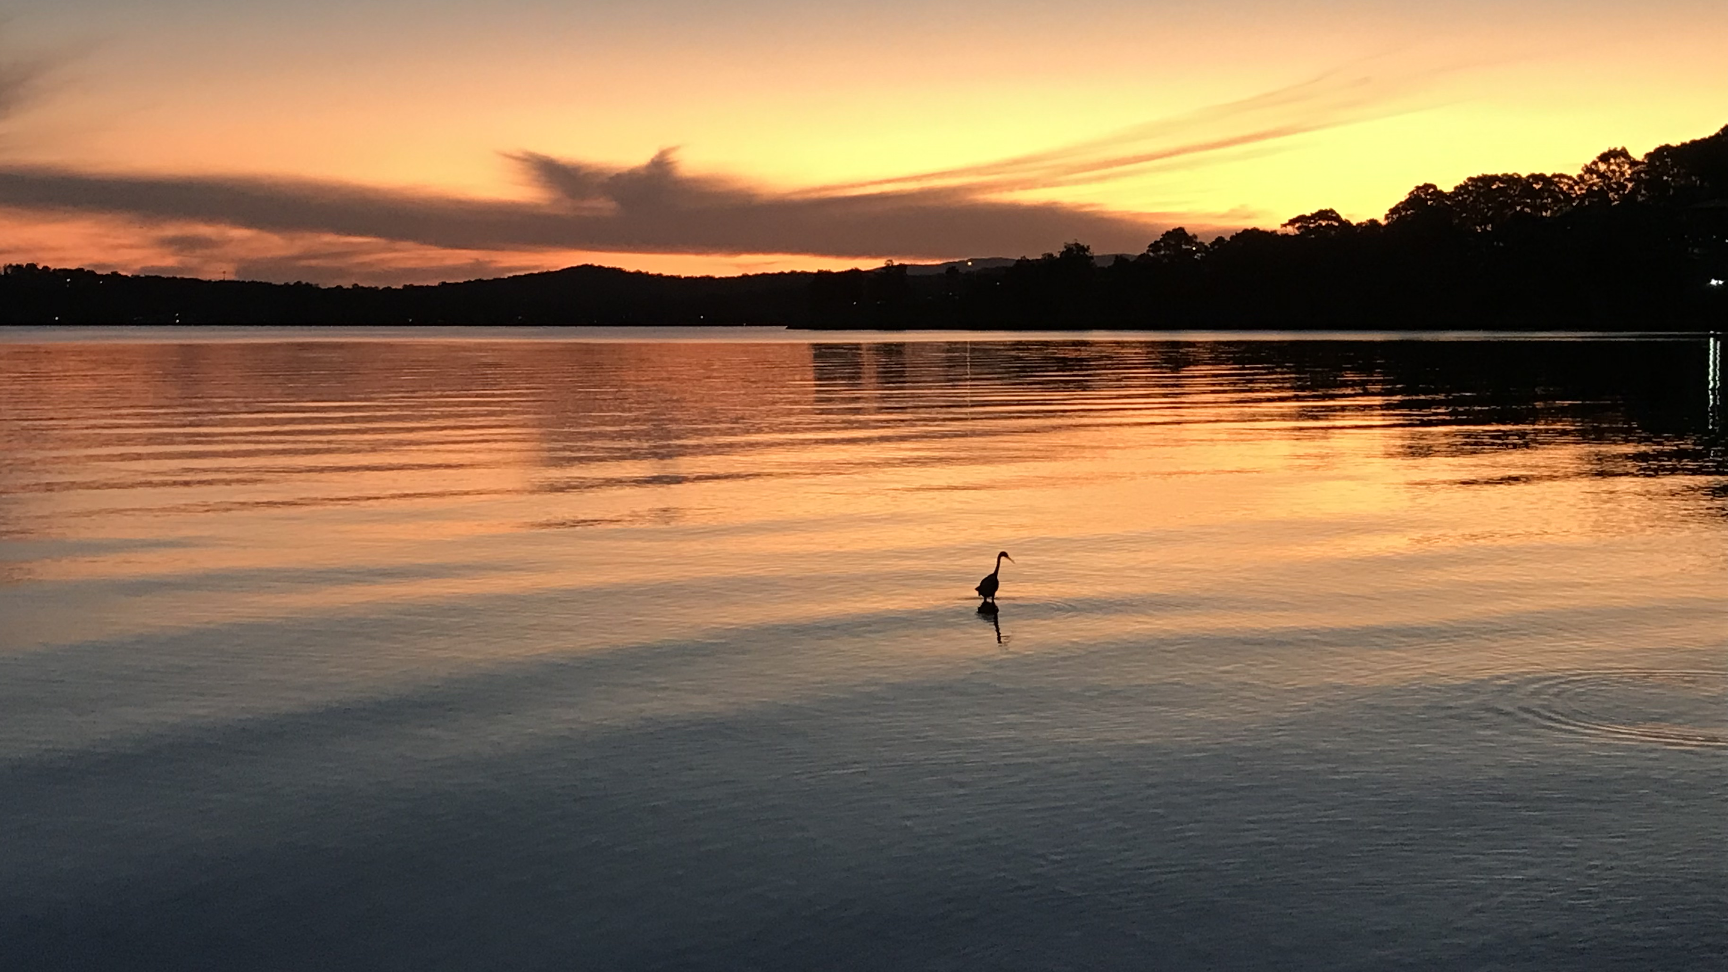
Always was always will be….

Slide 3
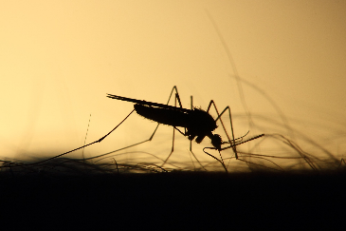
Some background
Malaria is an acute febrile illness that can be life-threatening
Malaria is caused by parasites (Plasmodium) that are transmitted to people through the bites of infected female Anopheles mosquitoes. It is preventable and curable.
There are 5 parasite species that cause malaria in humans, and 2 of these species – P. falciparum and P. vivax – pose the greatest threat. P. falciparum is the deadliest malaria parasite and the most prevalent on the African continent. P. vivax is the dominant malaria parasite in most countries outside of sub-Saharan Africa.
In 2021, there were an estimated 247 million cases of malaria worldwide.
The estimated number of malaria deaths stood at 619 000 in 2021.

Slide 4
Malaria signs, symptoms & impacts
The first symptoms – fever, headache and chills – usually appear 10–15 days after the infective mosquito bite and may be mild and difficult to recognize as malaria.
Fever; Chills; General feeling of discomfort; Headache; Nausea and vomiting; Diarrhoea; Abdominal pain; Muscle or joint pain; Fatigue; Rapid breathing; Rapid heart rate; Cough. Malaria “attack”
Left untreated, P. falciparum malaria can progress to severe illness and death within a period of 24 hours.
Malaria in returned travellers: CDC - Malaria - People With Malaria Speak
Inadequate chemoprophylaxis and the risk of malaria - PubMed (nih.gov)
Moms & Malaria: The Impact of Malaria on Families – United To Beat Malaria

Slide 5
Malaria in Malaita, Solomon Islands
Malaria is endemic in Solomon Islands and high rates are seen in Malaita.
In the 1960s, a malaria intervention called ‘indoor residual spraying’ – spraying the inside of homes with insecticide to kill mosquitoes – was popular in the Solomon Islands because mosquitoes typically entered homes late at night. But mosquitoes are a challenging foe, and it was soon realised the mosquitoes had adapted their behaviour to try to avoid the insecticide sprayed inside homes.
The Solomon Islands is the first country in which mosquito behavioural resistance was shown, where the mosquito changes its behaviour to avoid the insecticide - Professor Tom Burkot, a vector biologist at AITHM/JCU. The mosquitoes shifted their feeding behaviour from feeding indoors late at night to feeding outdoors early in the evening.
a more effective intervention was introduced in the mid-1990s that replaced indoor residual spraying in many homes in the Solomon Islands with insecticide treated bed nets.
But…..

Slide 6
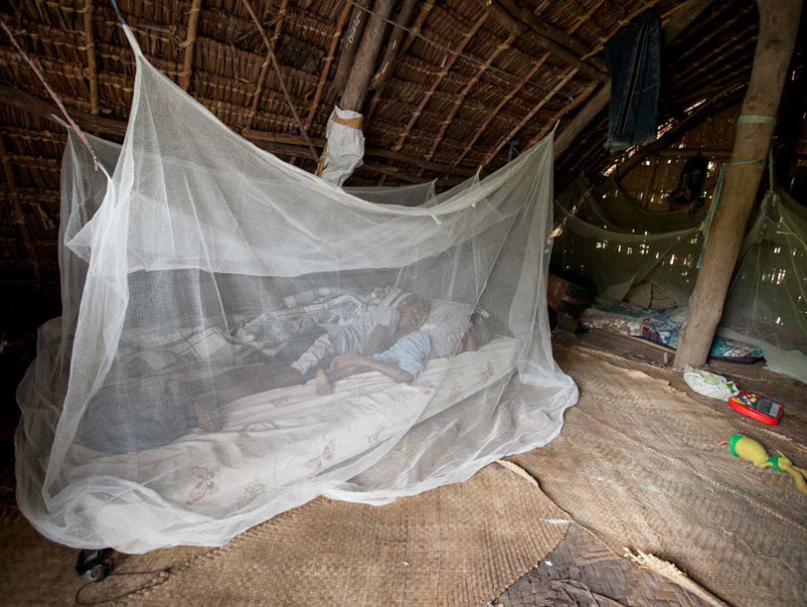
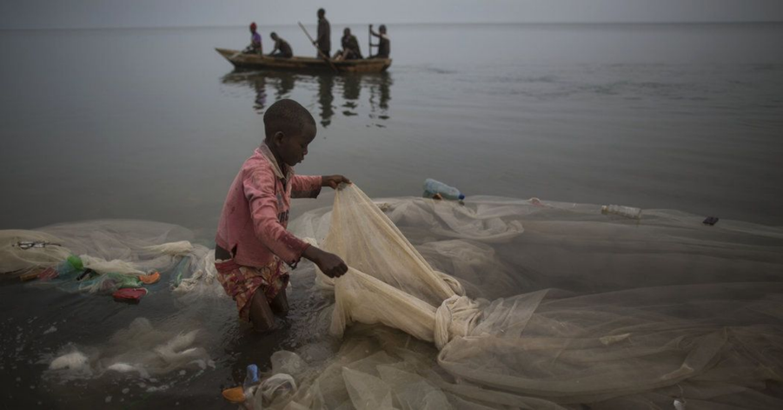
Malaria in Malaita

Slide 7
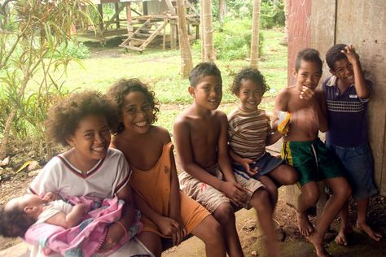
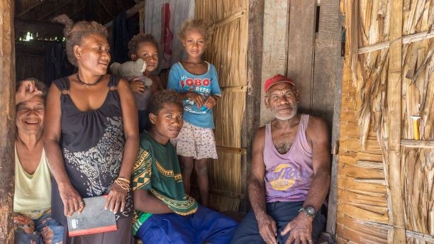

Slide 8
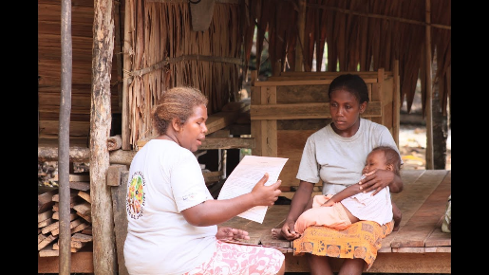
Rapid detection and treatment are key, along with vector control
In an ideal world rapid detection tests and village level treatment options would be available across areas that have malaria…..
The reality is that people need to walk, be carried, or paddle to a small number of hospitals and clinics
Atoifi Adventist Hospital, a remote hospital we have been supporting with public health research capacity building, a laboratory scientist noted a decline in the number of malaria cases and the proportion of cases due to Plasmoduim falciparum (Pf) between 2008 and 2013. However, the laboratory data had not been analysed.

Slide 9
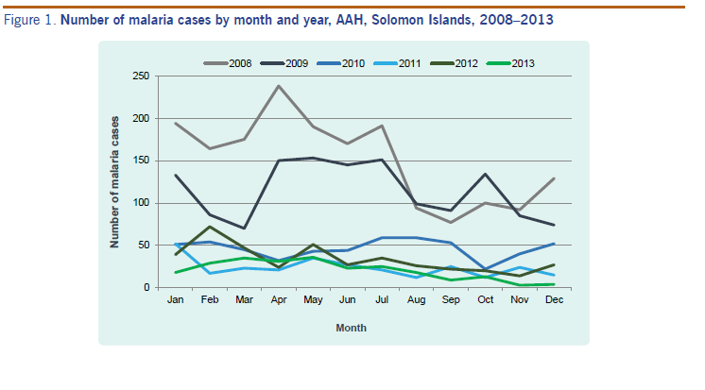
What was found….
About 10,000 people living in ~150 villages in the area the hospital is located
The hospital lab examined 35,608 blood films during 2008-2013
Cases of malaria decreased over time (now increasing again)

Slide 10
Some of the findings about malaria:

Slide 11
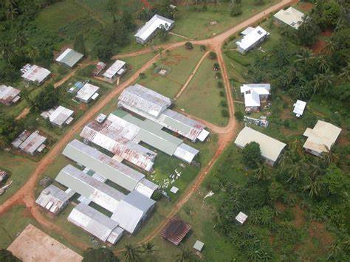
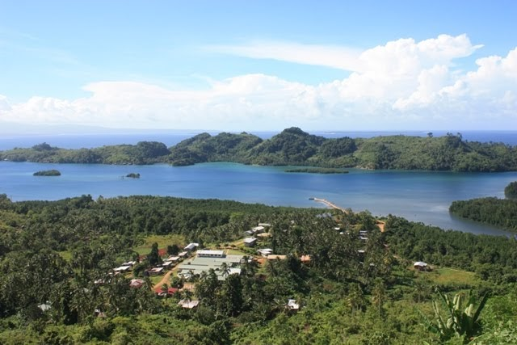
What areas were most at risk from malaria?
Villages next to marshes and swampy areas and near the hospital…..
And the hospital campus !!
Staff, family, visitors and patients were being infected with malaria at the hospital.

Slide 12
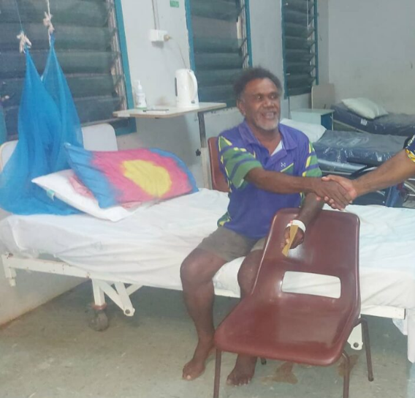
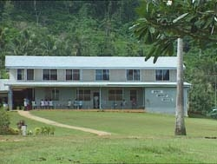
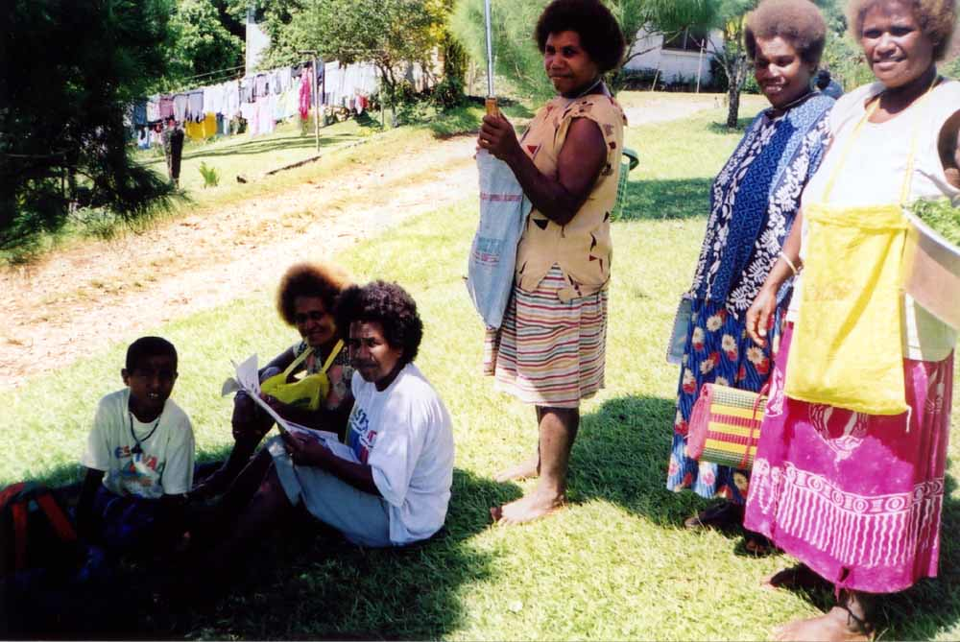
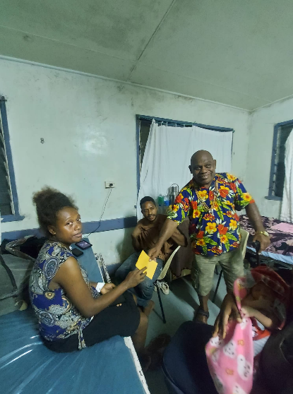
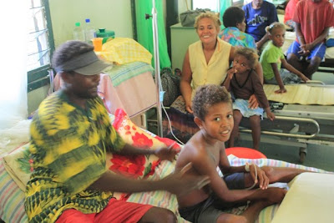

Slide 13
How to prevent malaria infection in the hospital and the campus?
Bed nets for patients…..
Insect screen on windows….
Rapid diagnosis and treatment….
Insecticides……
Avoiding mosquito bites when outside, eg when cooking or seeing family…
All come with challenges
Ambulances at Atoifi
Multi purposes for nets
Staffing for malaria tests
Real life on the ground and in the wards.

Slide 14
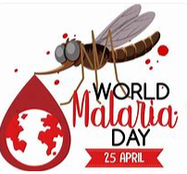
Some wisdom gained:
Listen to concerns from locals, listen carefully and explore further
Boxes of completed forms under desks can be a treasure trove of new understanding
Infection prevention is complicated
Resources, or lack of resources
Human behaviour
Systems that put people (staff, patients, visitors) at risk
Share stories as we all can learn

